Slide 1
Rio Road Sewer Spill
August 31, 2026
Location: Rio Road / Calle Hermosa – Sunnyslope flood-control channel crossing
Approximately 25 gallons of wastewater discharged
10-inch steel pipe was confirmed to be an active sewer main
Flow entered the flood-control channel and traveled downstream toward the Santa Ana River Basin
Temporary repair completed August 31; permanent lining repair completed September 1
1

Slide 2
Incident Summary & Timeline
1:00 p.m. – Service Crew began investigating two exposed pipelines believed to be abandoned water mains.
2:30 p.m. – Crew drilled into both pipes to verify they were not pressurized.
3:25 p.m. – 10-inch steel pipe identified as an active sewer main; wastewater observed leaking from an existing repair band.
3:30 p.m. – Collections Crew notified and dispatched.
4:00 p.m. – Sewer bypass established to reduce flow through the damaged section.
8:00 p.m. – Temporary repair completed; no additional leakage observed.
2

Slide 3
Cause, Response & Repairs
Cause:
Bottom of the 10-inch steel pipe was deteriorated and structurally compromised.
Previous repair band had failed/deteriorated.
Contributing Factor:
RCSD Atlas Map identifies the sewer line material as vitrified clay pipe (VCP).
The sewer crossing over the Sunnyslope flood-control channel is actually steel pipe.
Response:
Approximately 25 gallons discharged into the channel.
No visible solids, standing wastewater, or observed impacts to aquatic life.
Pipe Tech completed permanent lining repair on September 1, 2026.
3

Slide 4
Corrective Actions
Update RCSD Atlas Map/GIS information to correctly identify the pipeline material and active sewer status.
Document the repaired crossing and permanent lining repair.
Include the location in the District's routine inspection and preventive-maintenance program.
Maintain photographs, incident documentation, and repair records for the CIWQS report and future reference.
Conclusion: The discharge was stopped through immediate bypass and repair actions, followed by a permanent structural lining repair.
4

Slide 5
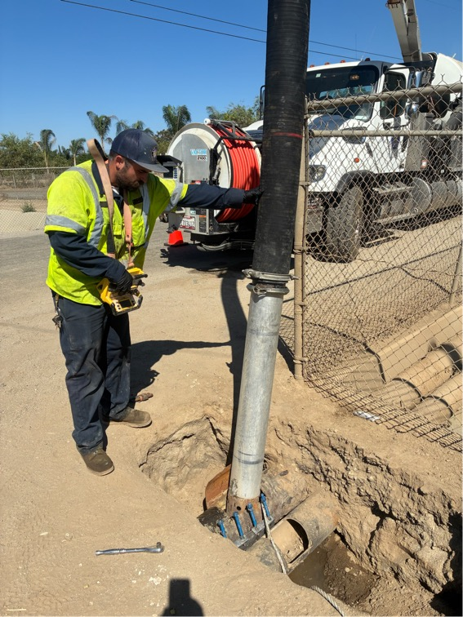
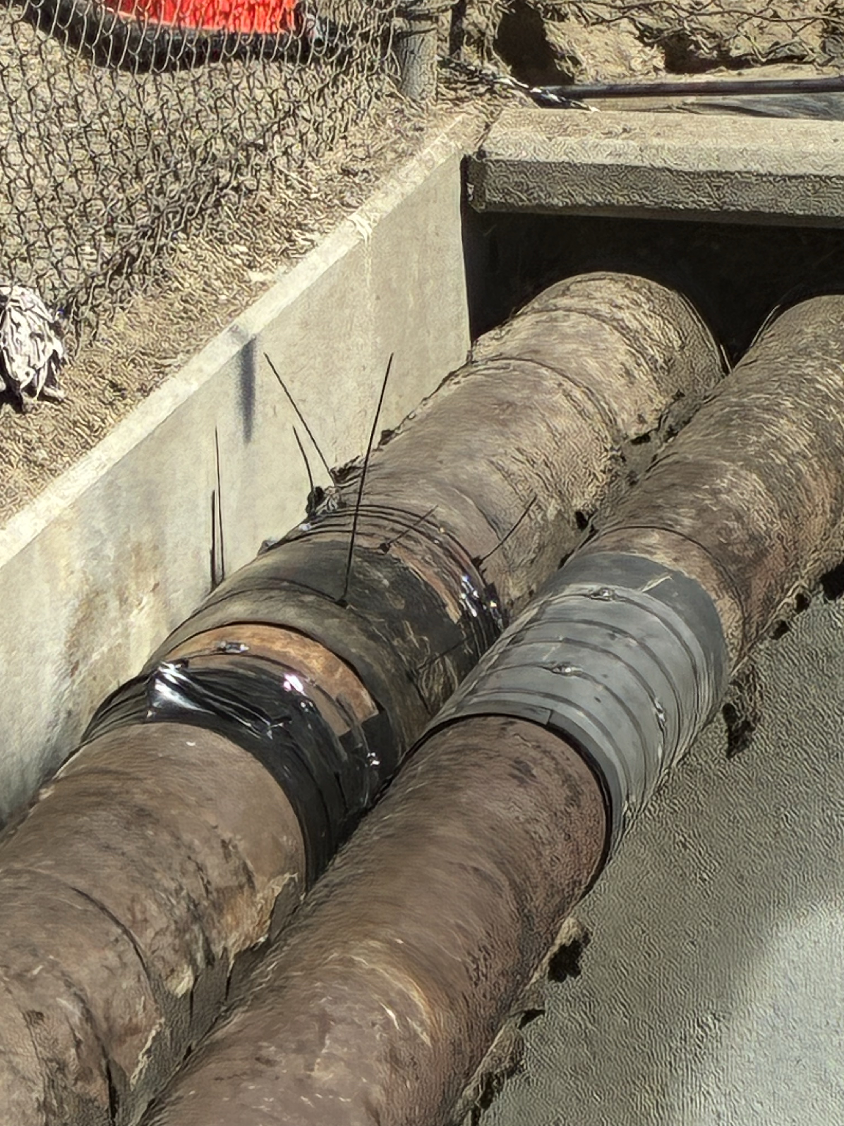
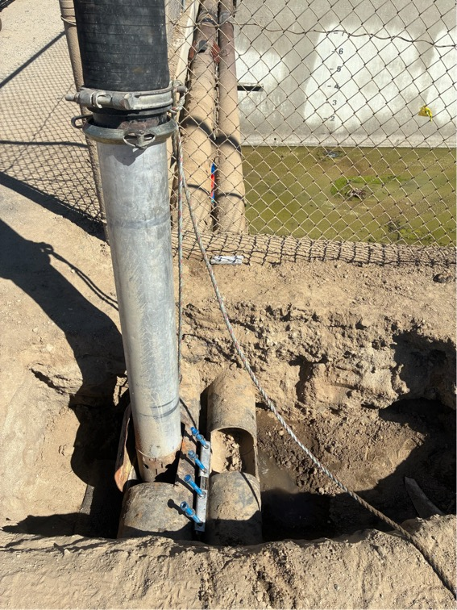
Pictures
5

Slide 6
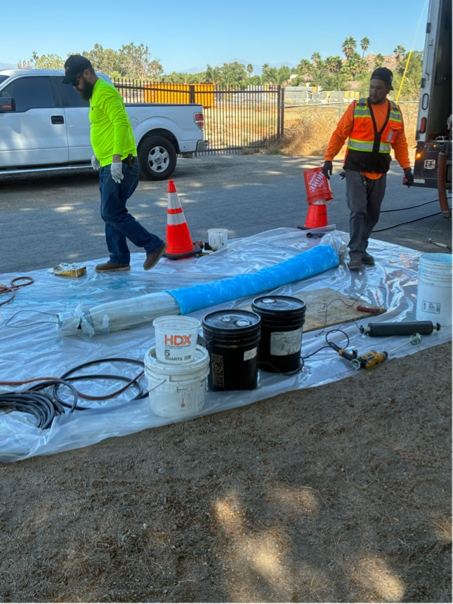
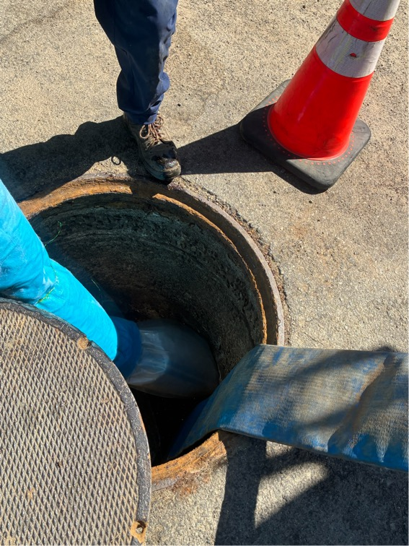
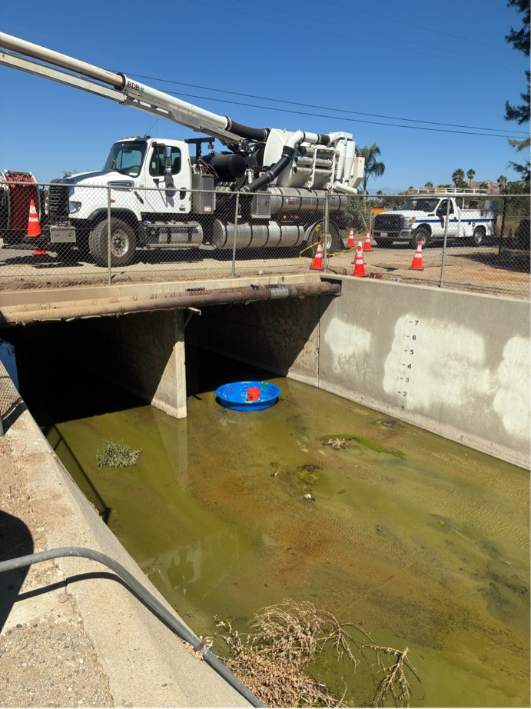
Pictures
6

Slide 7
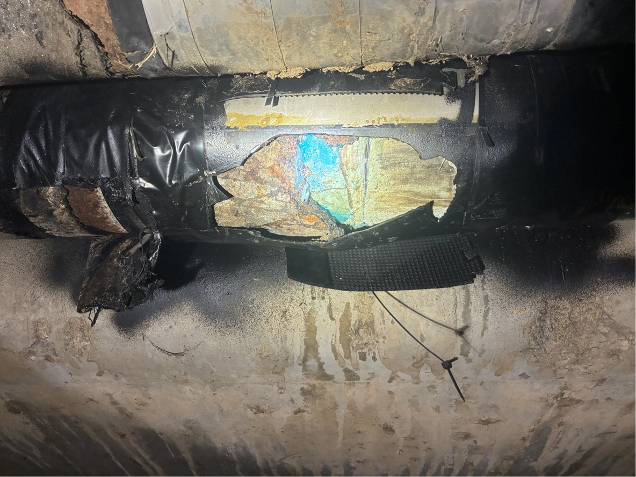
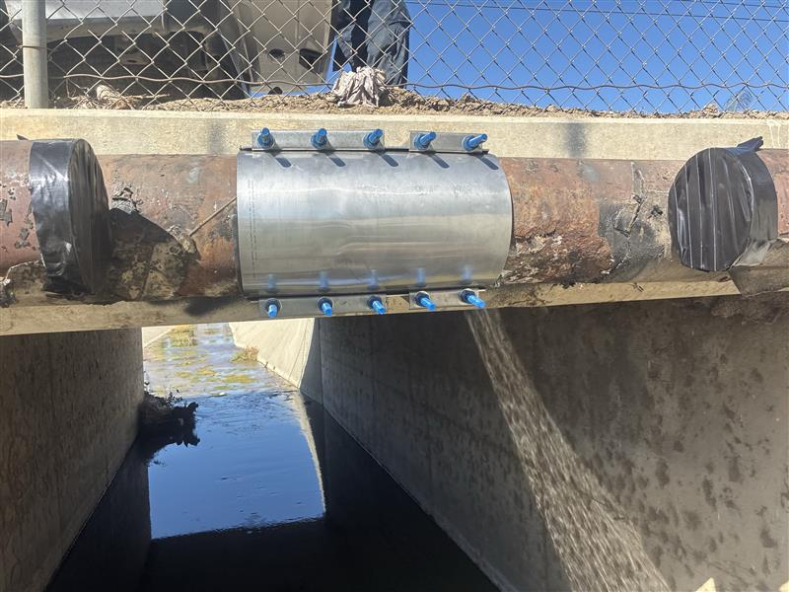
Pictures
7

