Slide 1
Director Memorandum 2025-74 Consideration to Award Professional Services Contract and Approve Master Consulting Agreement for Architectural and Engineering Services – Bldg. Project
August 7, 2025

Slide 2
Background
Past efforts:
Construction of a new two-story glass “wavy” building on the vacant lot diagonally across from the current Administration Building at 3590 Rubidoux Blvd. (2008-2017)
Acquisition of the County Fleet Services Building at 5293 Mission Blvd., either independently or in partnership with the City of Jurupa Valley (2018-2021)
Utilization of the Rubidoux Family Resource Center (5473 Mission Blvd.) for administrative functions, with a remodel of the existing facility at 3590 Rubidoux Blvd. for field operations (2021-2024)

Slide 3
Background
Current effort:
Remodel of existing Administrative Building and construction of a new Operations Building on the District-owned 2.3-acre parcel diagonally across the street
Single campus
Consolidate field and administrative functions
More collaborative and efficient work environment

Slide 4
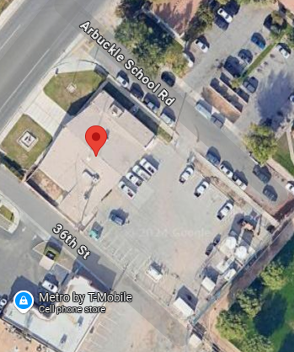
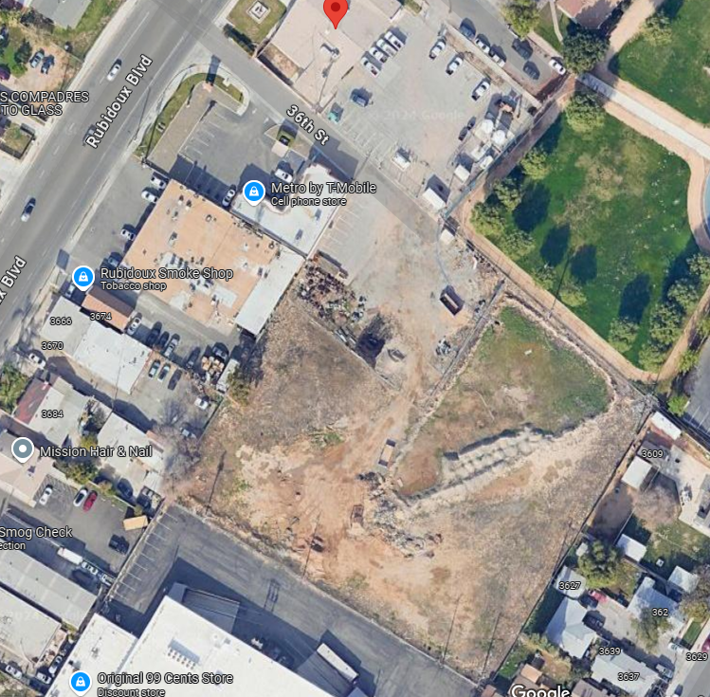
Single Campus
2.3-acres
.67-acres

Slide 5
Project Overview
Administration Building (3590 Rubidoux)
Modernize (preferred)
Reconfiguration of interior space for operational efficiency and customer service
ADA upgrades
Seismic retrofitting
Energy efficient measures
Updated audio/visual systems and furniture systems
Exterior improvements:
Relocate emergency generator and fuel tank
Enhance pedestrian and vehicle circulation

Slide 6
Project Overview
New Operations Center (2.3-acre vacant lot)
Pre-engineered or custom metal building with administrative areas
Vehicle maintenance bays
Secure storage
Employee facilities
Exterior improvements:
Dedicated parking
Fuel and generator locations
EV charging infrastructure
Stormwater management
Fencing
Lighting
Vehicle washing station
Site security

Slide 7
Project Overview
Scope
Design (concurrently) and construction (concurrently or close succession)
Admin Building:
Preference: retain and modernize building
But…
Evaluation of existing building: hazmat survey, as-built drawings, and structural/condition analysis with scenario options (remodel vs. replacement cost)

Slide 8
Scope of Services and Deliverables
Scope
Facility Assessment
Programming & Space Planning
Design Services
Permitting & Agency Coordination
Cost Estimating
Bid & Construction Support
Stakeholder Engagement
Furniture & A/V Design Support
Need: Architectural and Engineering Design Services Firm RFP

Slide 9
Request For Proposal (RFP)
Released: May 15, 2025
Mandatory site walk: May 27, 2025
Due date: July 3, 2025
Selection Criteria:
Project Understanding / Approach – 45 Points
Firm Qualifications and Experience – 40 Points
Project Schedule – 15 Points
4 proposals received
2 interviews conducted
1 clear firm……..

Slide 10
Preferred Firm
SVA Architects
Demonstrated strongest understanding of the District’s vision, scope, implementation challenges and preferred schedule
Ability to enter into Master Consulting Agreement (reviewed by General Counsel)
Relevant work:
City of Jurupa Valley City Hall Remodeling & Building Addition
Monte Vista Water District Master Plan & Renovation

Slide 11
Project Schedule
Now – June 2026 (1 year): Pre-Design through Bid Support
July 2026 – July 2027 (1 year): Construction, close-out, and move-in
Schedule subject to change

Slide 12
Budget Considerations
Proposed Cost: $1,324,795 (all scope items)
Proposed Contingency: $175,205 (~13%)
Proposed Total Authorization: $1,500,000

Slide 13
Budget Considerations
Proposed Budget Amendments:
General Fund Ln. 57 ‘Admin. Bldg. Proj’ - $675,000 to $1,500,000
Funding Source: General Fund LAIF Unrestricted Property Tax Reserve
Current Balance: ~$6.5 million
General Fund Ln. 60 ‘Transfer from Proj Admin Bldg Reserves’ - $675,000 to $0
Note: Amount reduced as these are restricted loan proceeds to be utilized towards construction costs

Slide 14
Recommendation
Staff recommends the Board of Directors consider the following actions:
Accept Fee Proposal and enter into Master Consulting Agreement with SVA Architects for Bldg. Project.
Authorize architectural and engineering design costs up to $1,500,000.
Issue a TO to SVA Architects for $1,324,795 and allow issuance of individual TO’s for unforeseen design costs up to $1,500,000.
Amend the FY 2025|2026 General Fund Budget
Ln. 57: $675,000 to $1,500,000; Ln. 60: $675,000 to $0
Utilize $1,500,000 from GF Unrestricted Property Tax Reserve

Slide 15
Questions
Rubidoux Community Services District
Office: 951.684.7580
www.rcsd.org
15

