Slide 1

RUBIDOUX COMMUNITY SERVICES DISTRICT
Fire Station 38
Roof Replacement Update
October 15, 2026
BOARD PROGRESS REPORT | OCTOBER 2026

Slide 2
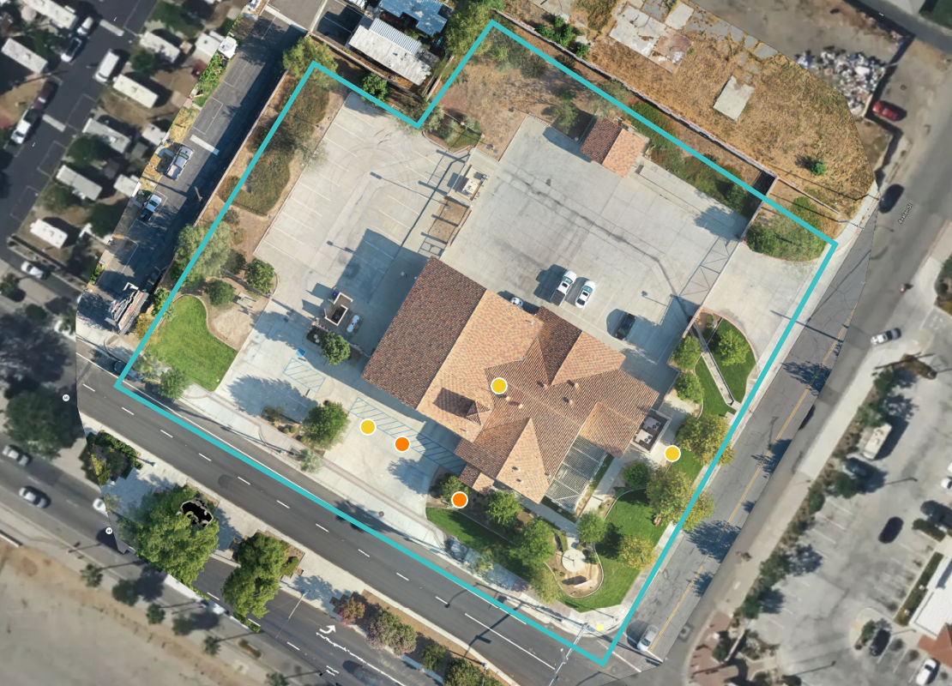
Background & Board Authorization
Summarize the emergency, prior repairs, and Board action authorizing the work.
BOARD ACTION
DM 2026-85 (October 1, 2026) – Board approved emergency award of the Fire Station 38 Tile Roof Replacement Project to HYT Construction, Inc.
• Scope:
- Demo existing tile, flashings, underlayment, and roof sheathing
- Install new plywood, full-deck water proofing, new flashings and drainage components, concrete tile roofing
• Project Period: October 5 – October 30
• Amount: $270,000; plus $25,000 District-controlled allowance
• Other Considerations:
- All work coordinated with District and station personnel
- Preserve emergency access, protect apparatus and occupants
- Keep open roof area watertight at the end of every workday
- Daily updates/photos
[Optional caption or key detail]
CURRENT STATUS: PHASED DEMO AND INSTALL OF PLYWOOD AND WATER PROOFING
RUBIDOUX COMMUNITY SERVICES DISTRICT | FIRE STATION 38 ROOF UPDATE
01

Slide 3
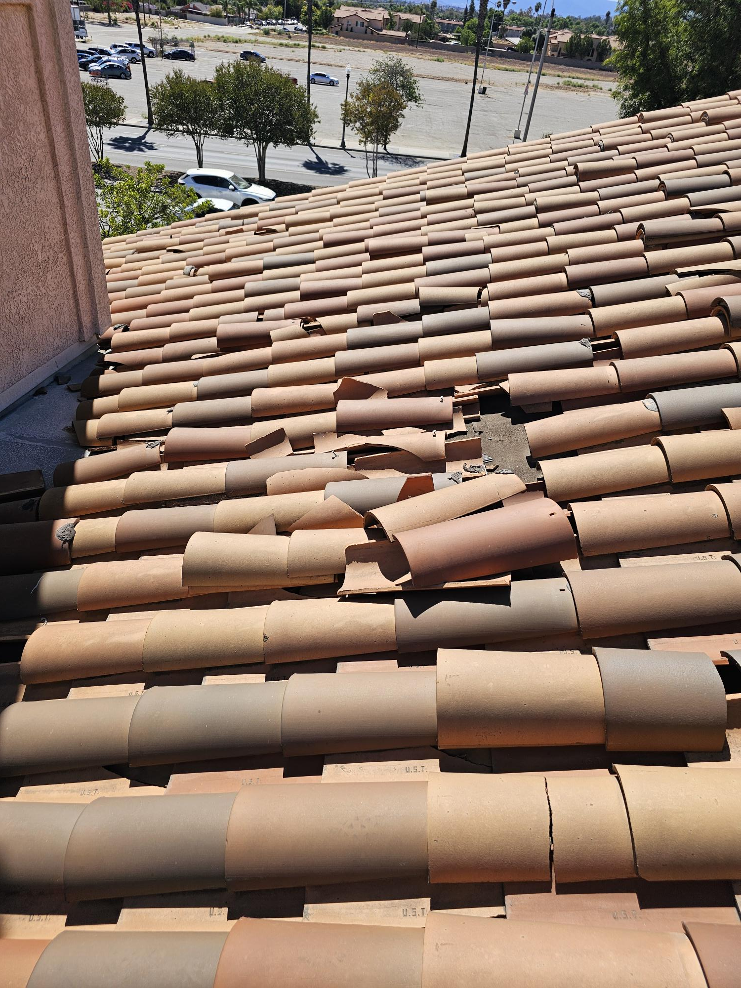
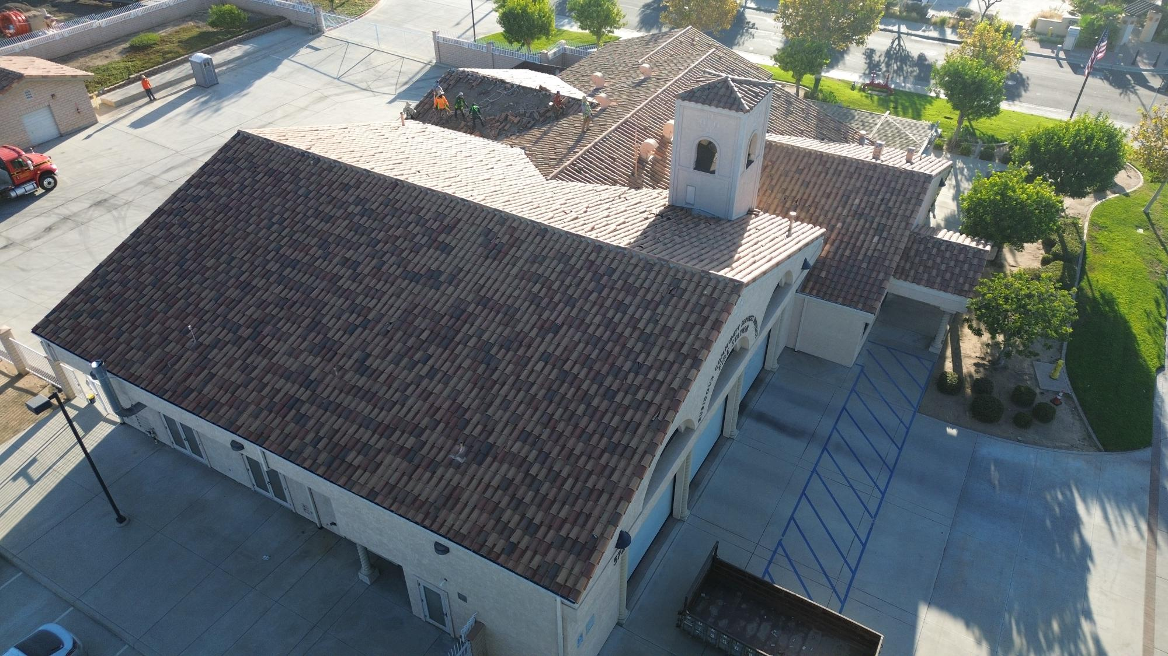
Daily Progress Update — Day 01
10/5/26 | CONTRACT EXECUTED – DEMOLITION STARTED
RUBIDOUX COMMUNITY SERVICES DISTRICT | FIRE STATION 38 ROOF UPDATE
02

Slide 4
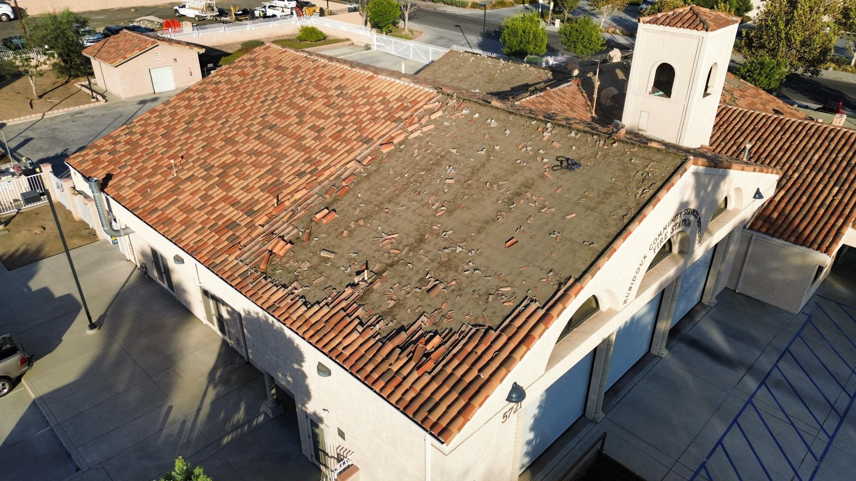
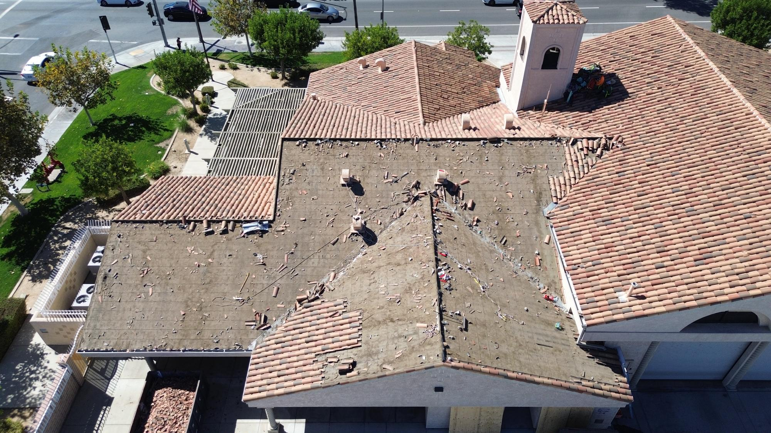
Daily Progress Update — Day 02
10/6/26 | DEMOLITION TILE REMOVAL - CONTINUED
RUBIDOUX COMMUNITY SERVICES DISTRICT | FIRE STATION 38 ROOF UPDATE
03

Slide 5
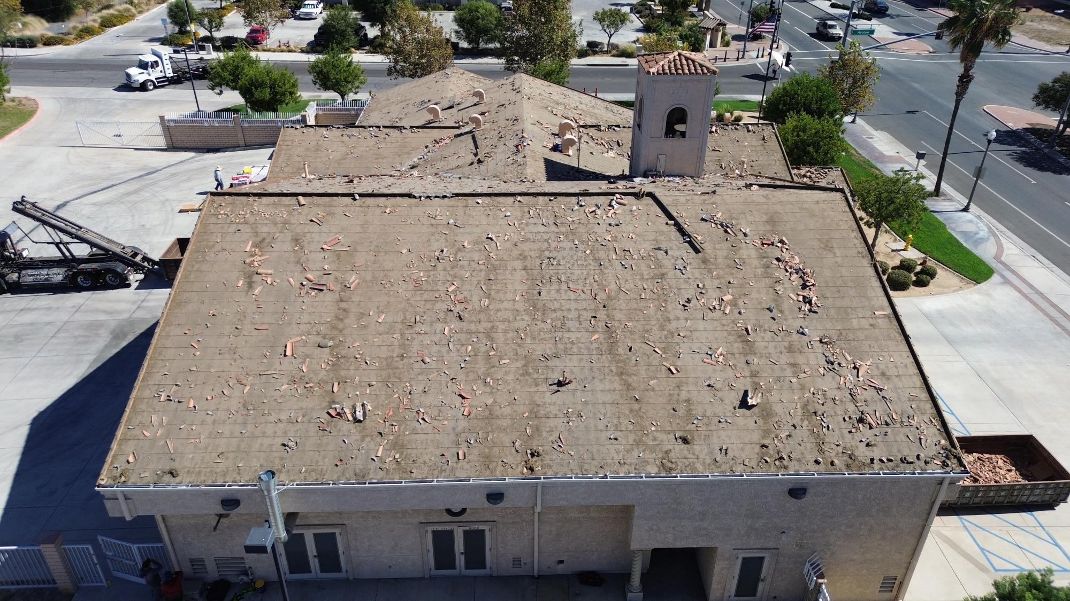
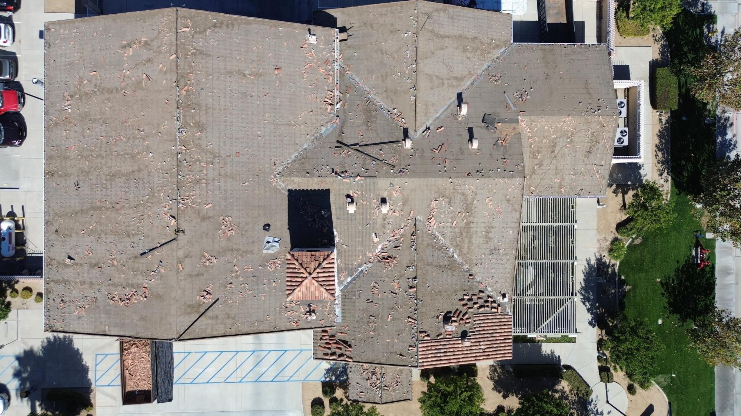
Daily Progress Update — Day 03
10/7/26 | DEMOLITION TILE REMOVAL - CONTINUED
RUBIDOUX COMMUNITY SERVICES DISTRICT | FIRE STATION 38 ROOF UPDATE
04

Slide 6
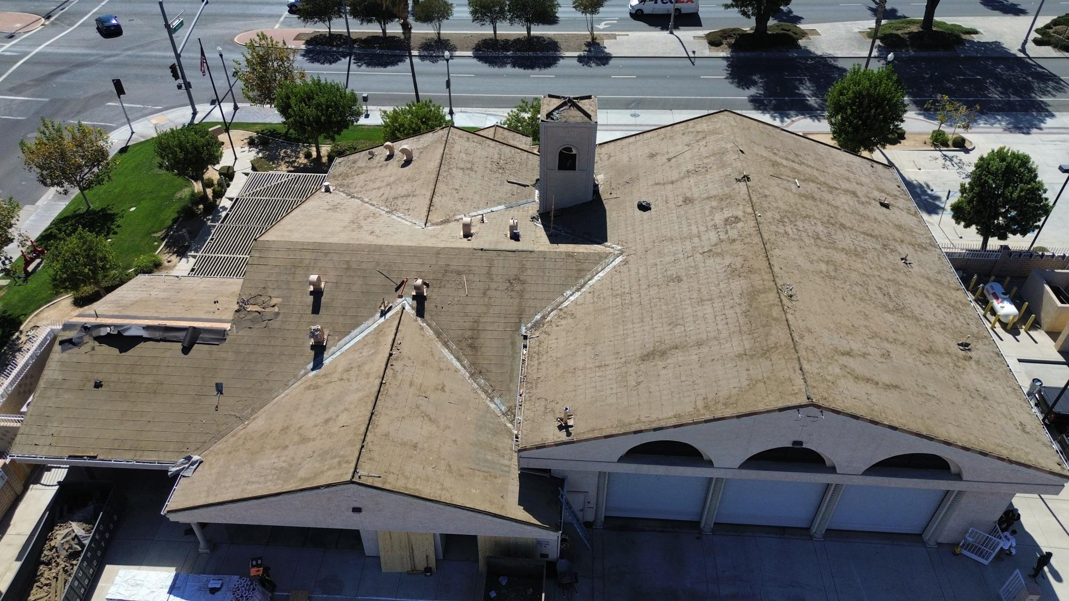
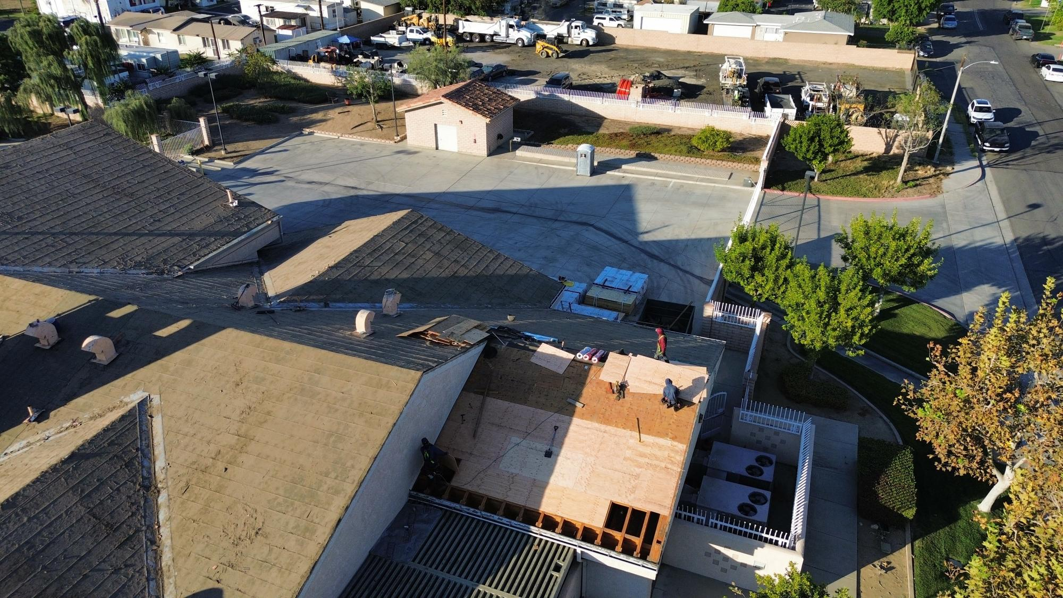
Daily Progress Update — Day 04
10/8/26 | DEMOLITION TILE AND PLYWOOD REMOVAL; PLYWOOD INSTALL
RUBIDOUX COMMUNITY SERVICES DISTRICT | FIRE STATION 38 ROOF UPDATE
05

Slide 7
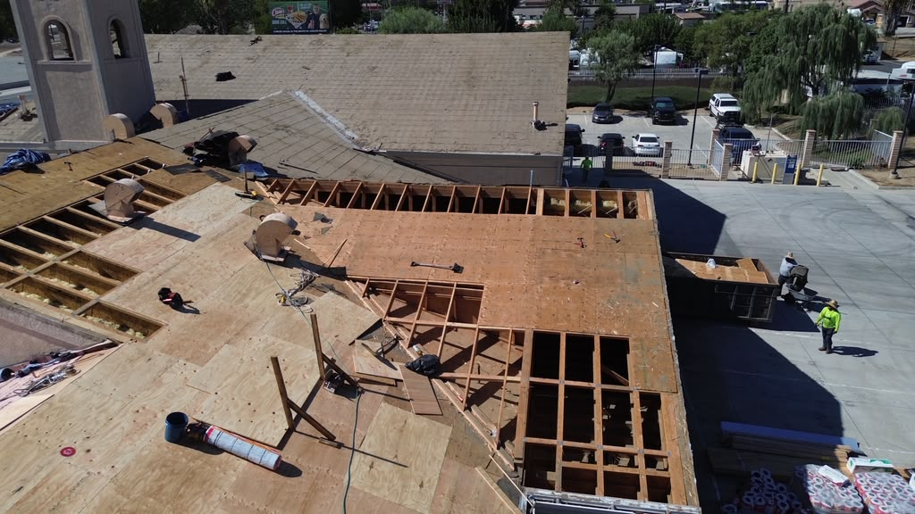
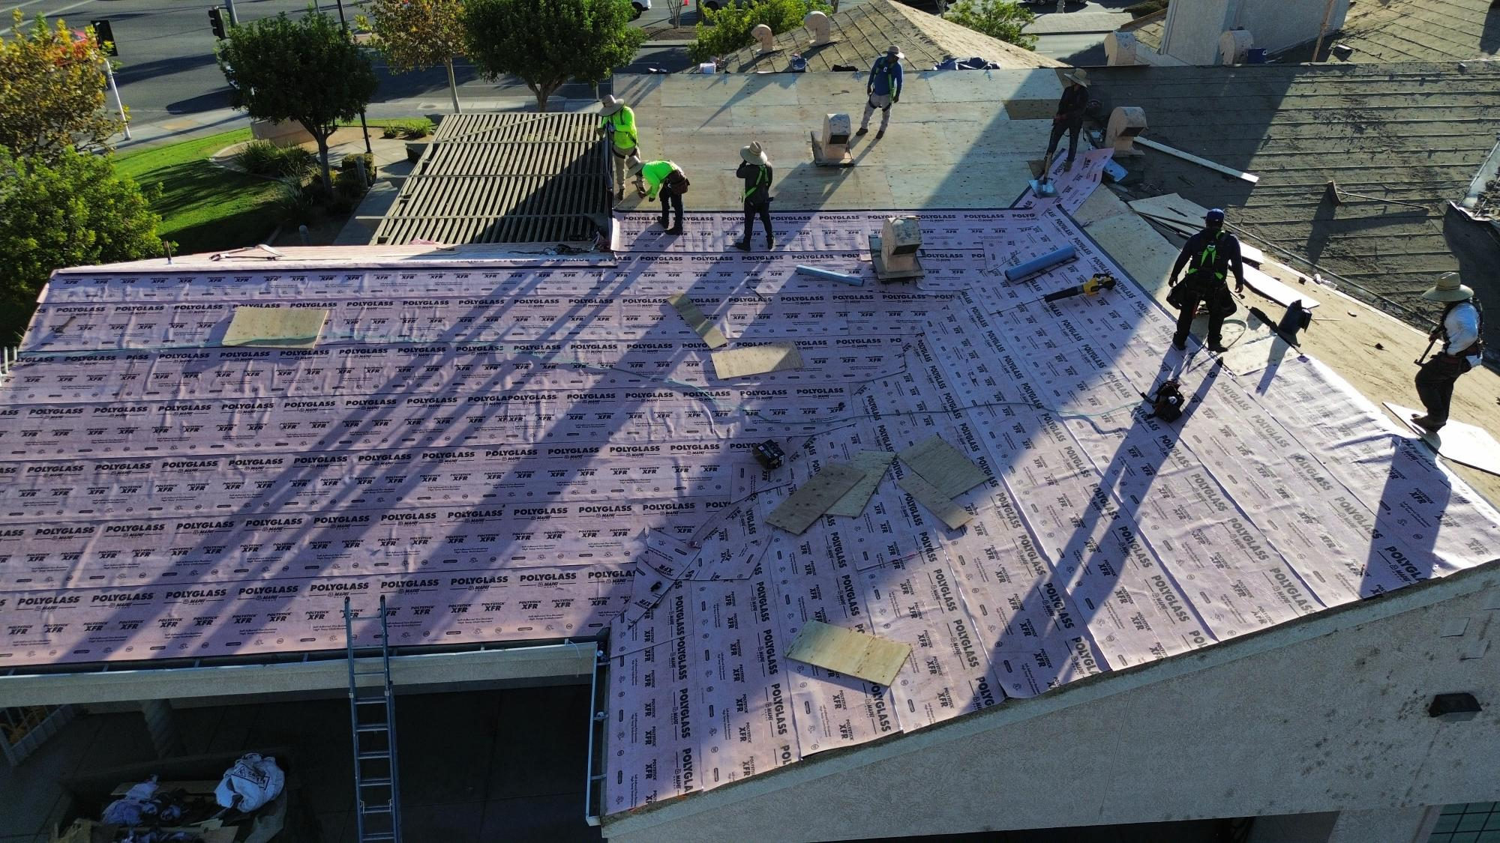
Daily Progress Update — Day 05
10/9/26 | DEMOLITION OF EXISTING AND INSTALL OF NEW PLYWOOD; INSTALL WEATHER PROOFING MATERIAL
RUBIDOUX COMMUNITY SERVICES DISTRICT | FIRE STATION 38 ROOF UPDATE
06

Slide 8
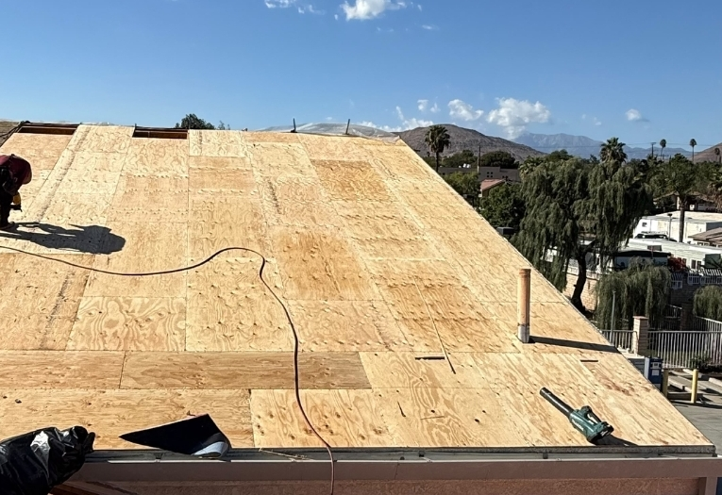
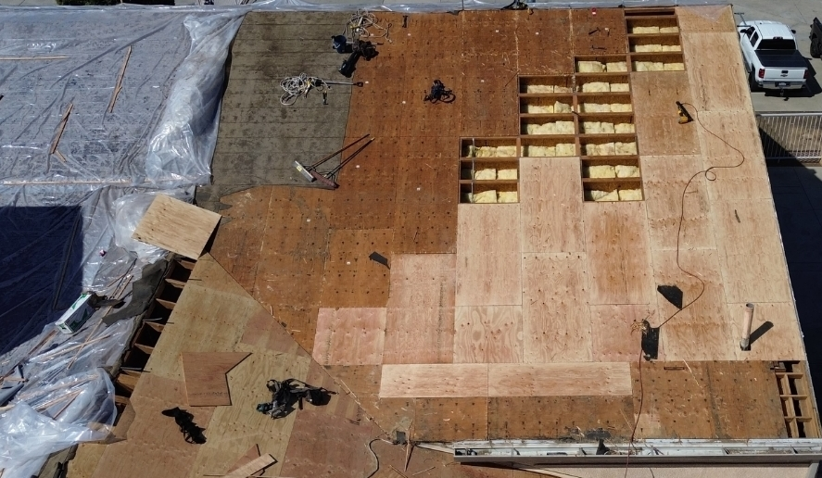
Daily Progress Update — Day 06
10/10/26 | DEMOLITION OF EXISTING AND INSTALL OF NEW PLYWOOD; INSTALL WEATHER PROOFING MATERIAL; WEATHER TIGHT SEAL
RUBIDOUX COMMUNITY SERVICES DISTRICT | FIRE STATION 38 ROOF UPDATE
07

Slide 9

Daily Progress Update — Day 07 and Day 08
10/11 – 10/12/26 | NO WORK DUE TO RAIN
Station 38 Captain noted the weather proofing seemed to hold during the rain with no major issues.
RUBIDOUX COMMUNITY SERVICES DISTRICT | FIRE STATION 38 ROOF UPDATE
08

Slide 10
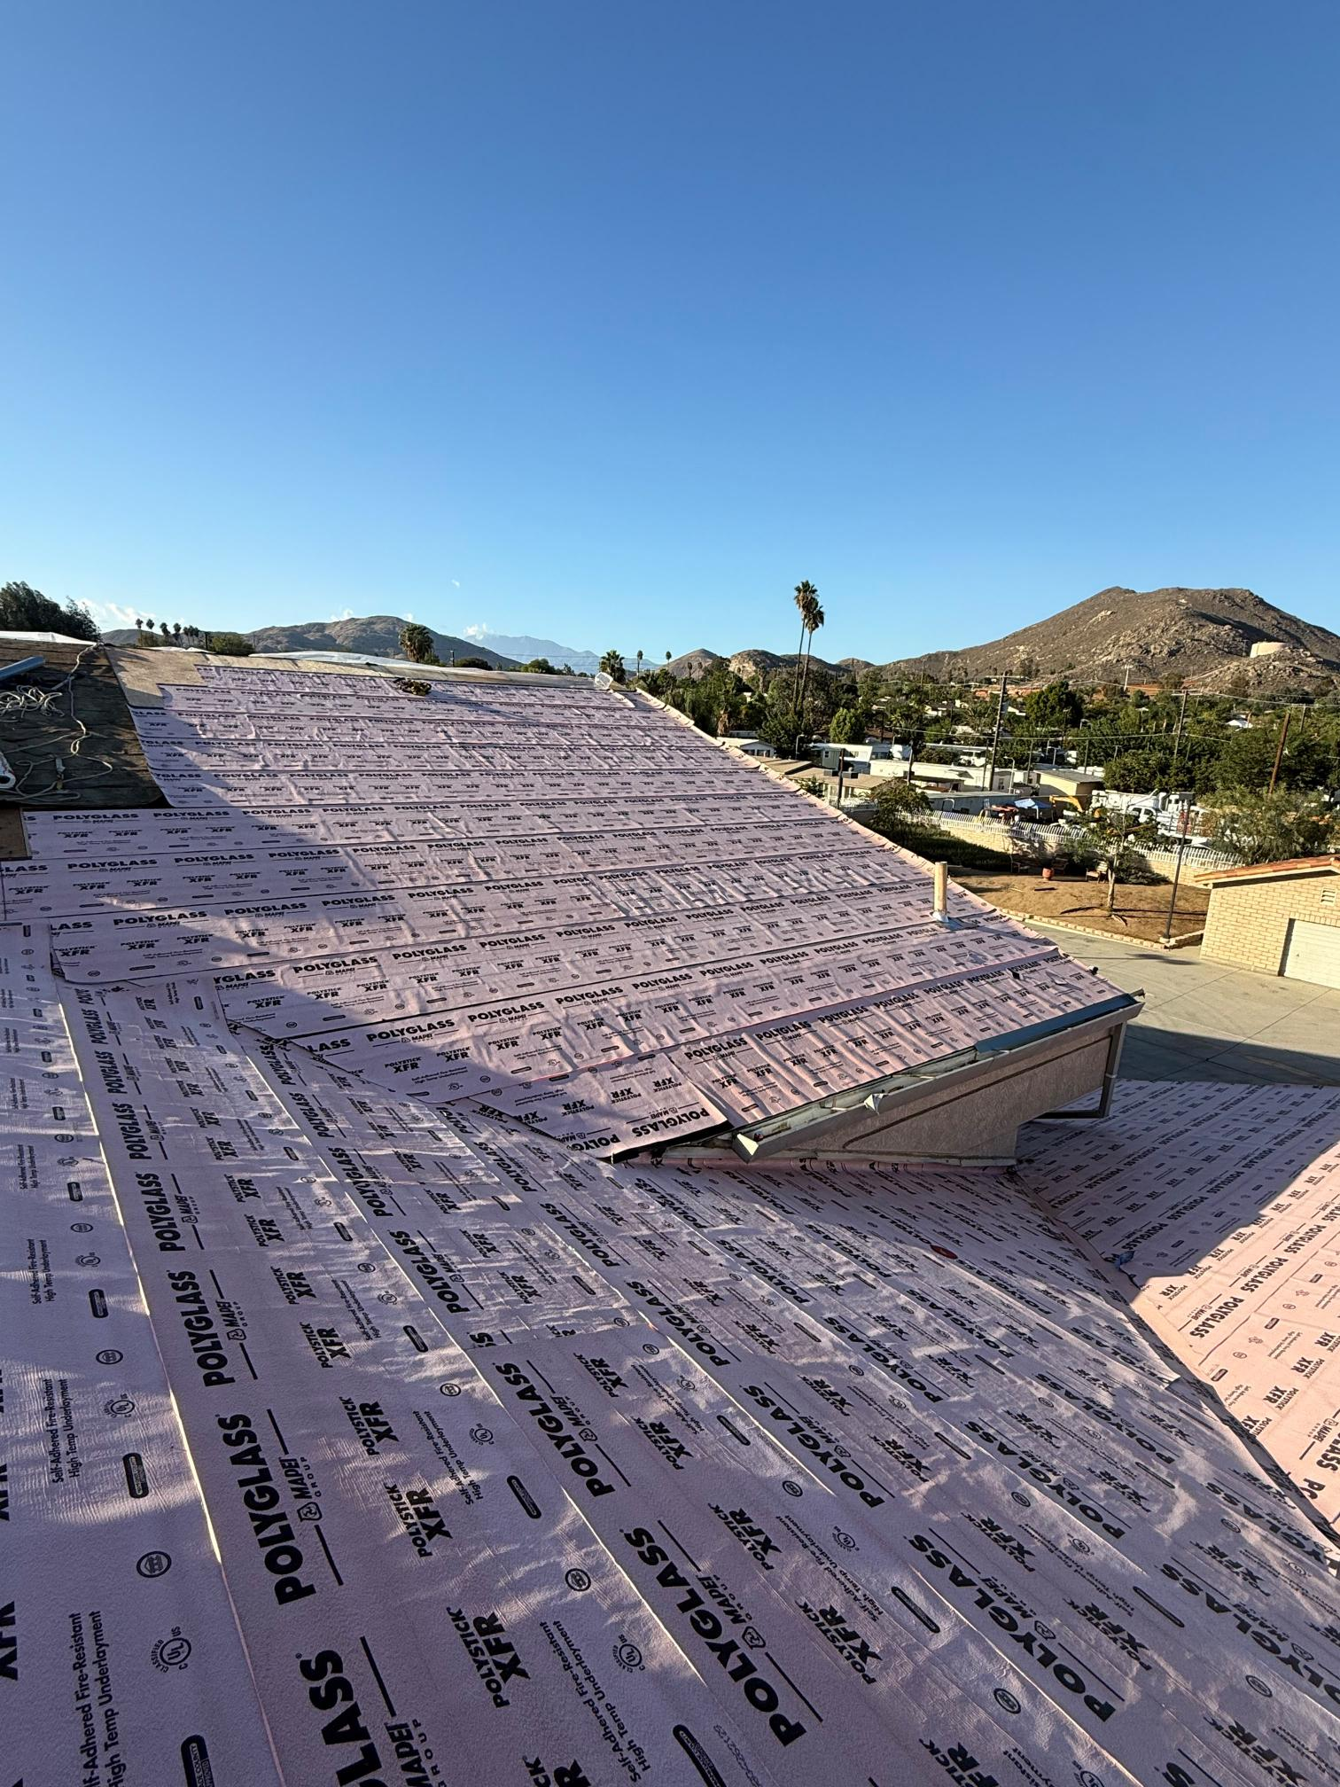
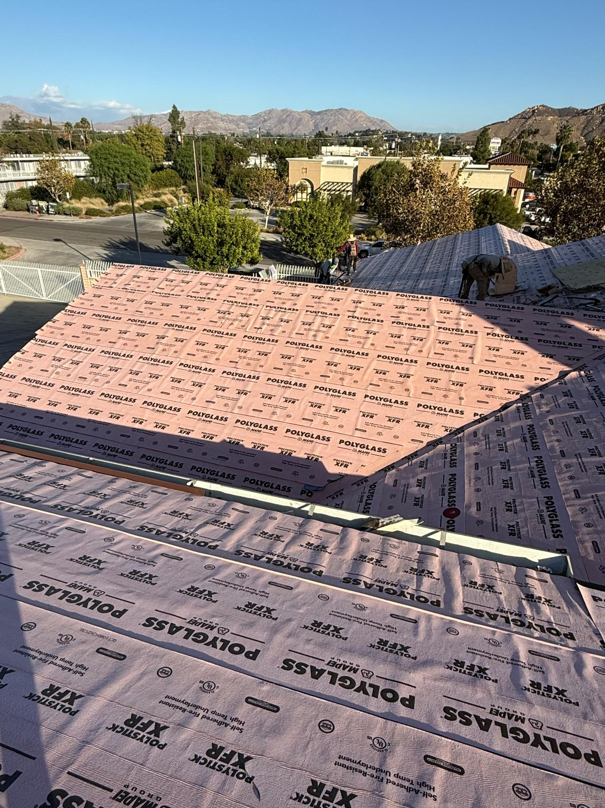
Daily Progress Update — Day 09
10/13/26 | DEMOLITION OF EXISTING AND INSTALL OF NEW PLYWOOD; INSTALL WEATHER PROOFING MATERIAL
RUBIDOUX COMMUNITY SERVICES DISTRICT | FIRE STATION 38 ROOF UPDATE
09

Slide 11
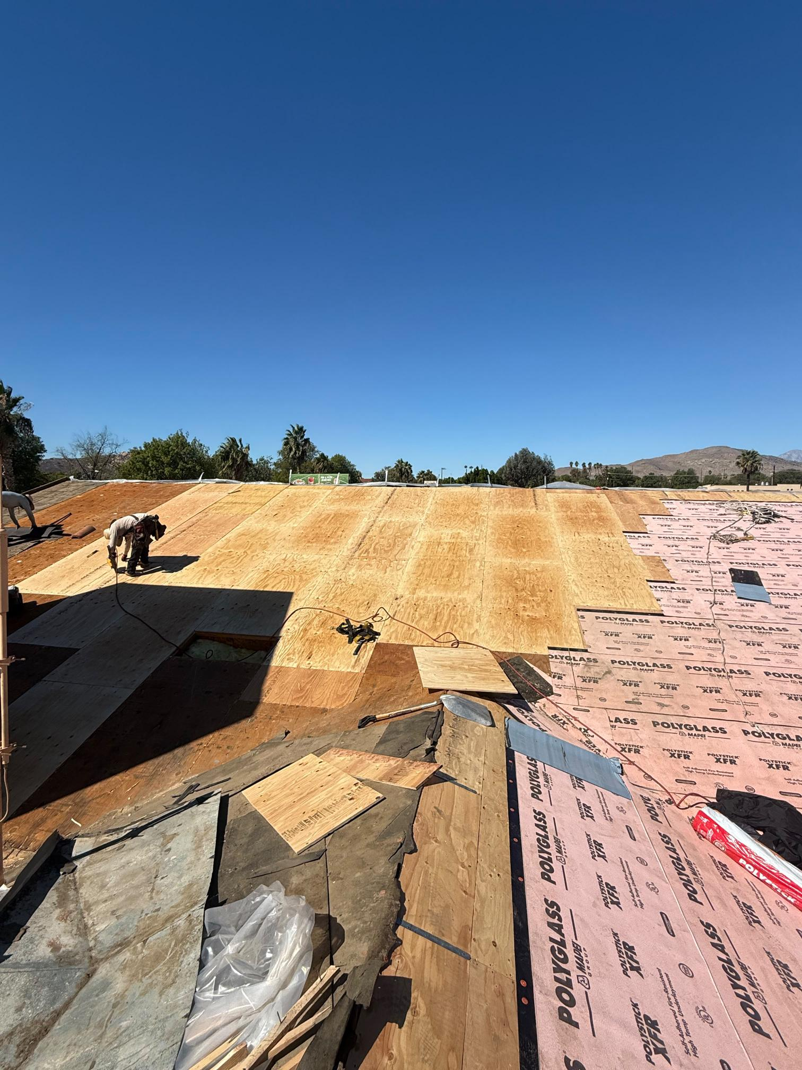
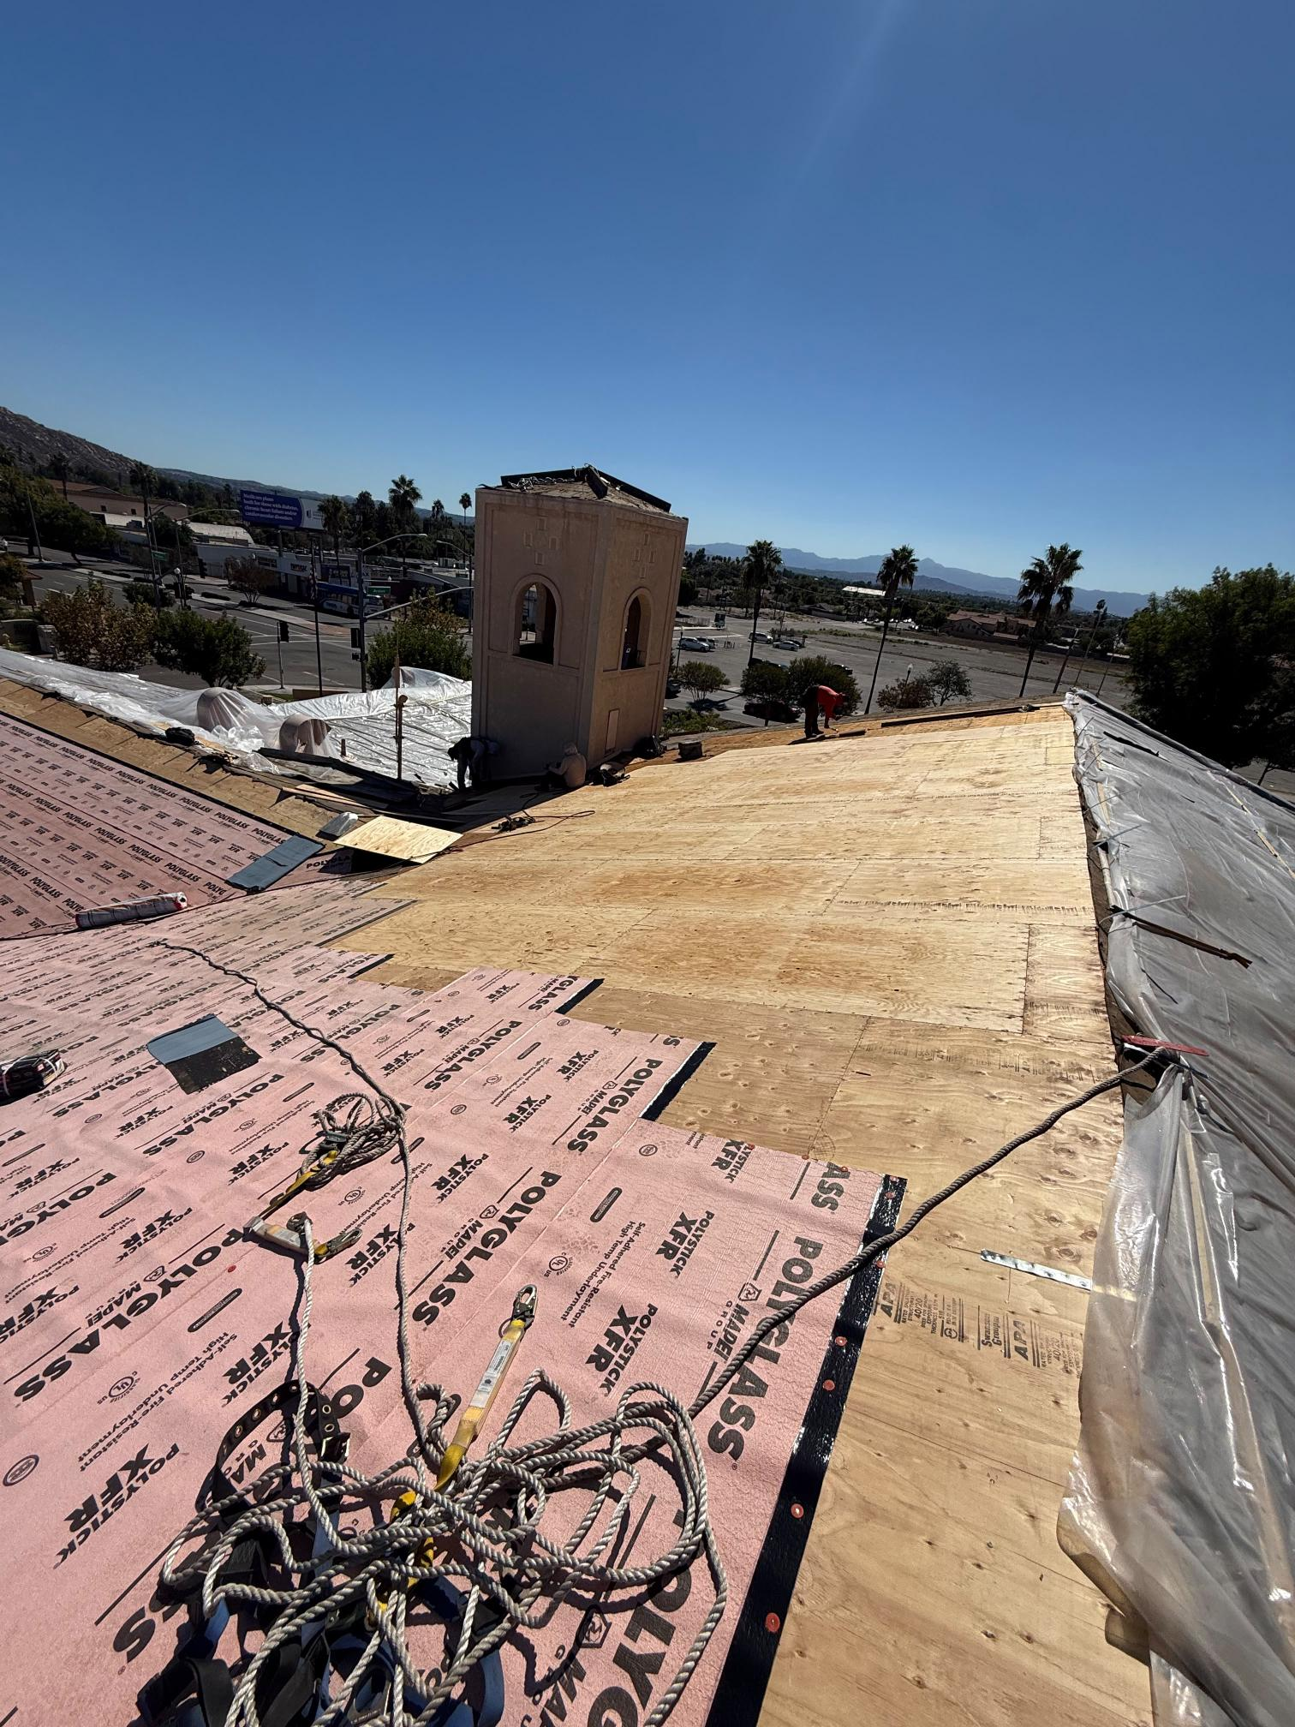
Daily Progress Update — Day 10
10/14/26 | DEMOLITION OF EXISTING AND INSTALL OF NEW PLYWOOD; INSTALL WEATHER PROOFING MATERIAL
RUBIDOUX COMMUNITY SERVICES DISTRICT | FIRE STATION 38 ROOF UPDATE
10

Slide 12
Upcoming Action Items & Next Steps
Close out the emergency work, document completion, and report back to the Board.
UP NEXT
ADDITIONAL BUDGET REQUESTS
BOARD FOLLOW-UP
• By end of week: Finish demo of existing plywood and install of new plywood and underlayment
• By end of week: Battens laid out and installed
• Monday (10/19): Tile scheduled for delivery
• None at this time, District controlled contingency of $25,000 remains available for slight change orders
• Target Completion remains October 30, 2026
• Next update: November 5, 2026
RECOMMENDATION
• Receive and file status update
QUESTIONS?
RUBIDOUX COMMUNITY SERVICES DISTRICT | FIRE STATION 38 ROOF UPDATE
12

