Slide 1
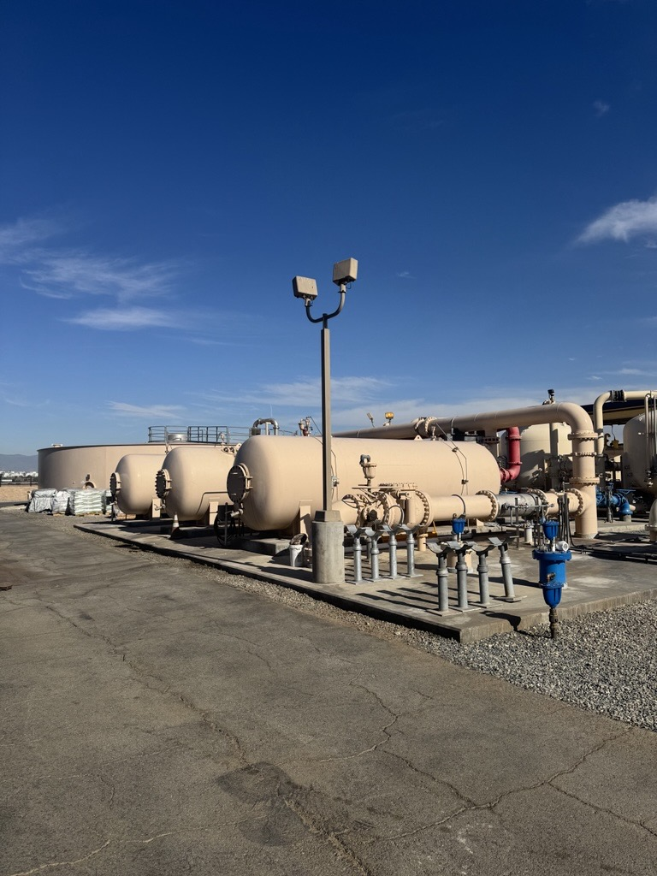
Leland Thompson Vessel Rehabilitation

Slide 2
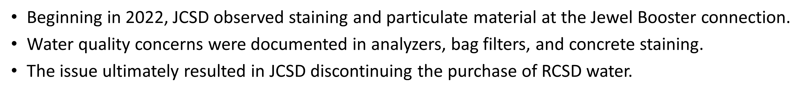
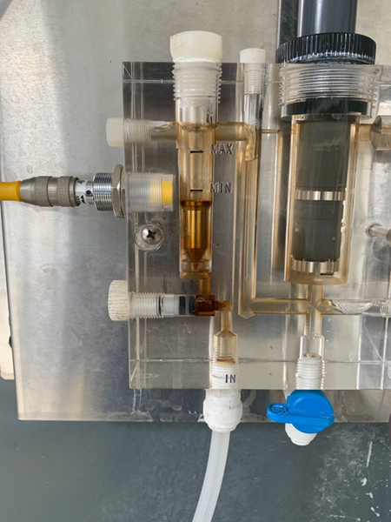
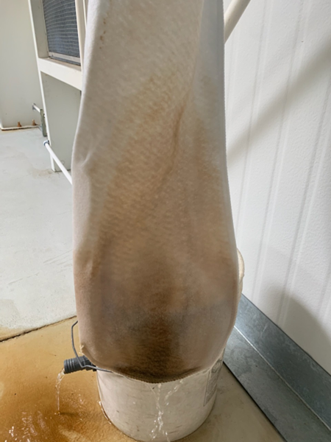
Background

Slide 3
Why the Staining Occurred??
Over time, the treatment media within the Thompson iron and manganese vessels deteriorated and lost effectiveness.
As the media condition declined, iron and manganese removal performance became unstable, allowing fine oxidized particulate material to migrate through portions of the system.
Chemical dosage and oxidation control prior to plant entry also required optimization to improve treatment performance and stabilize the process.
The issue required extensive investigation, operational testing, and coordination between Operations, Maintenance, and Engineering.
The combination of vessel rehabilitation, replacement of the treatment media, and operational adjustments were determined to be the best course of action to correct the staining and resolve the water quality concerns.

Slide 4
Team Effort to Rehabilitate the Thompson Vessels
Maintenance staff emptied the spent media from vessels 1 and 2 and removed necessary concrete and piping to prepare the vessels for rehabilitation work.
The District moved forward with rehabilitation of the iron and manganese treatment vessels and replacement of the treatment media.
Contractors recoated the interior vessel surfaces and reinstalled concrete around the new stainless steel piping modifications.
Staff evaluated and adjusted chemical dosage prior to plant entry to improve oxidation and treatment performance.
Operations, Maintenance, Engineering, and contractor teams worked together throughout the rehabilitation process to return the plant to reliable operation.
The combined effort ultimately improved water quality stability and resolved the staining concerns.

Slide 5
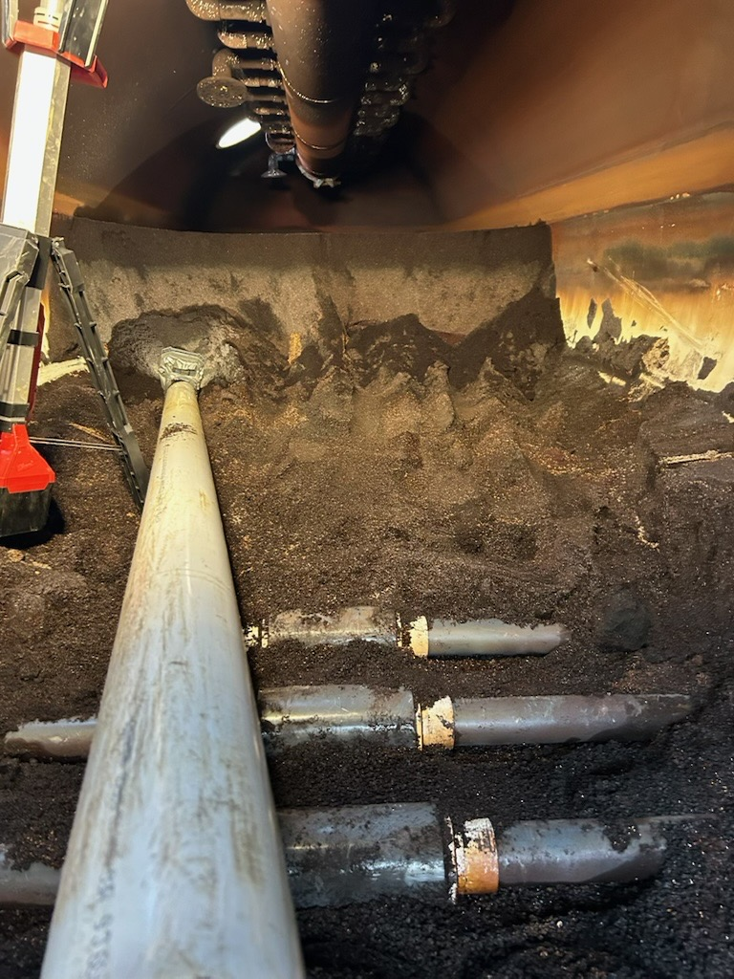
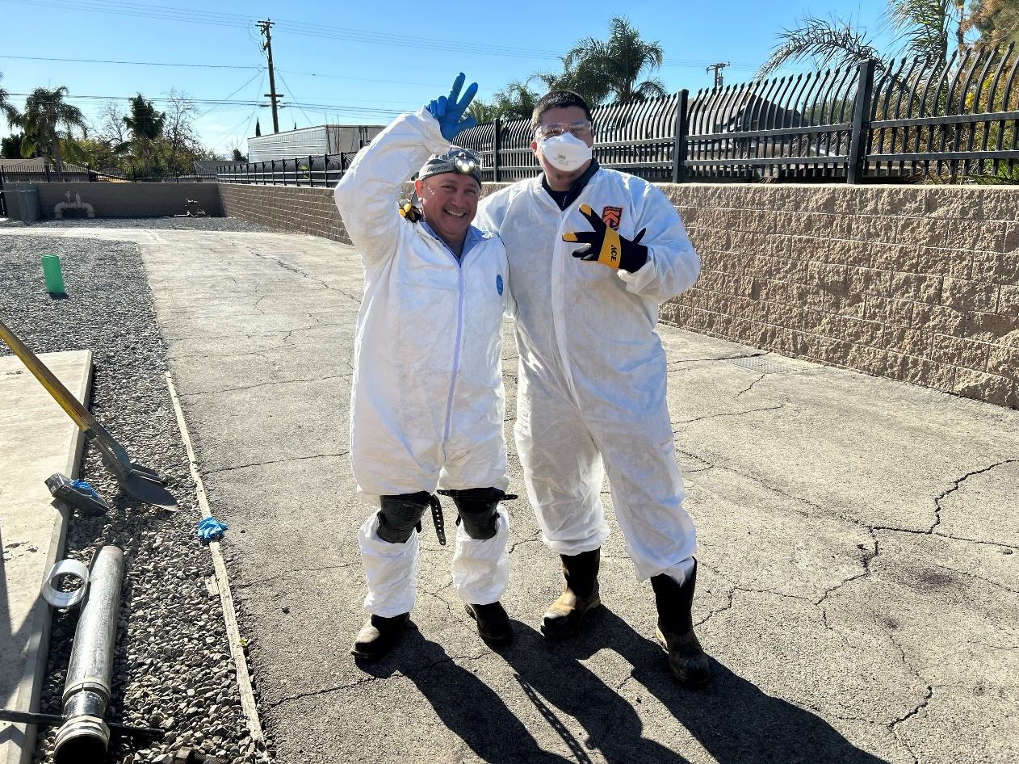

Slide 6
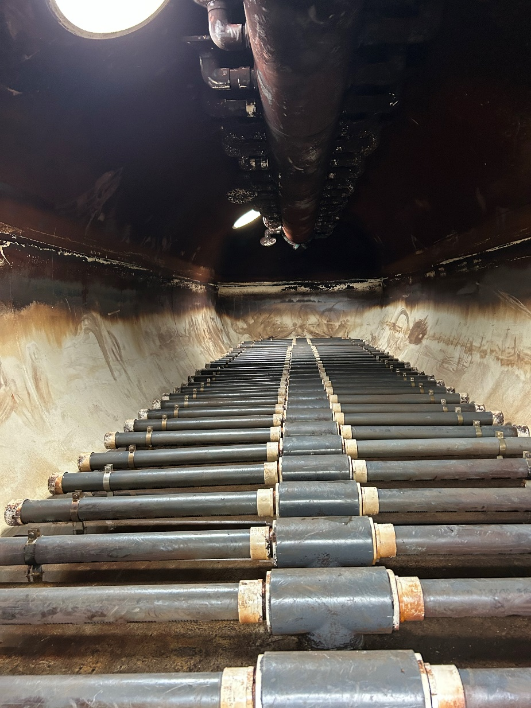
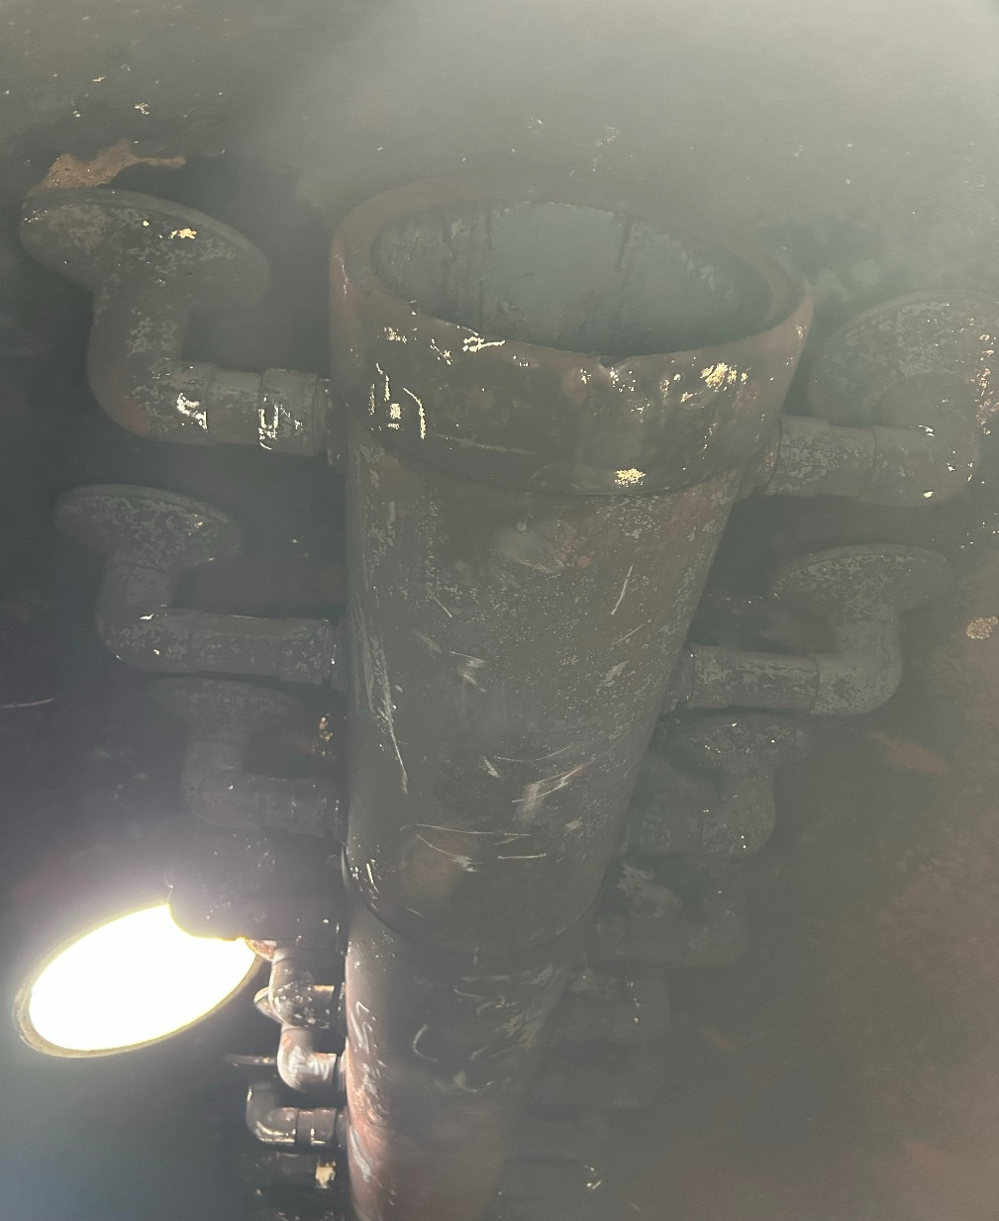

Slide 7
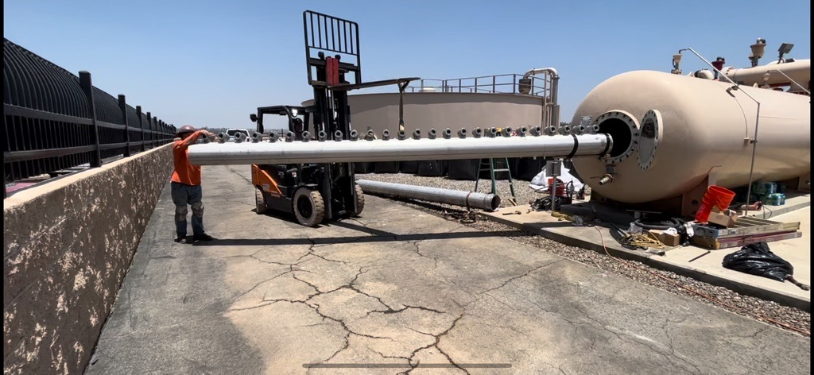

Slide 8
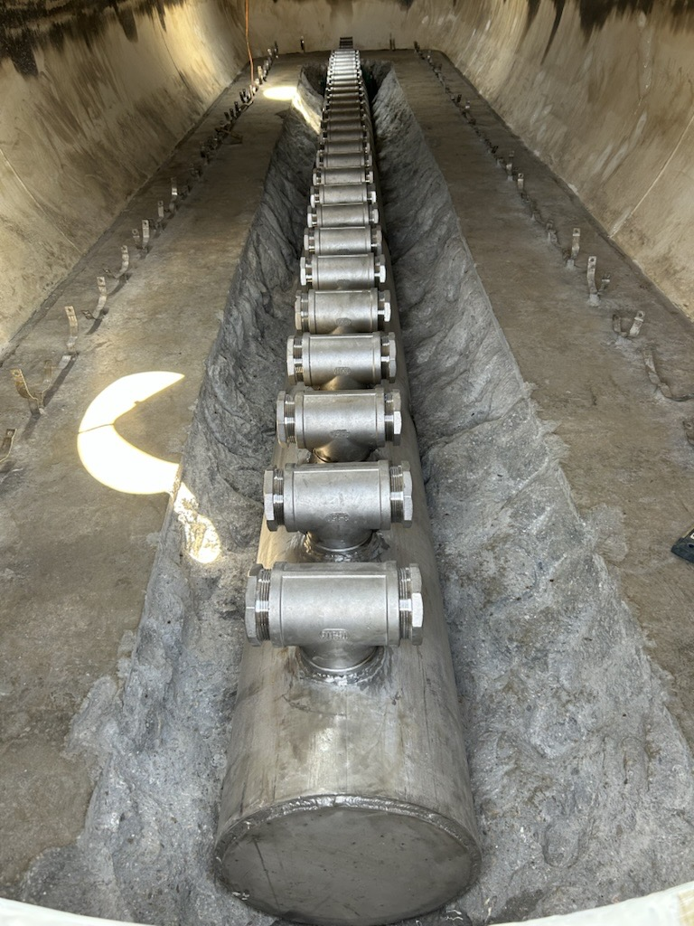
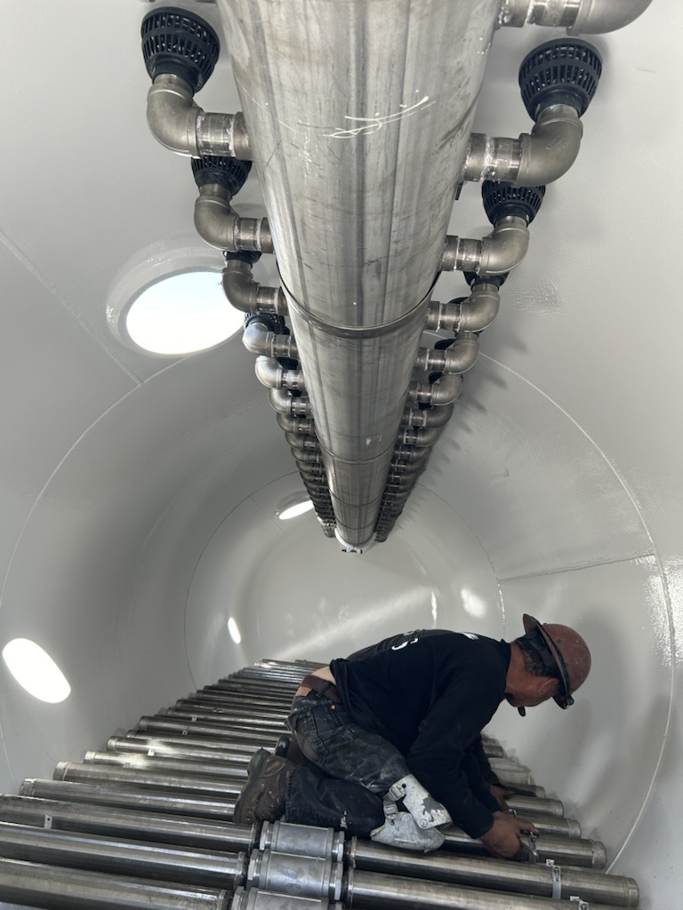

Slide 9
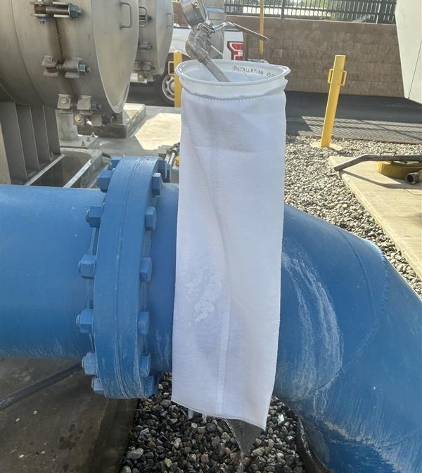
Today
The Thompson Vessel Rehabilitation Project began in March 2025 and was completed in November 2025.
Rehabilitation of the treatment vessels, replacement of the deteriorated filter media, and adjustment of chlorine dosage prior to plant entry successfully corrected the water quality issues that had been problematic for the District.
The improvements restored treatment performance, stabilized water quality, and resolved the staining concerns experienced within the system.
This project demonstrated the importance of persistence, operational excellence, and teamwork across all departments.

Slide 10
Thank You!
The successful completion of this project reflects the dedication, teamwork, and commitment of RCSD staff to continuous improvement and operational excellence.
Teamwork Made It Happen
10

