Slide 1
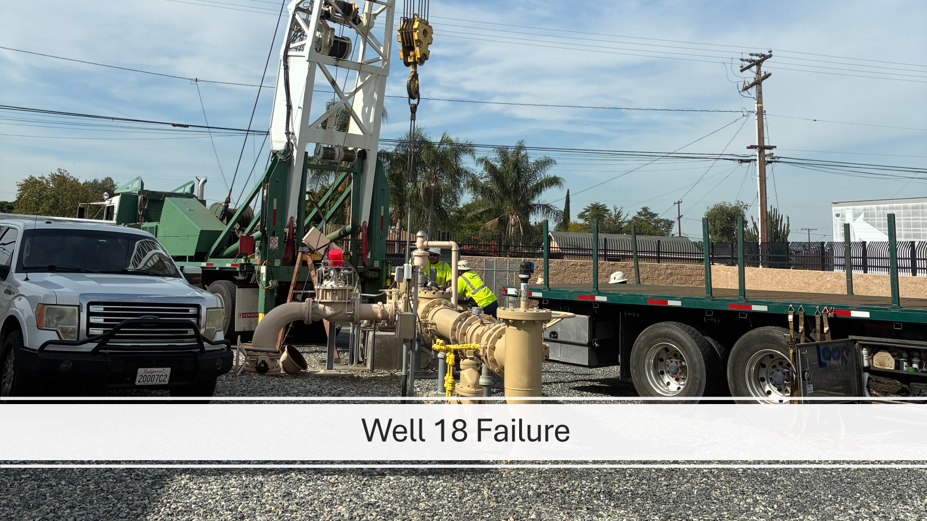

Slide 2
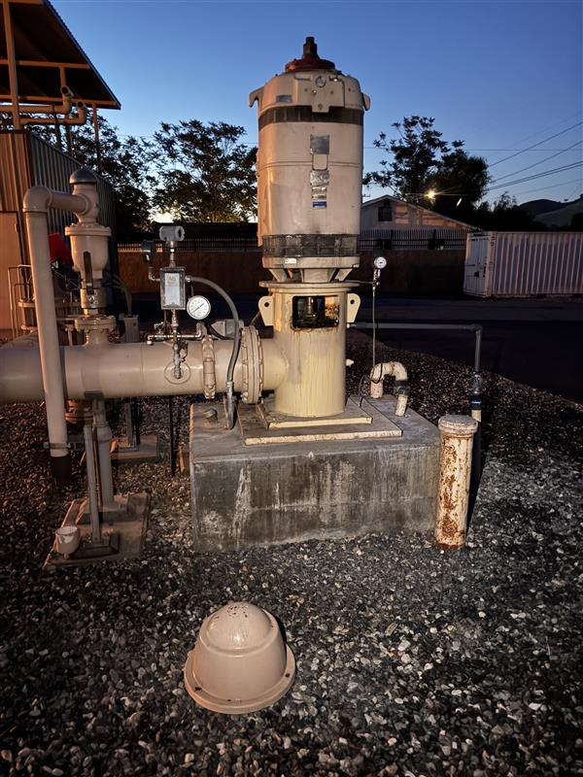
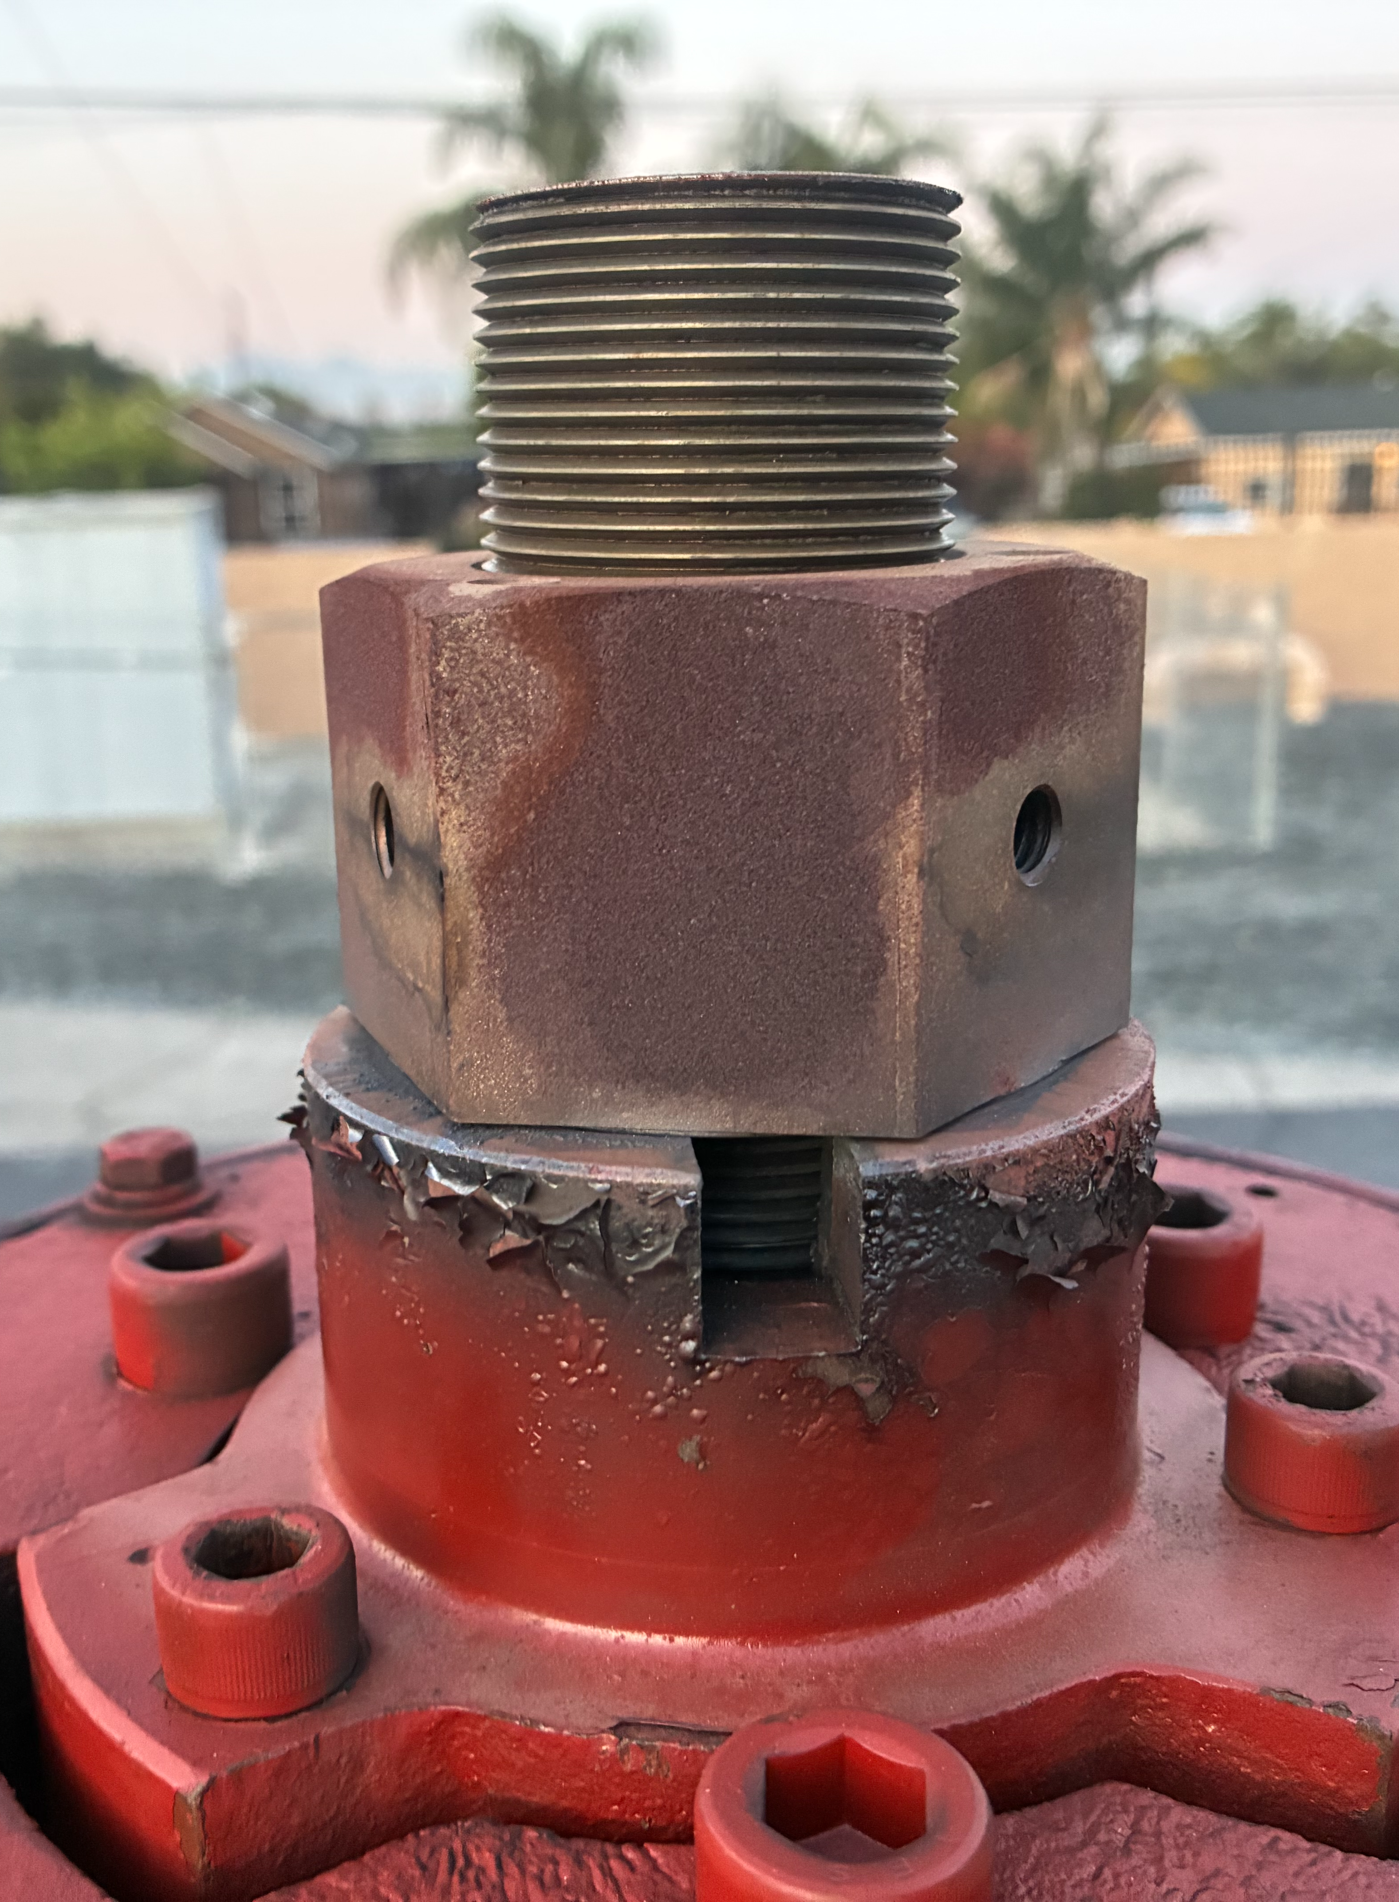
Well 18 Emergency Failure
April 15, 2026
Well 18 experienced a catastrophic mechanical failure resulting in the pump assembly separating and falling into the well casing.
Initial Findings
Bowl assembly separated in multiple locations
Column pipe thread failure
Damaged shafting
Crushed cone strainer
Significant downhole mechanical damage observed during video inspection
2

Slide 3
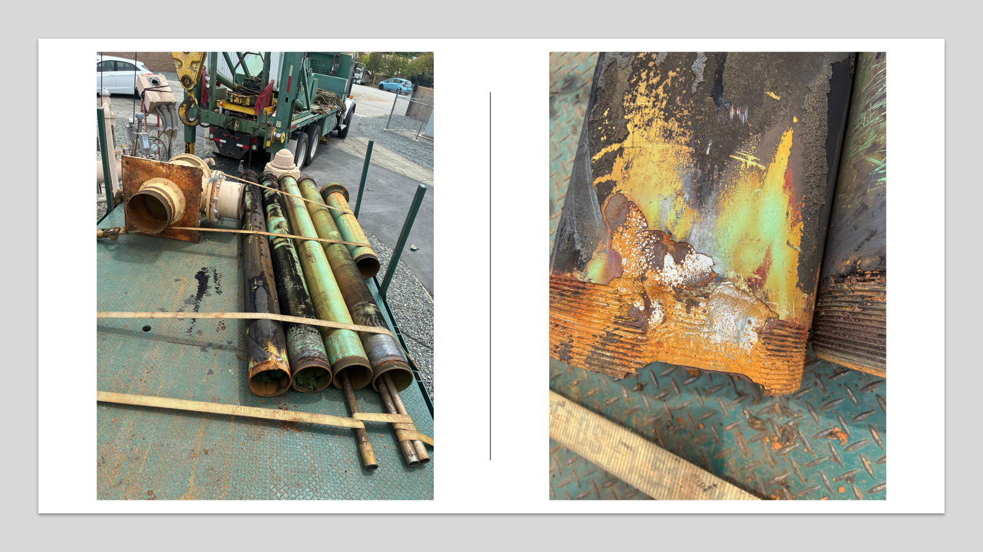
3

Slide 4
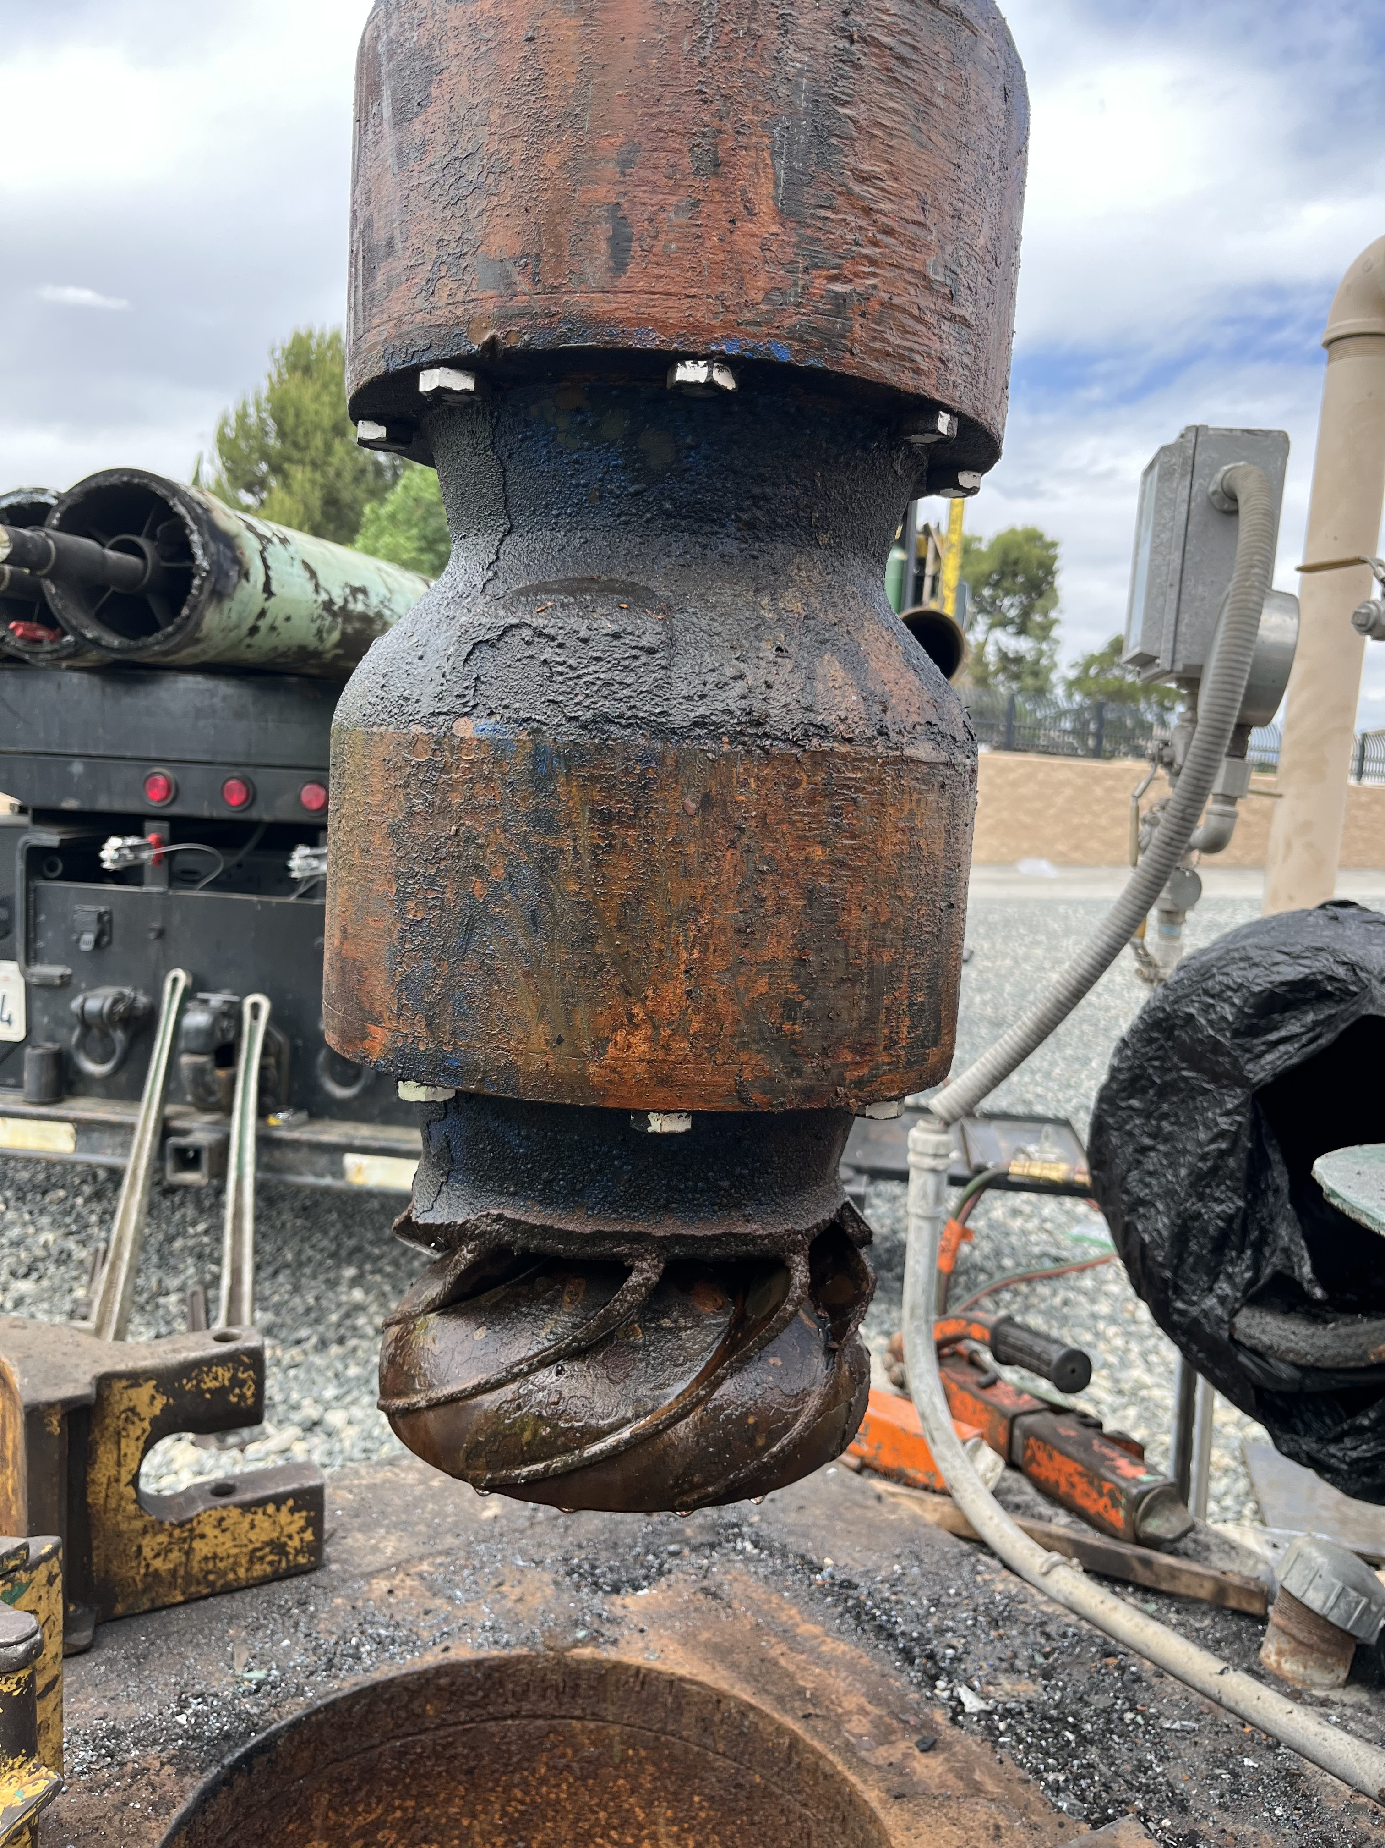
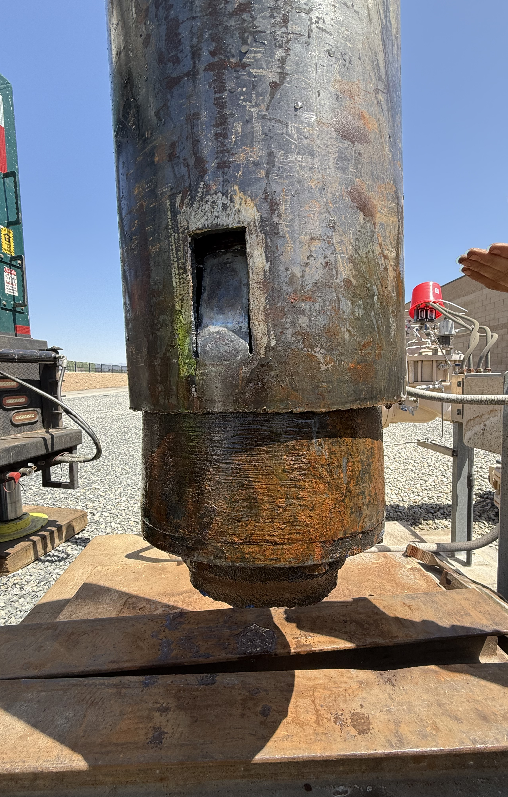
Immediate Actions Taken
Emergency contractor mobilization Downhole video inspection
Fishing operations to recover failed equipment Mechanical rehabilitation of the well
Brush and bail cleaning performed
New pumping equipment procured and installed
4

Slide 5
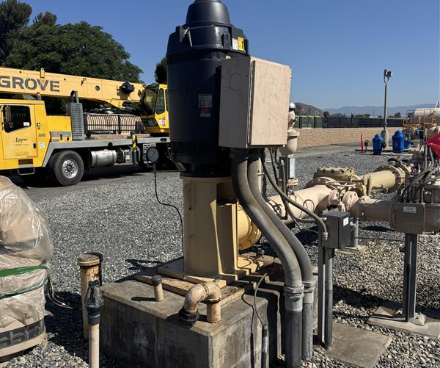
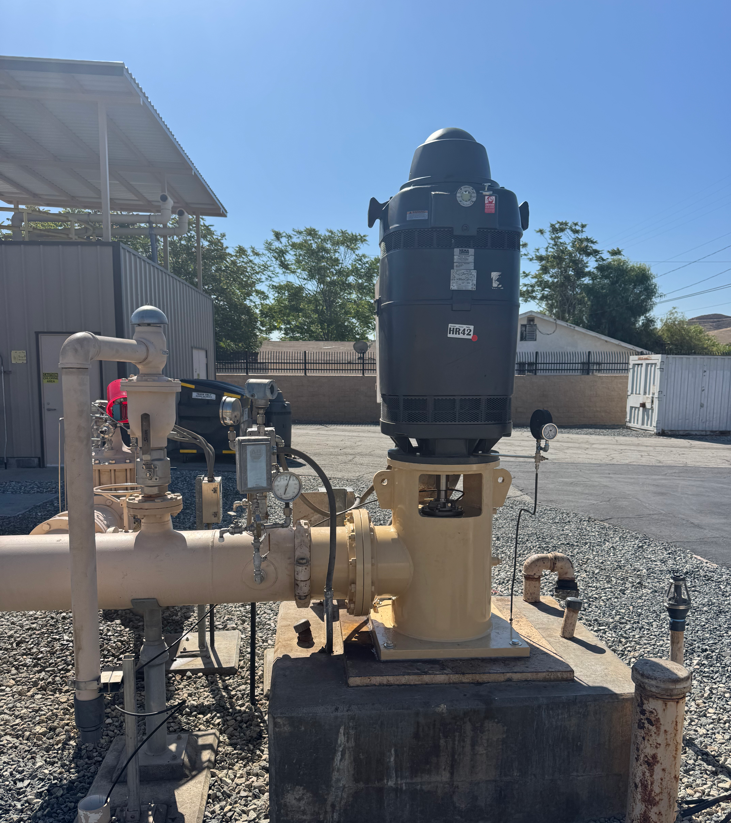
Well 18 Re-Installed and Operational 5-1-2026
Confirmation sample results received 5-6-2026
5

Slide 6
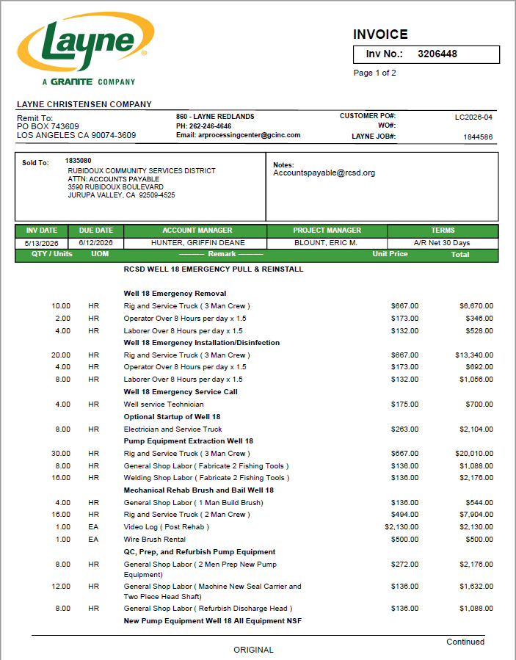
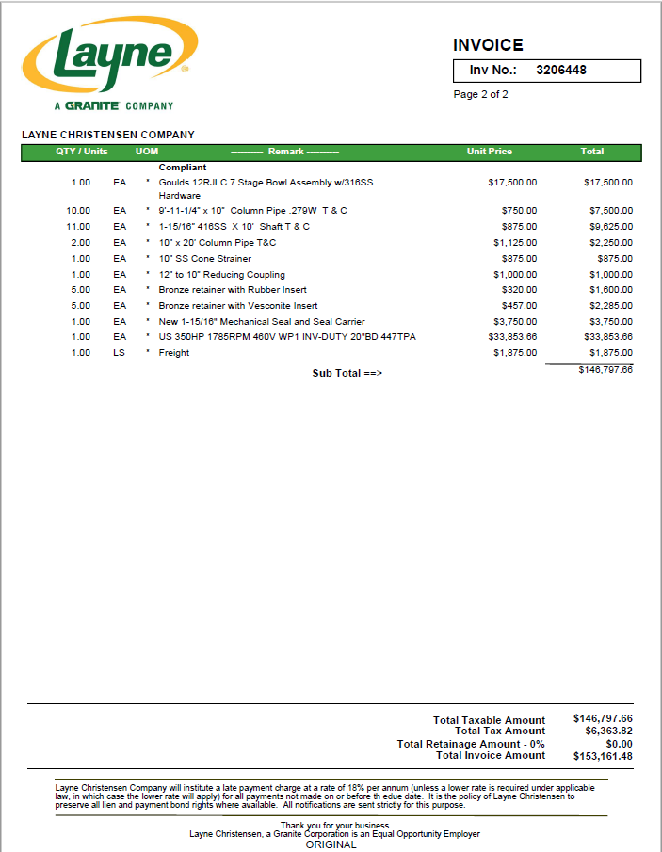

6

Slide 7

Questions????

