Slide 1
Director Memorandum 2025-73
Consideration to Approve a Reimbursement Agreement with EM Ranch Owner, LLC Related to Construction of a Raw Water Pipeline for Tract No. 38318
August 7, 2025

Slide 2
Background
Project Overview:
  Formerly Emerald Meadows
  247-acre mixed-use development
    Residential – 3-story apartments (~1,100 units)
    Commercial
    Hospitality
    Warehouse/industrial
    Park/open space

Slide 3
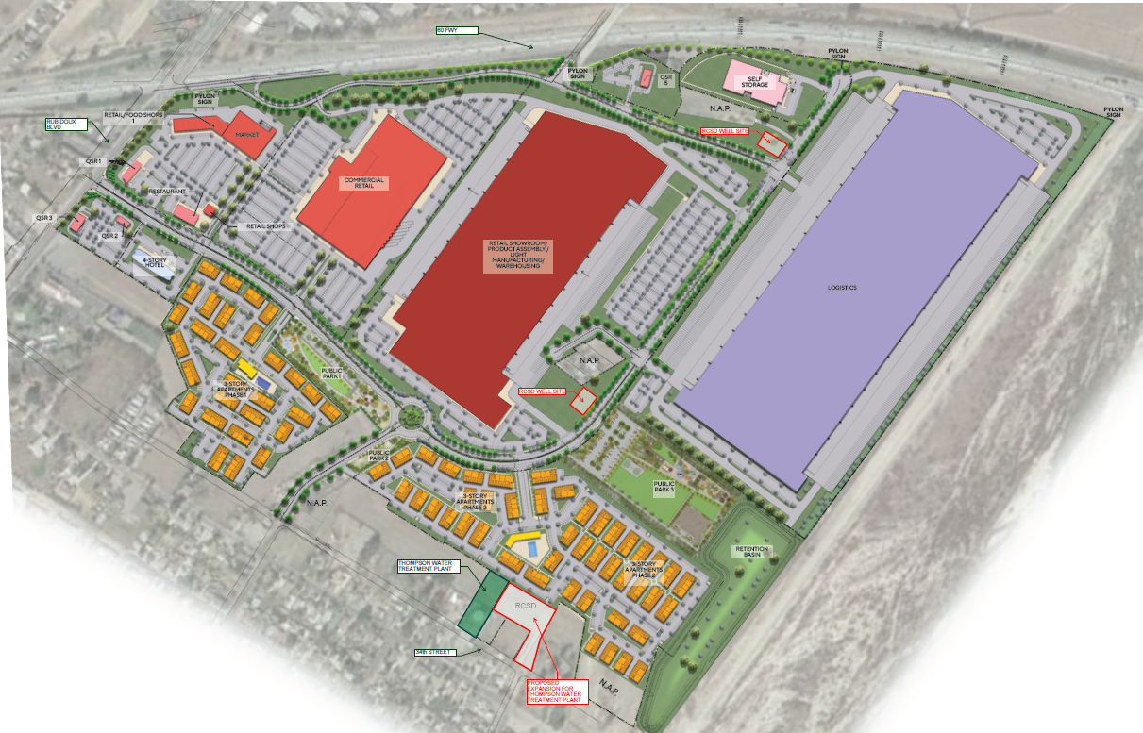
Illustrative Site Plan

Slide 4
Developer Agreements
Development Agreement (3/30/2023)
  Defined real property to be purchased by and conveyed to RCSD
  Amendment 1 (10/10/2023):
    Allowed for cash purchase option (original agreement was Water EDU Fee Credits only) for greater flexibility
  Amendment 2 (3/6/2025):
    Formalized transaction price for real property
      Lot 8 – Thompson WTF Expansion (1.35-acres): $1,385,075
      Lot 17 – Well 23 (.28-acres): $381,120
      Lot 18 – Well 24 (.25-acres): $366,533
      Total - $2,132,728
      District elected Water EDU Fee Credits

Slide 5
Raw Water Pipeline
Project
  Connect raw water from Well Sites 23 and 24 to expanded Thompson WTF.
Why?
  Well Sites 23 and 24 are in the District’s 2022 Water Master Plan and will need to be developed for ultimate system build-out and increased demand.
Who?
  Developer (EM Ranch Owner) Reimbursement Agreement.
  Utilize developer’s active construction presence and resources.
Why now?
  Land currently undeveloped.
  More efficient and cost-effective through economies of scale, shared materials and labor, and more efficient scheduling.
via

Slide 6
Developer Agreements
Reimbursement Agreement (Proposed 8/7/25):
  Purpose: Formalize terms, responsibilities, and cost obligations for the Raw Water Pipeline.
  Key Terms:
    Scope of Work: Construction of ~1,700 lineal feet of 12-inch pipeline and ~2,340 lineal feet of 18-inch pipeline
    Reimbursement:
      Pre-Construction Costs (~$58,000): Cash
      Construction and Management (~$1,130,000): Water EDU Credits ($6,800 per EDU)
    Bidding: Competitively bid at prevailing wage
    Inspection and Acceptance: District will inspect during construction, ensuring compliance with plans and District standards.
  Reimbursement Agreement reviewed by General Counsel

Slide 7
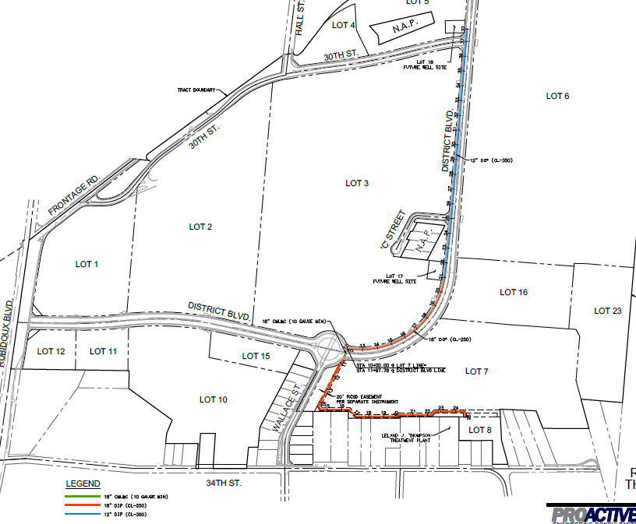
Raw Water Pipeline Alignment

Slide 8
Budget Considerations
Pre-Construction Costs (~$58,000) – Cash
  Funded by LAIF Water Mainline (current balance ~$3.0 million)
  Amend FY 25|26 Water CIP – Master Plan Project Budget
    Add new project “District at JV – Raw Water Pipeline” and fund at $60,000
Construction Costs (~$1,130,000) – Water EDU Credits
  No budget impact

Slide 9
Recommendation
Staff recommends the Board of Directors consider the following actions:
  Approve the Reimbursement Agreement with EM Ranch Owner, LLC to construct the Raw Water Pipeline for Tract No. 38318.
  Amend the FY 25|26 Water CIP – Master Plan Projects Budget by adding project “District at JV – Raw Water Pipeline” and funding the project for $60,000.

Slide 10
Questions
Rubidoux Community Services District
Office: 951.684.7580
www.rcsd.org
10

