Slide 1
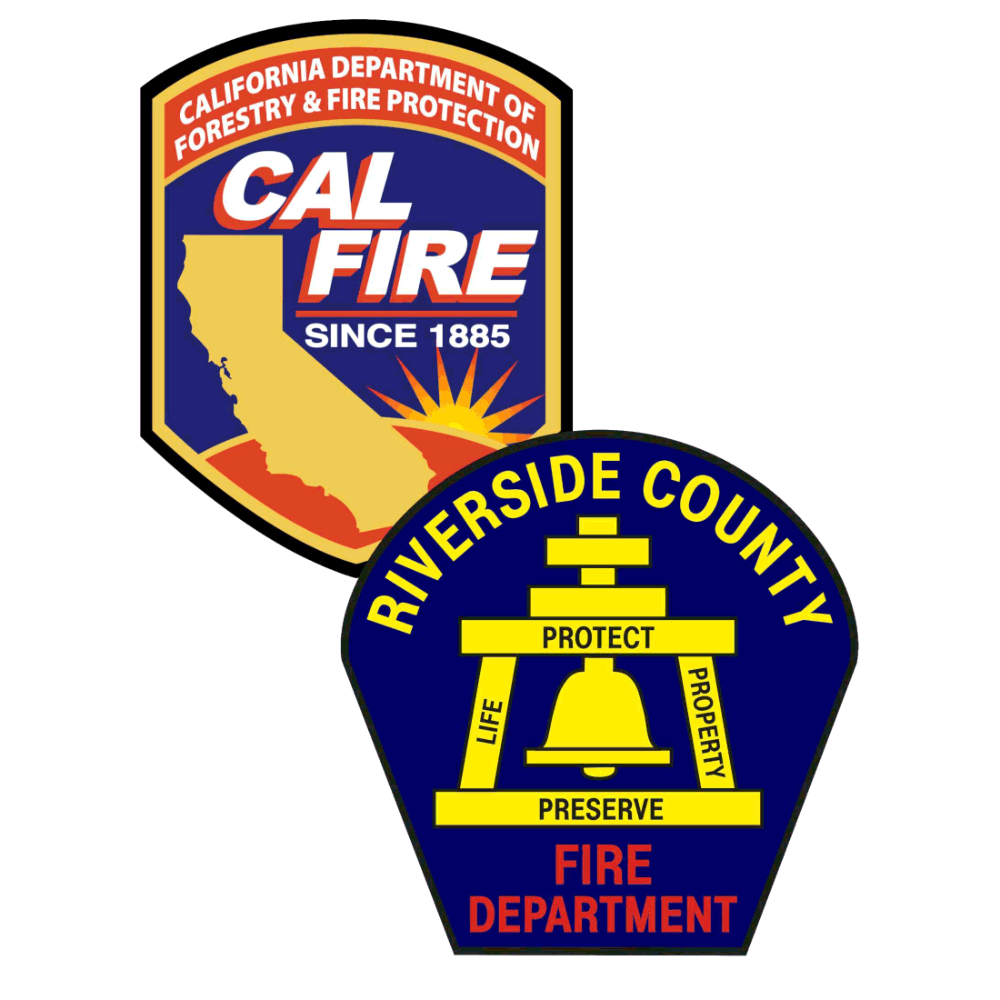

CAL FIRE / Riverside County Fire
Division Chief William Otterman

Slide 2
Proposed Questions
Are there vegetation and hazardous fuel management programs withing CAL FIRE? What are they and what do they entail?
Can we get a full report including pics of the local Clay Fire?
What’s CAL FIRE’s philosophy on prescriptive burns? Are they utilized in the area? How frequently, etc.

Slide 3
Vegetation Management Program
The goal of the Vegetation Management Program is to reduce the chance of large, damaging wildfires by reducing fire hazards on wildland in California.
Three Broad Goals
  Reduction
  Optimization of Soil and Water Productivity
  Protection and Improvement of Intrinsic Floral and Faunal Values

Slide 4
Vegetation Management Program
Fuel Brakes
Prescribed fire
  Pile burning
  Broadcast burning
Mechanical Removement
  Masticators
  Hand Crews
  Chippers

Slide 5
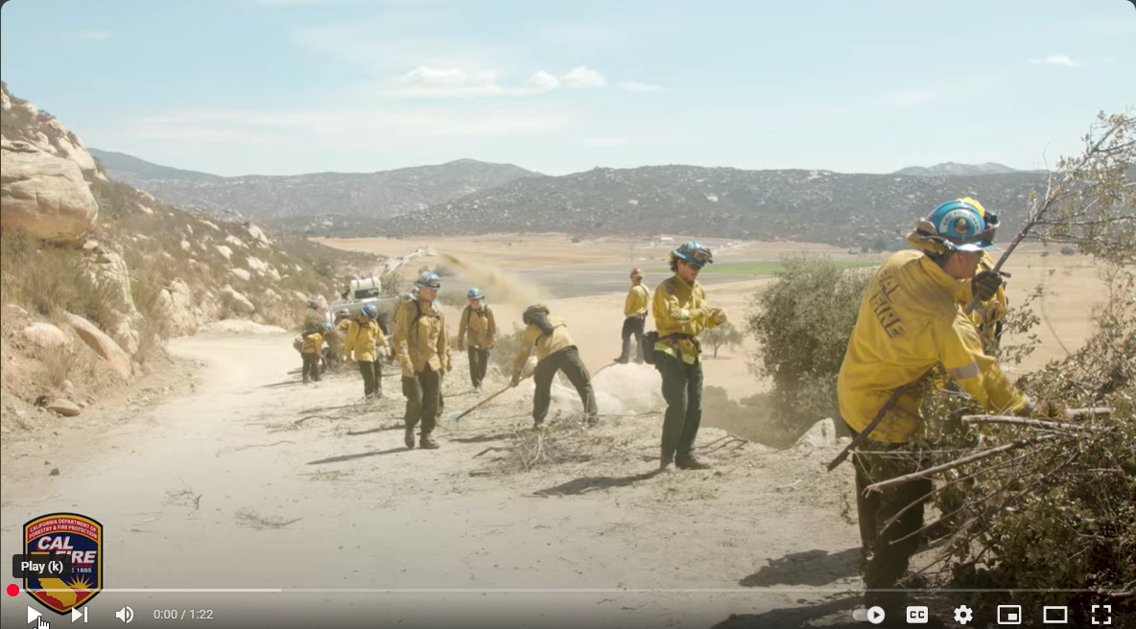
Fuel Breaks

Slide 6
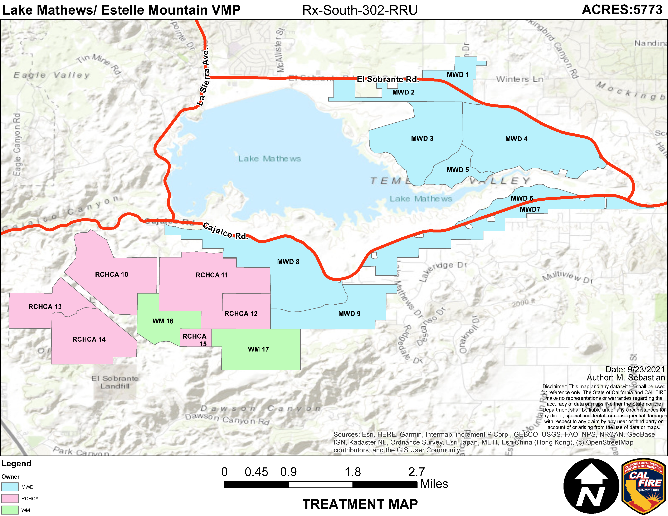
Multiple VMP Projects within Riverside County

Slide 7
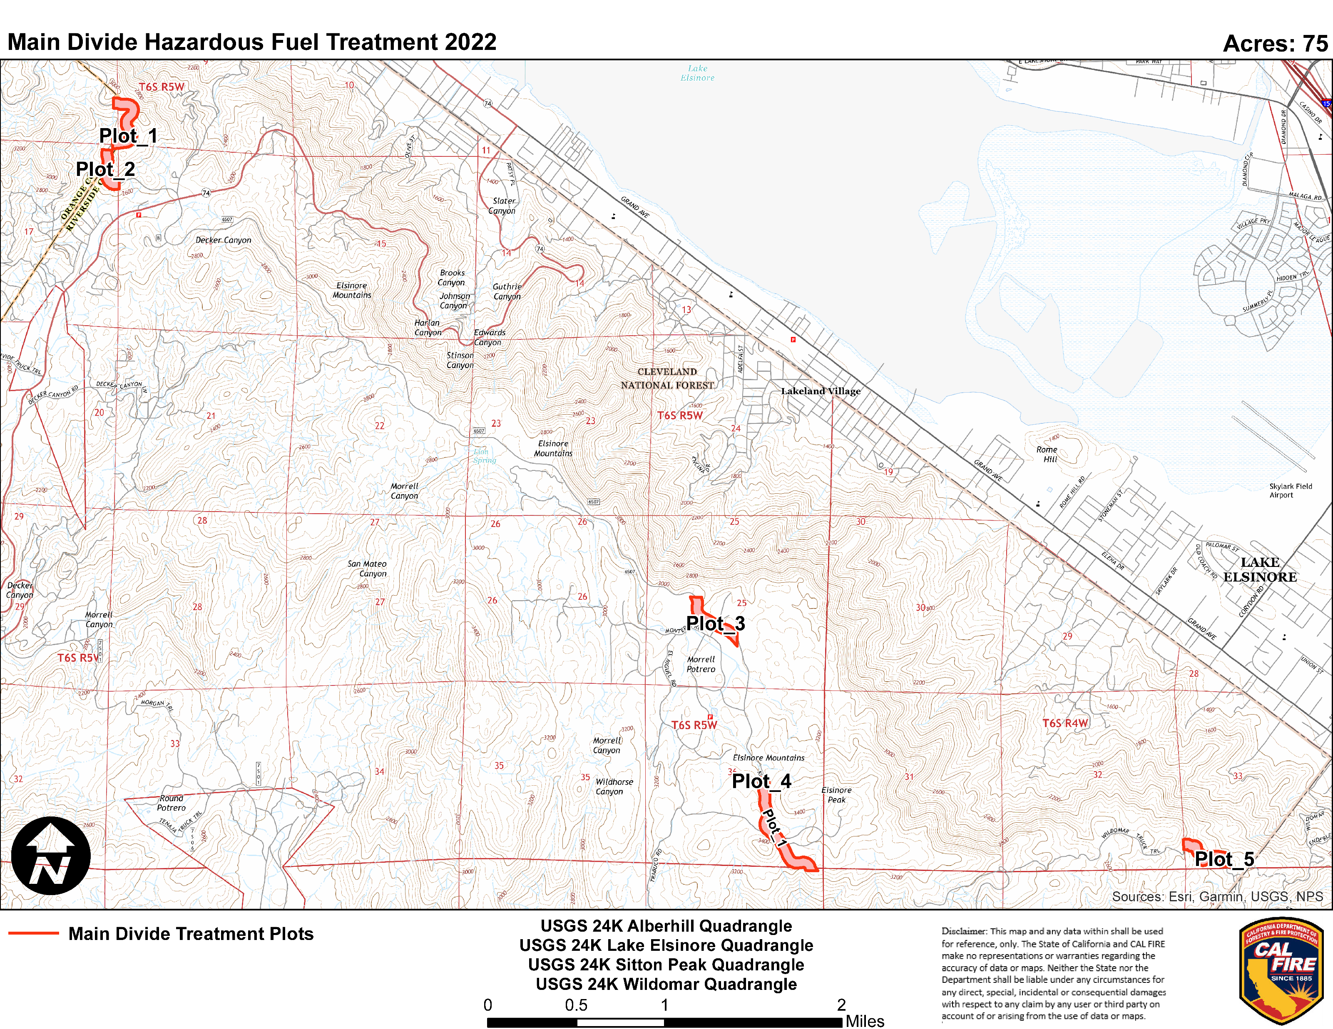
Multiple VMP Projects within Riverside County

Slide 8
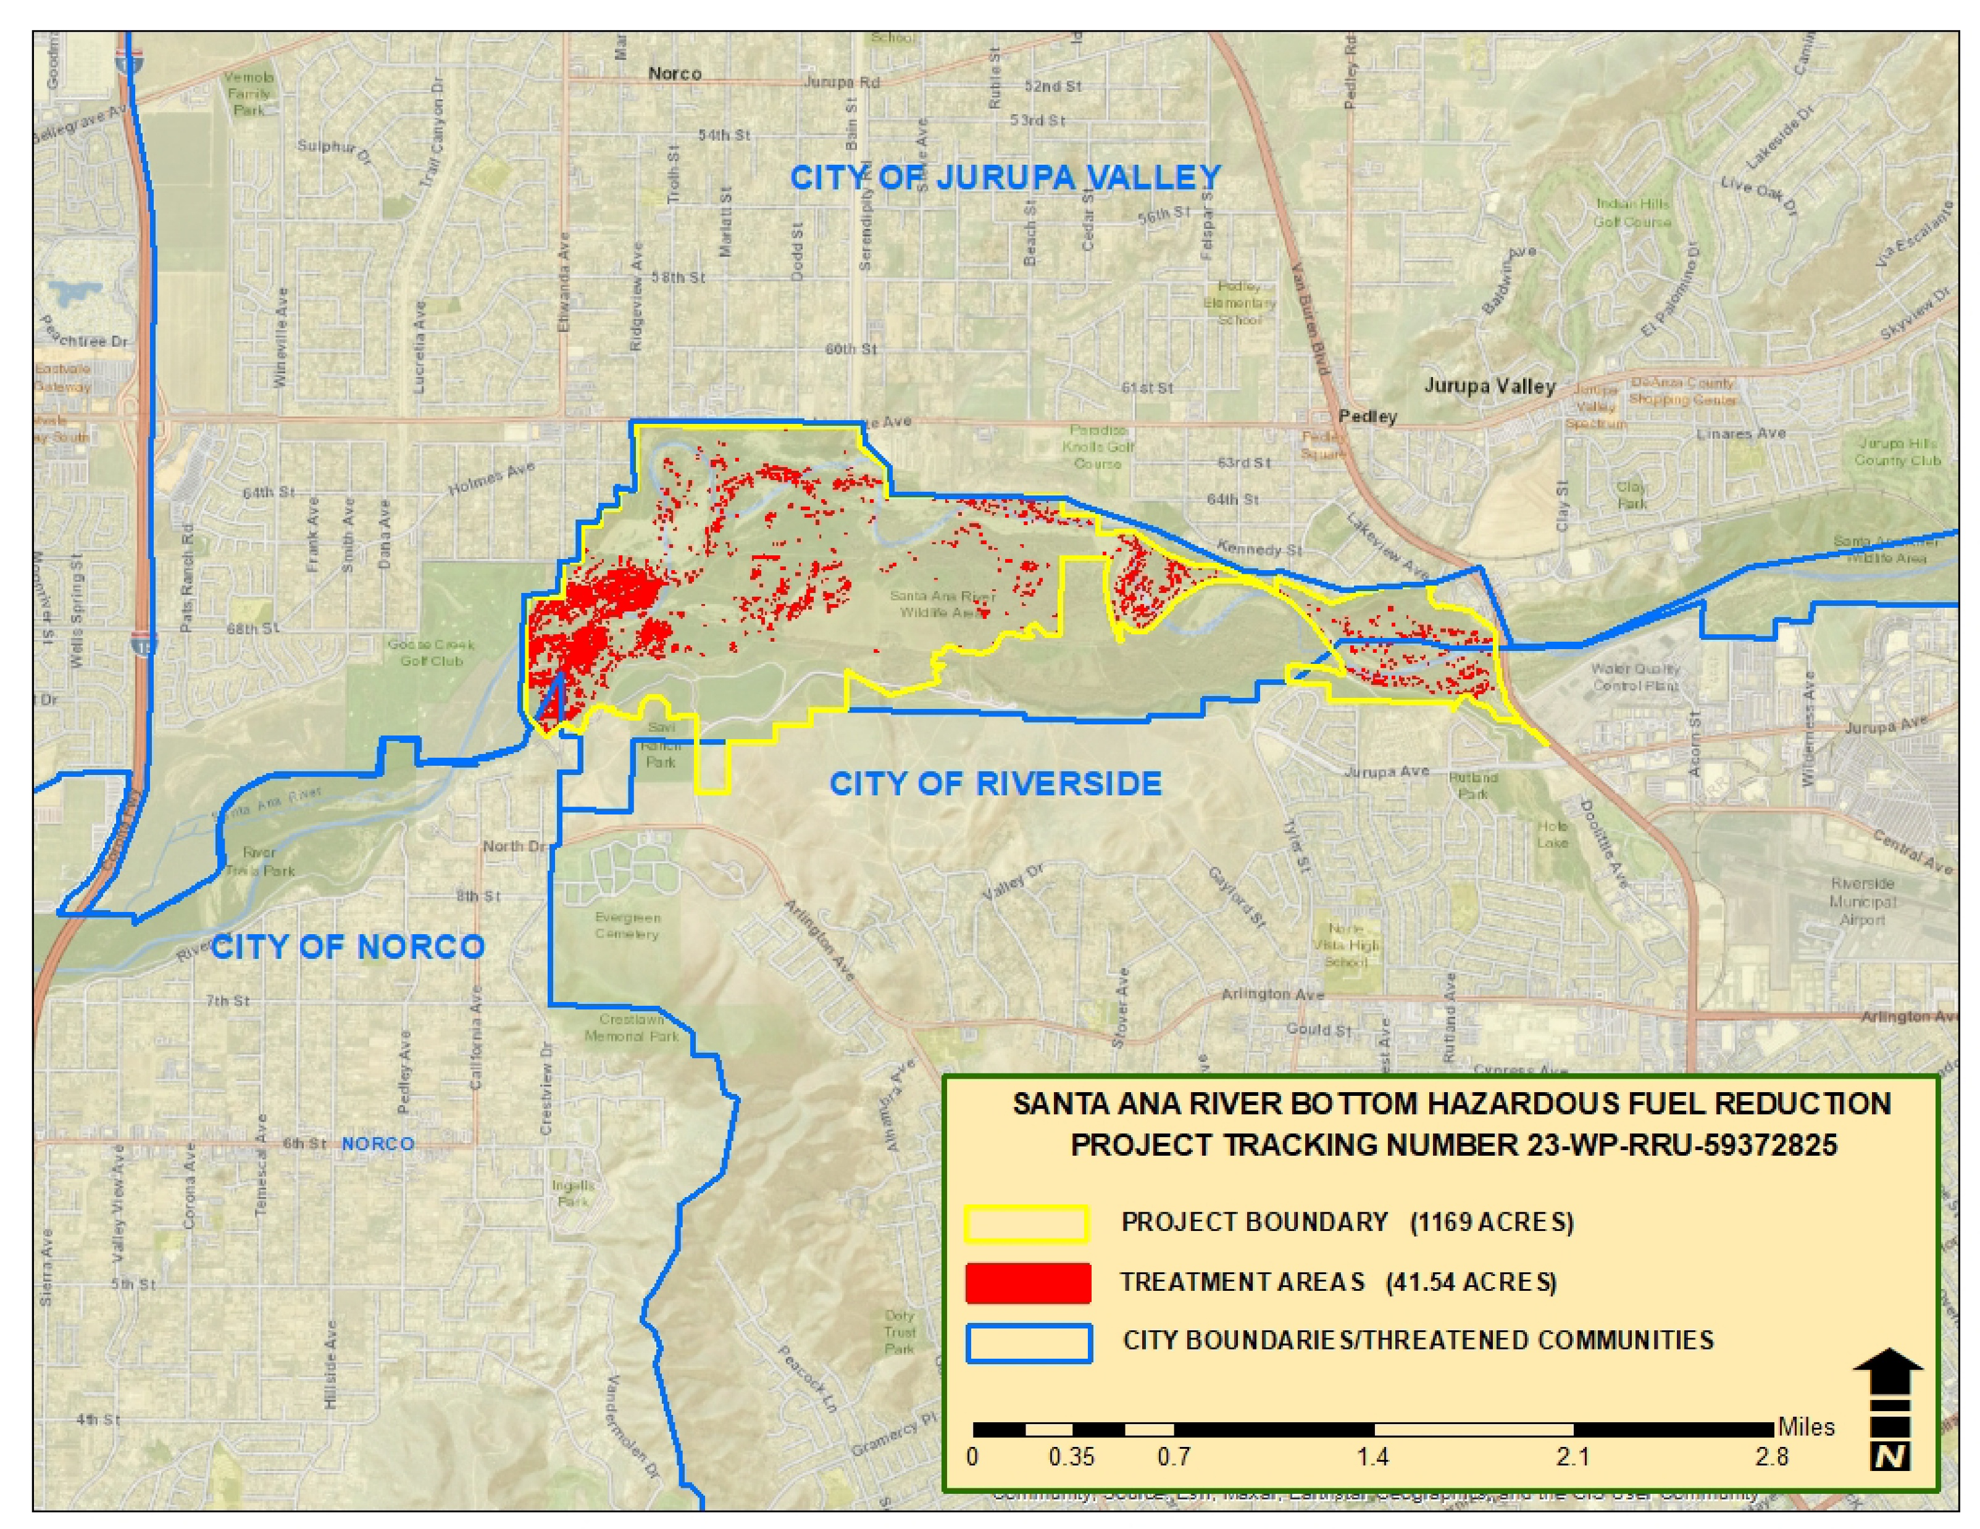
Multiple VMP Projects within Riverside County

Slide 9
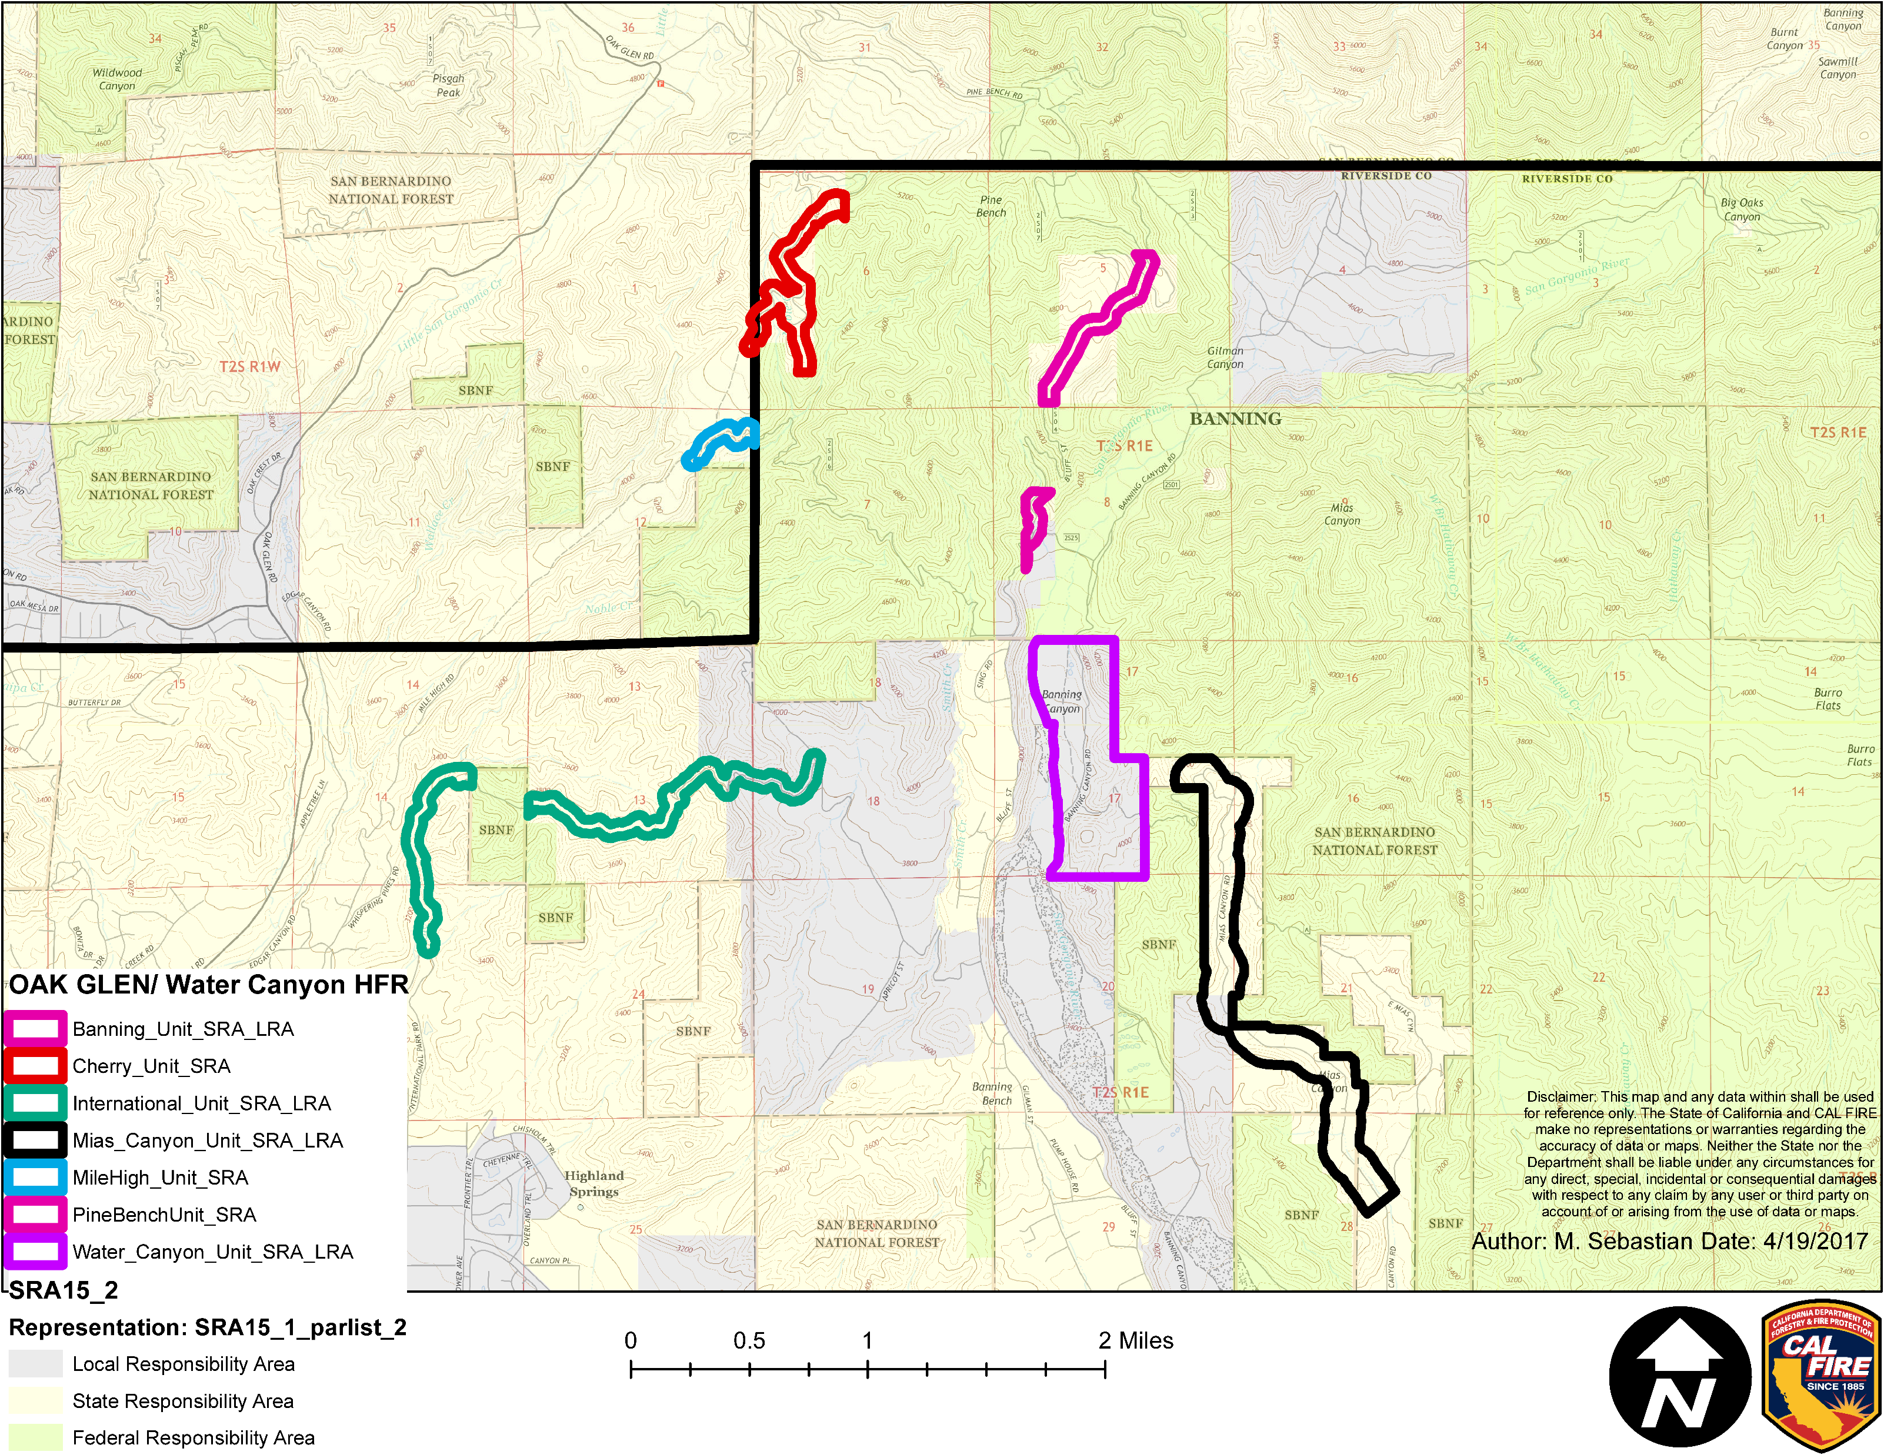
Multiple VMP Projects within Riverside County

Slide 10
Other VMP Projects
Astro Camp/Upper Dry Creek
Lake Skinner
Point of Rocks
Red Hill
Santa Rosa Plateau
Tenaja

Slide 11
Clay Fire
Fire started on January 21st at approx. 5:15pm
  Wind driven fire with low humidities
  Fire started by warming/cooking fire
Fire controlled on January 26th at 5pm
Total acres - 39
Total costs - $1,024,278

Slide 12
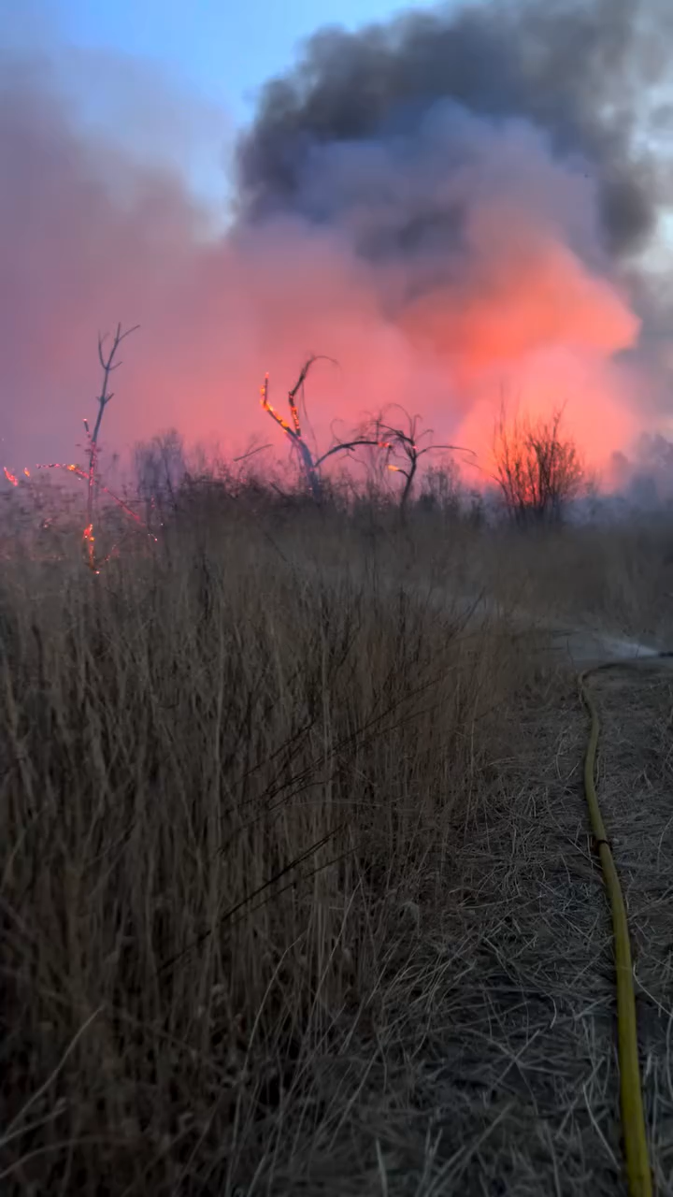

Slide 13
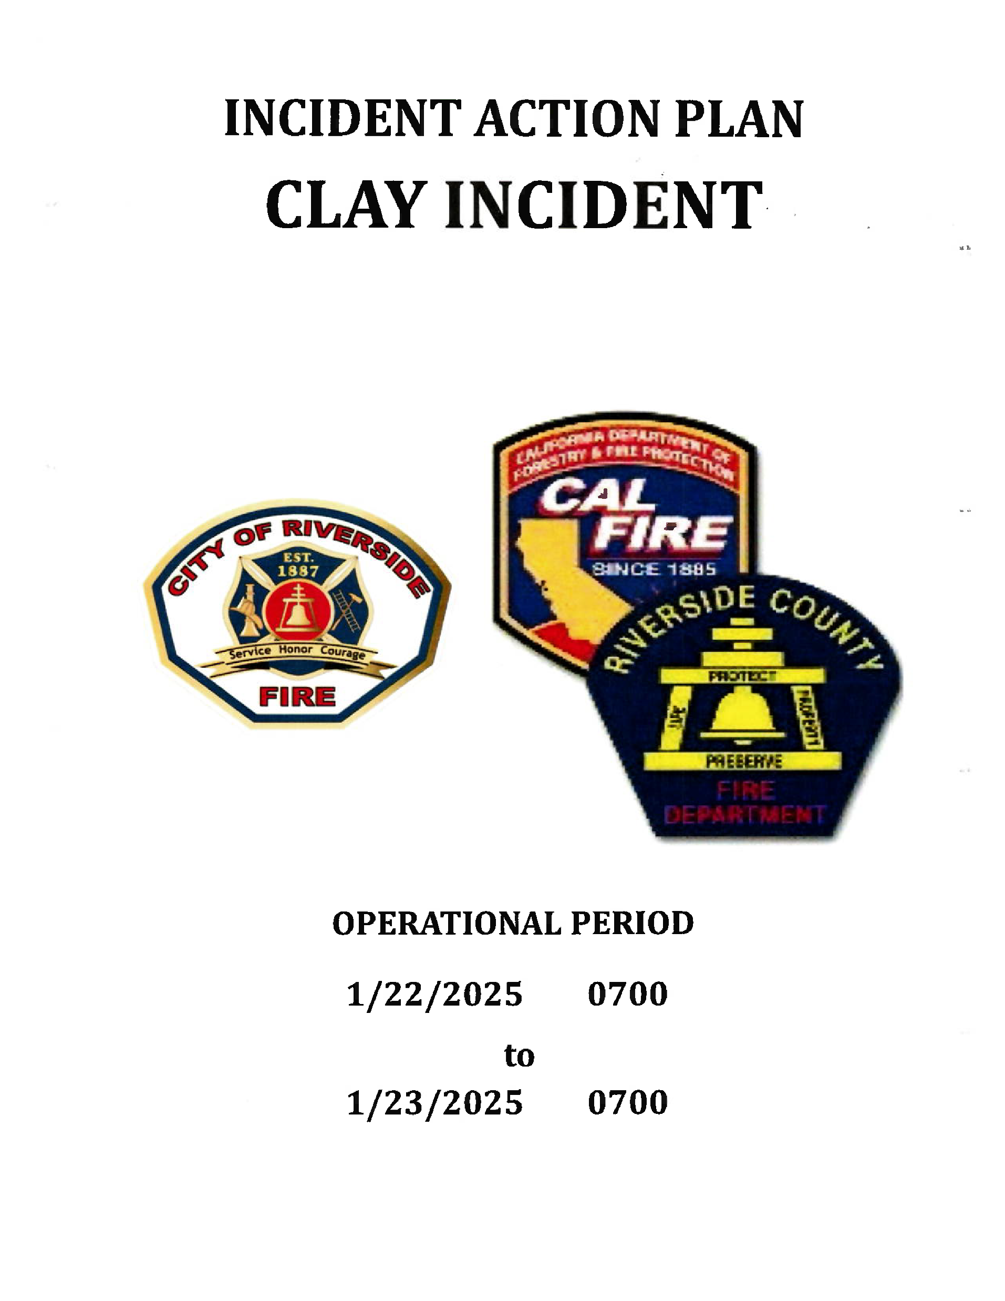

Slide 14
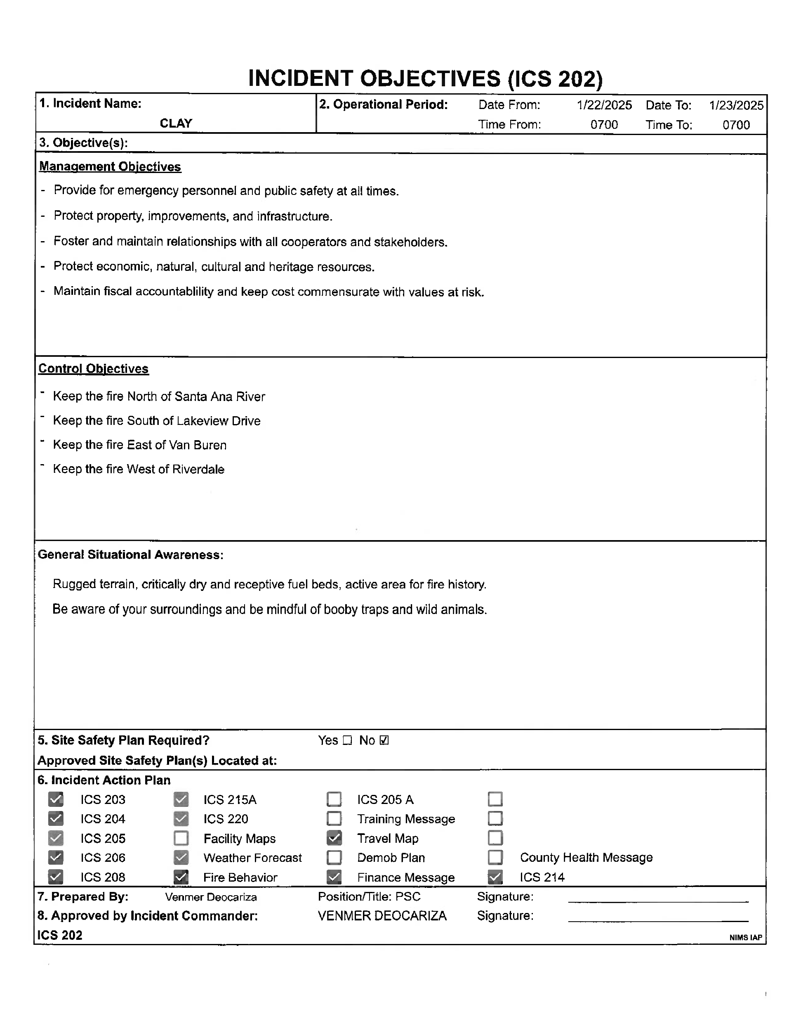
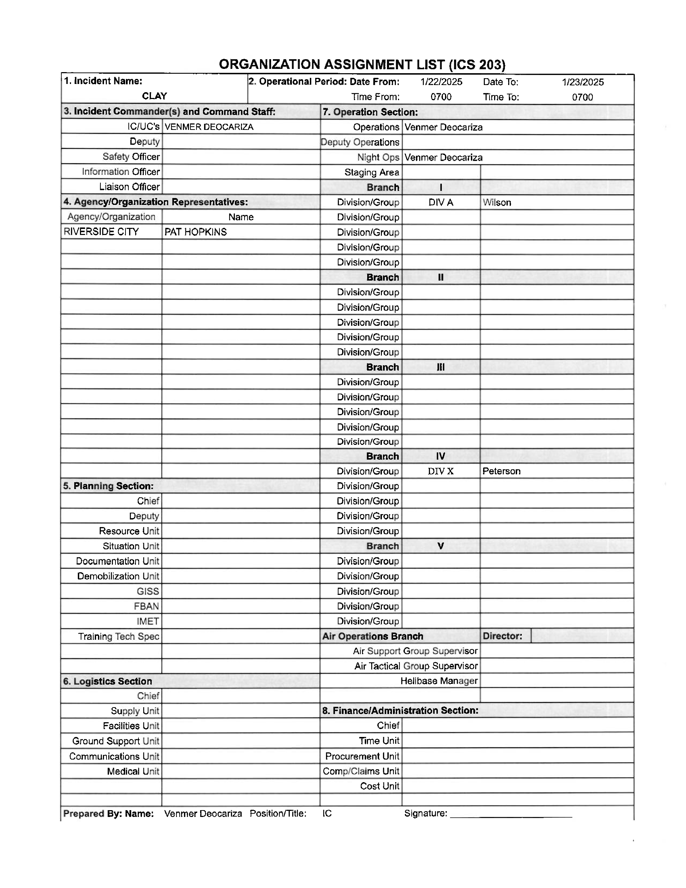

Slide 15
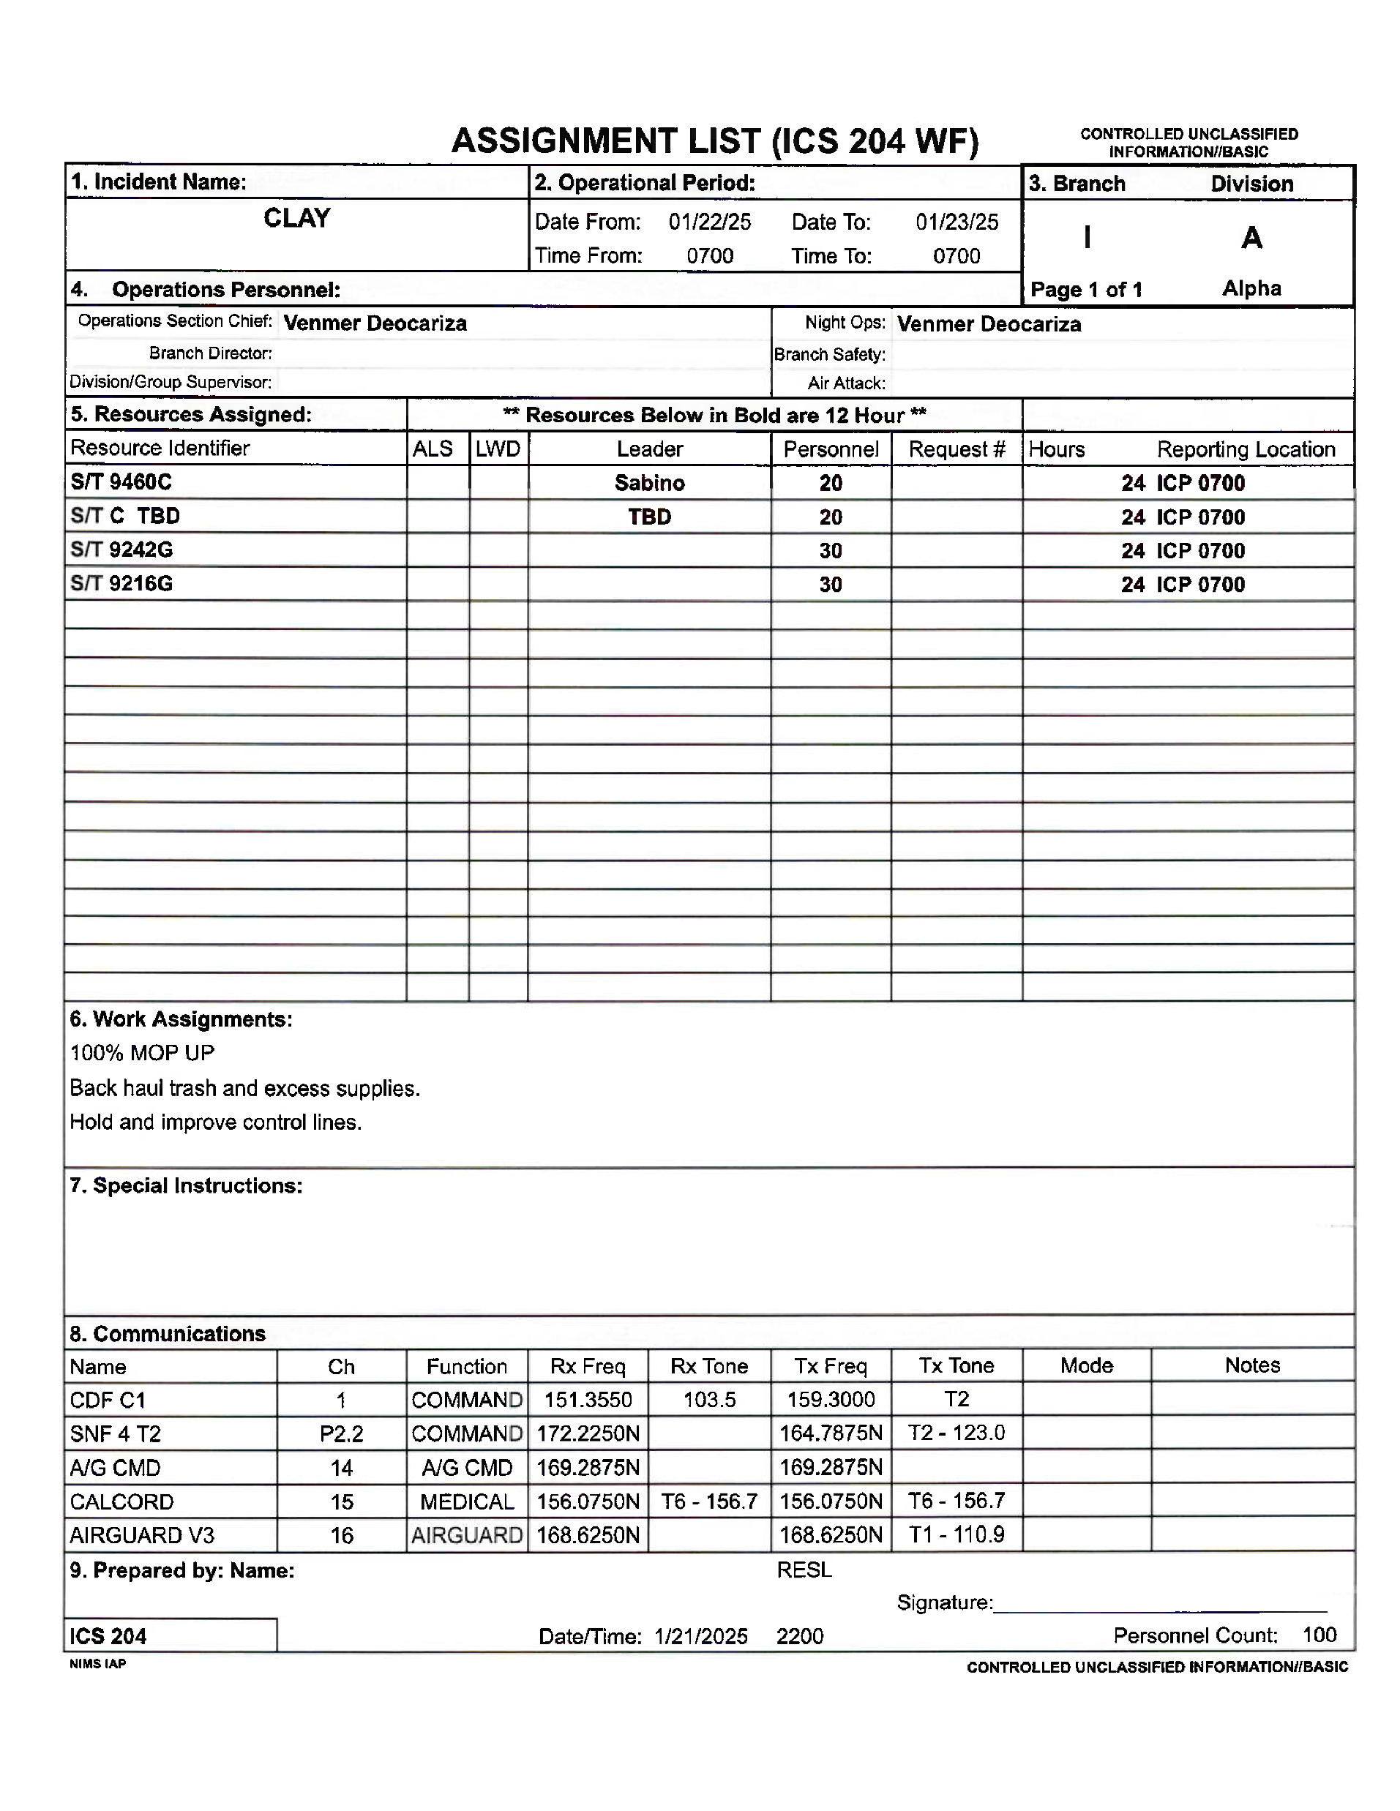
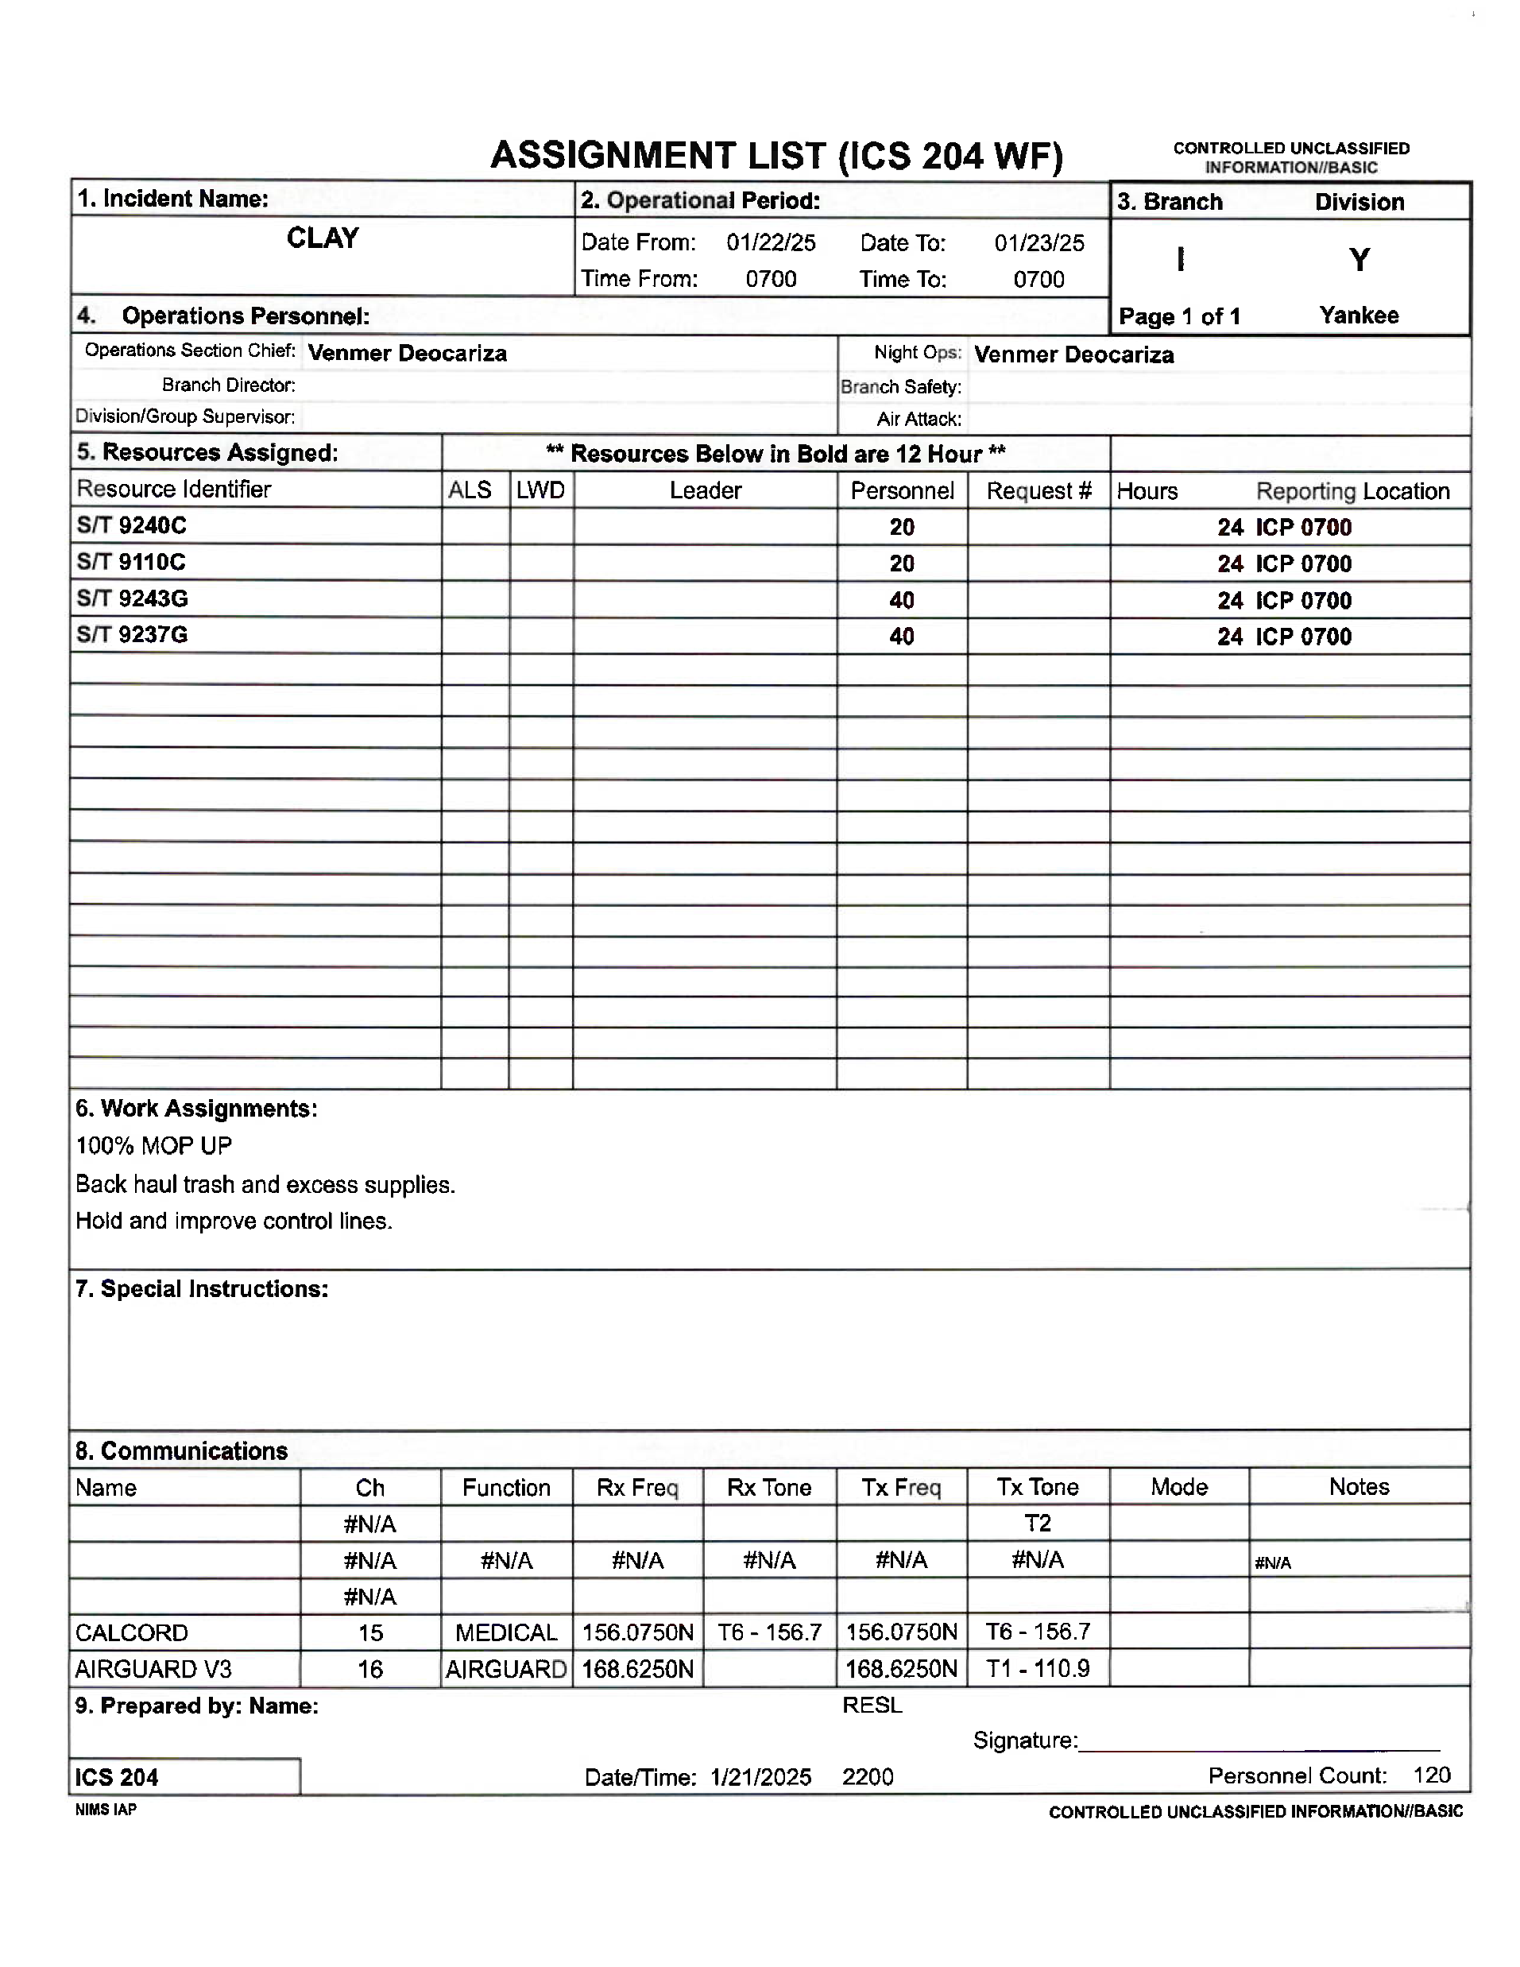

Slide 16
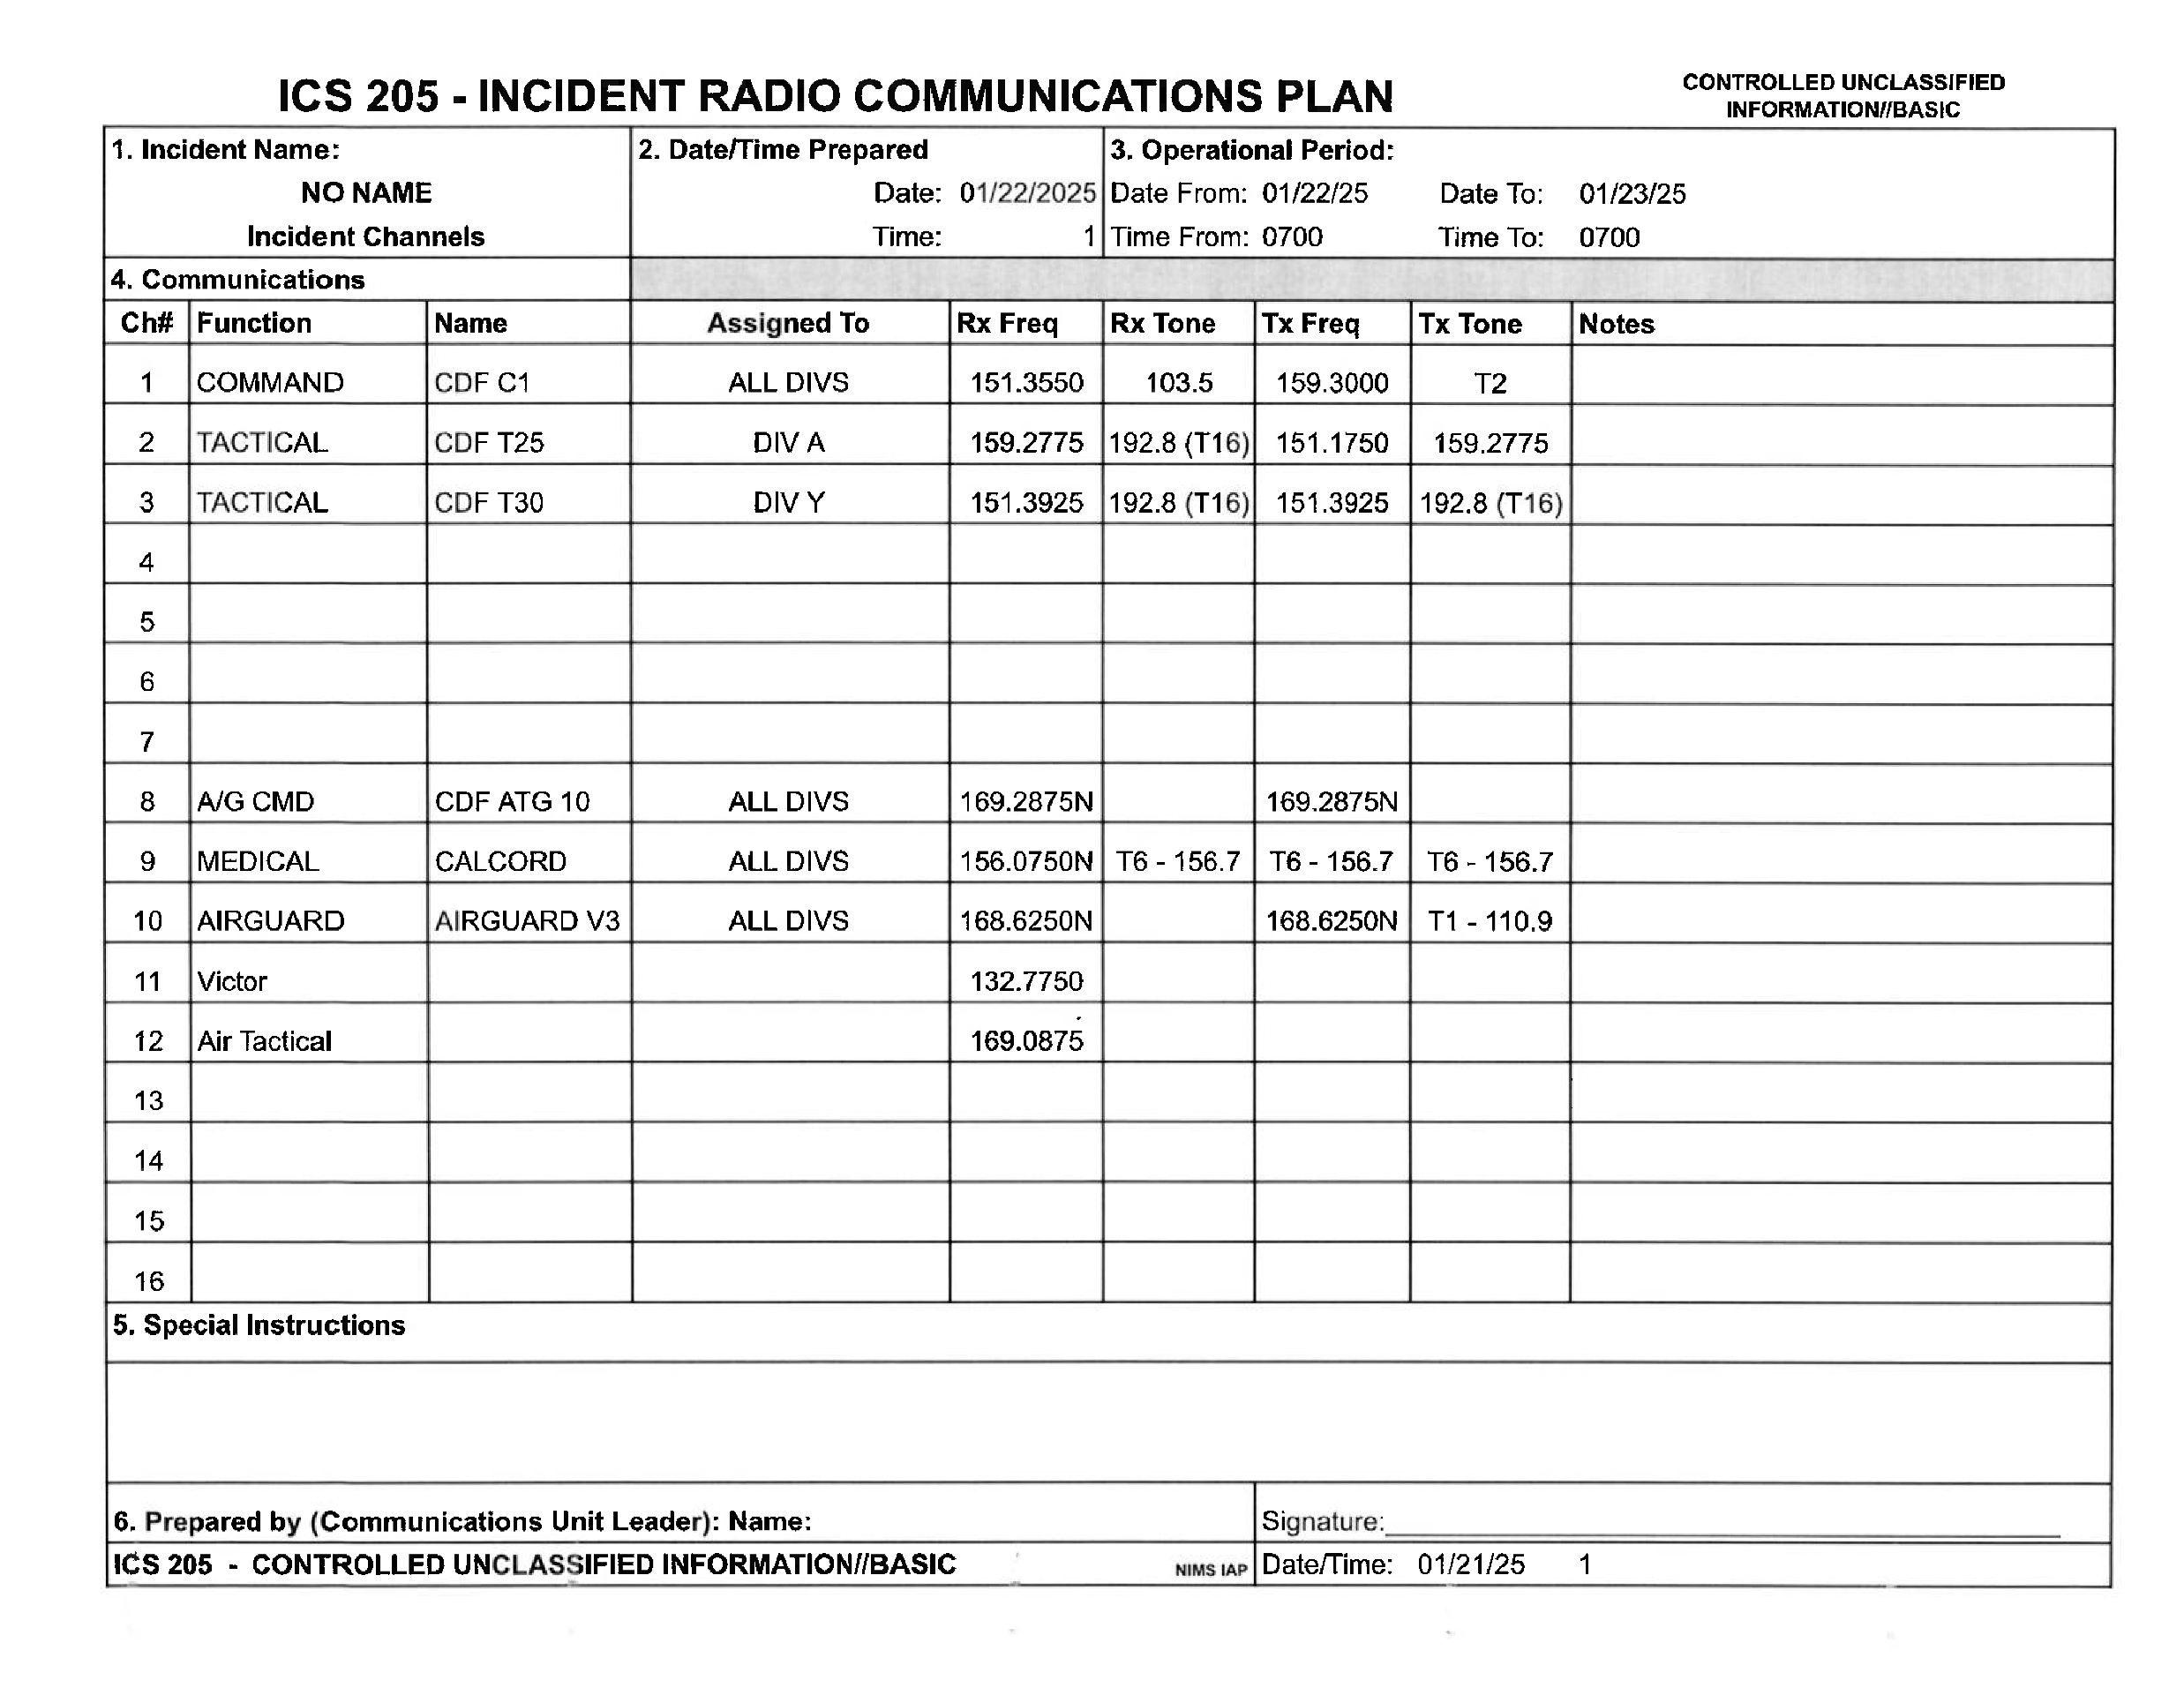

Slide 17
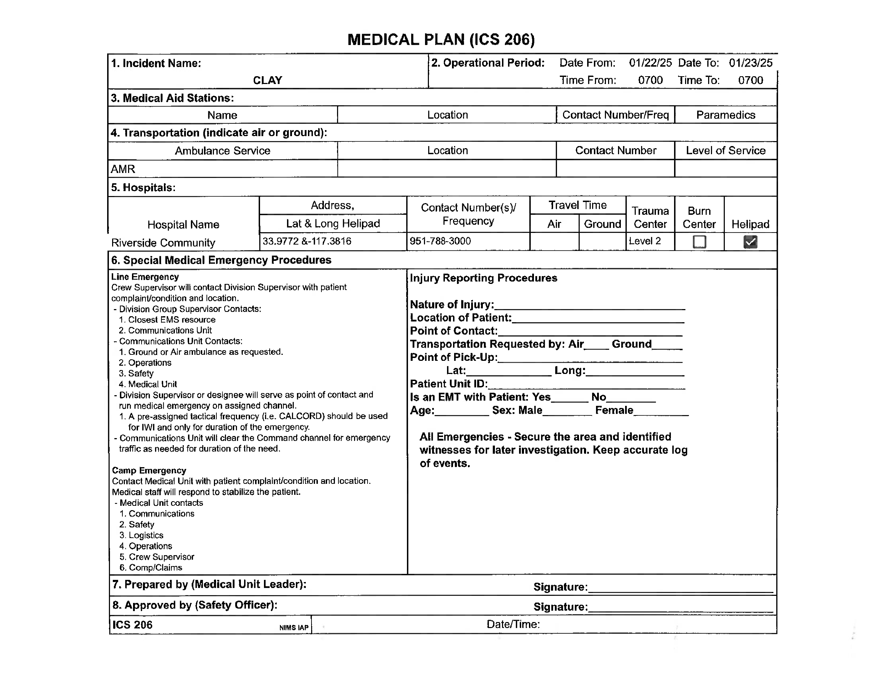

Slide 18
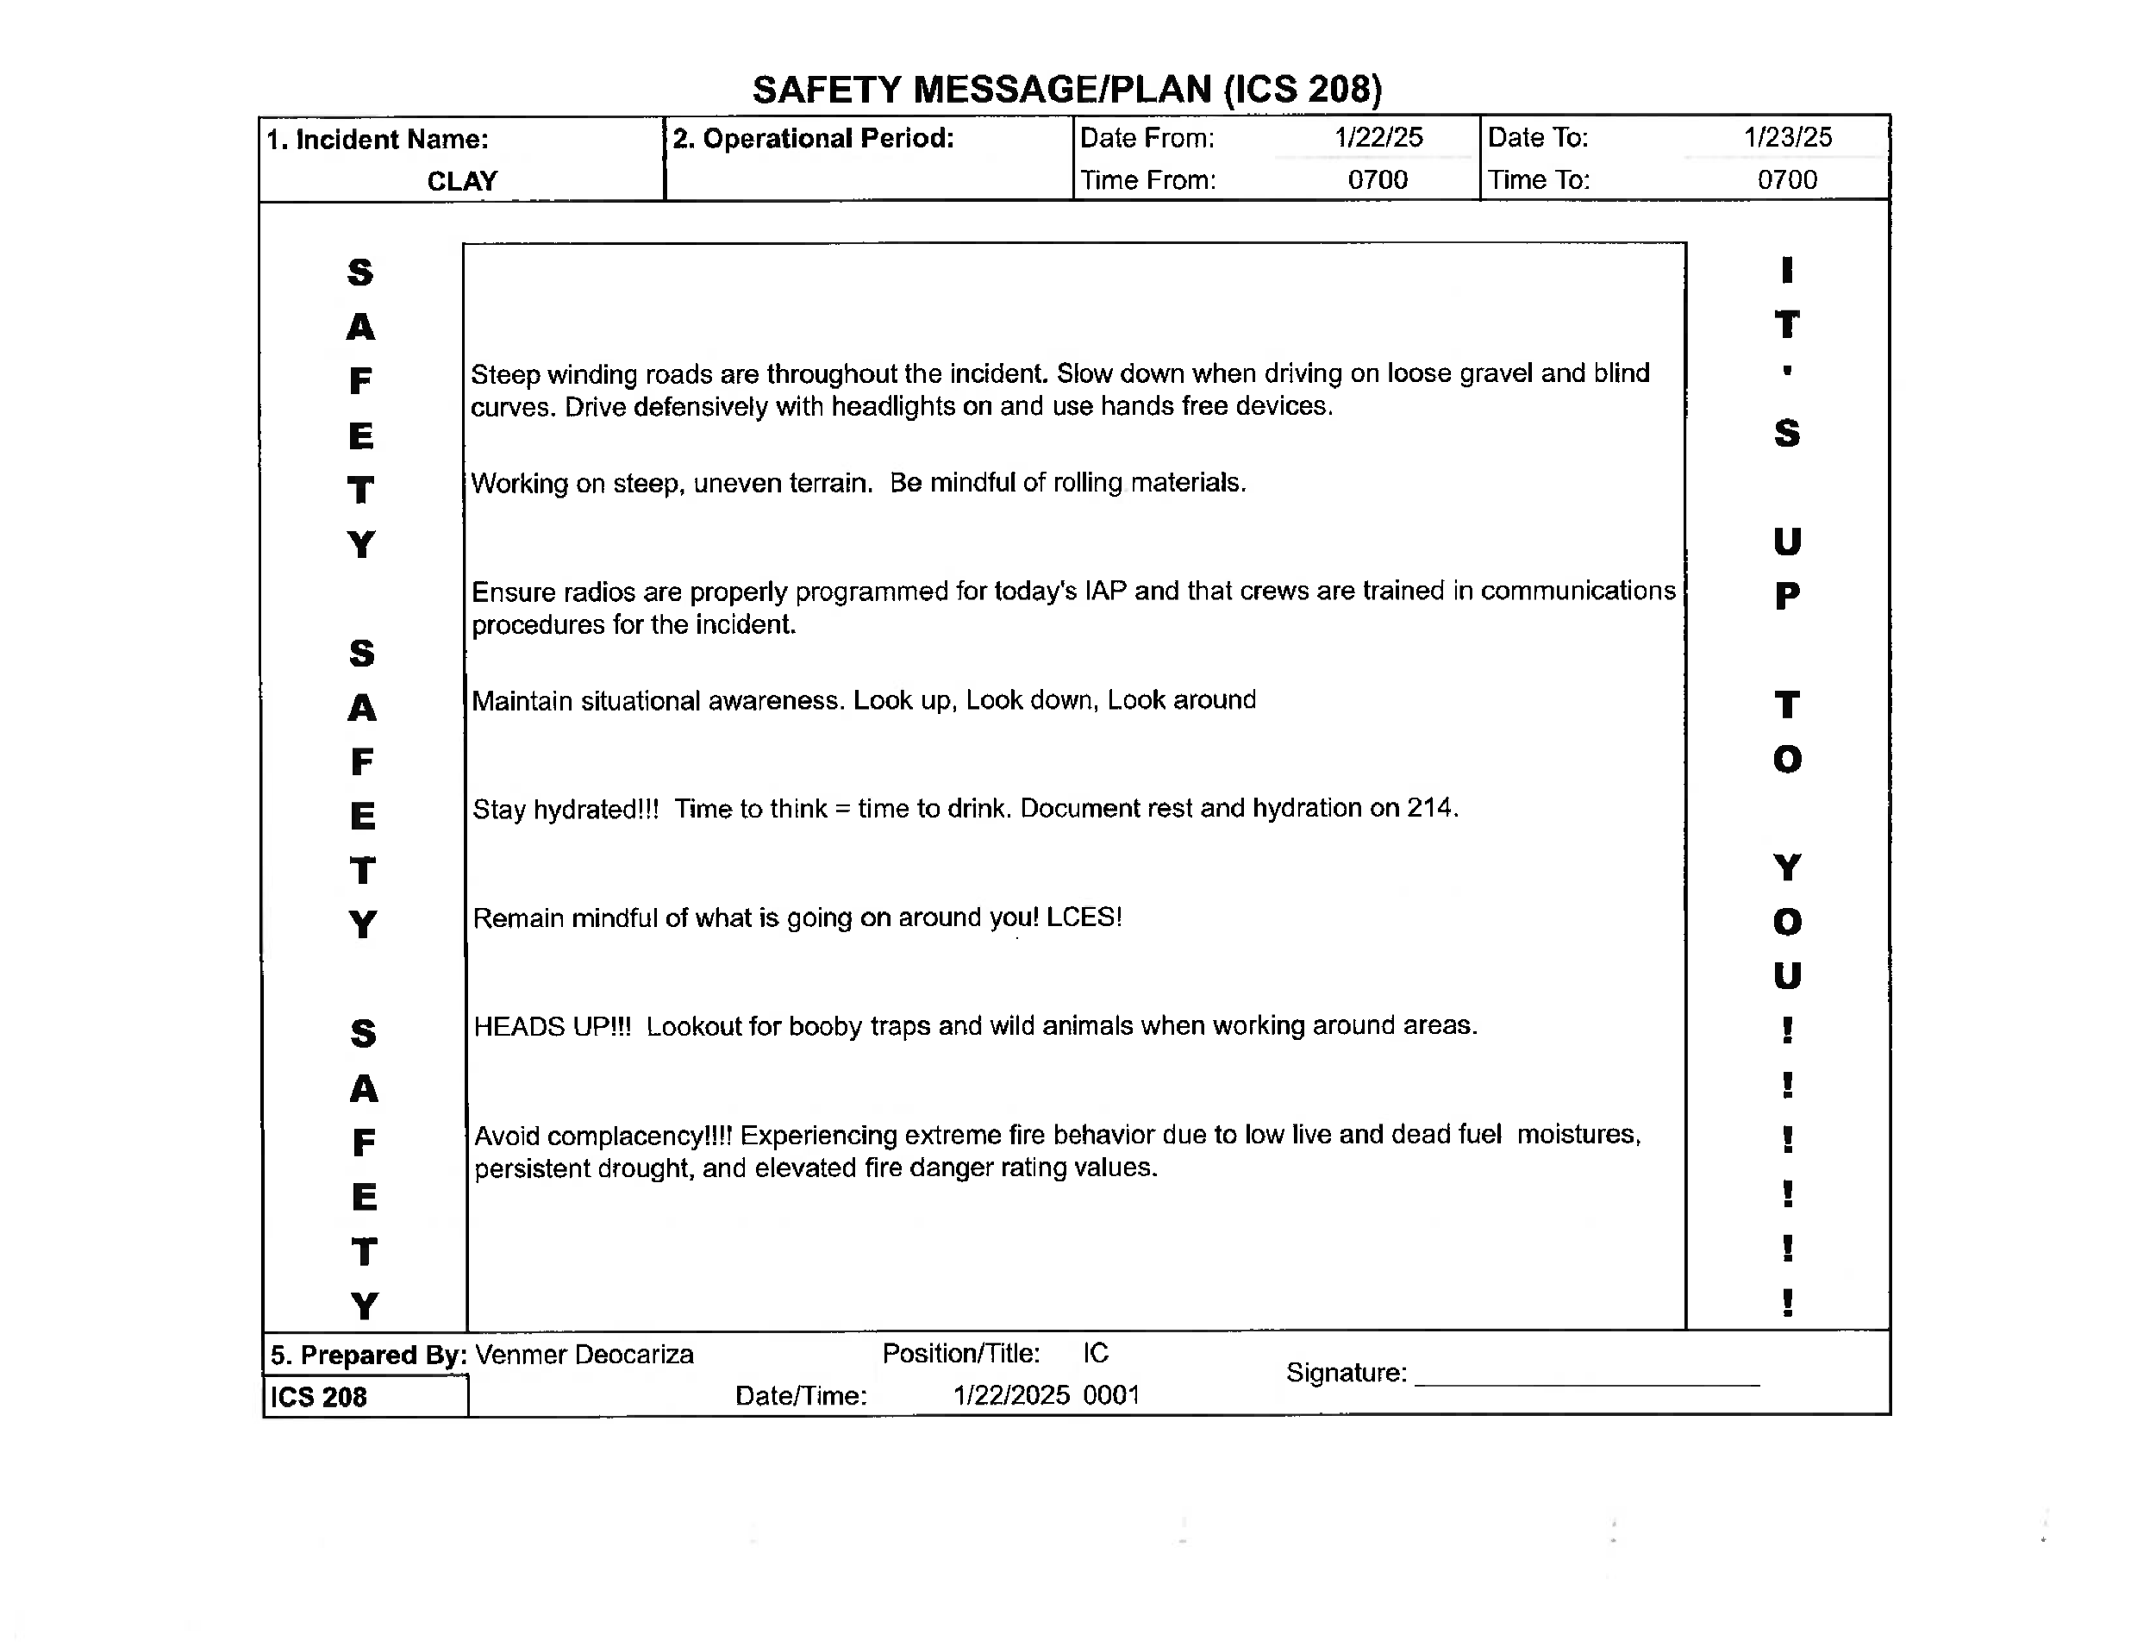

Slide 19

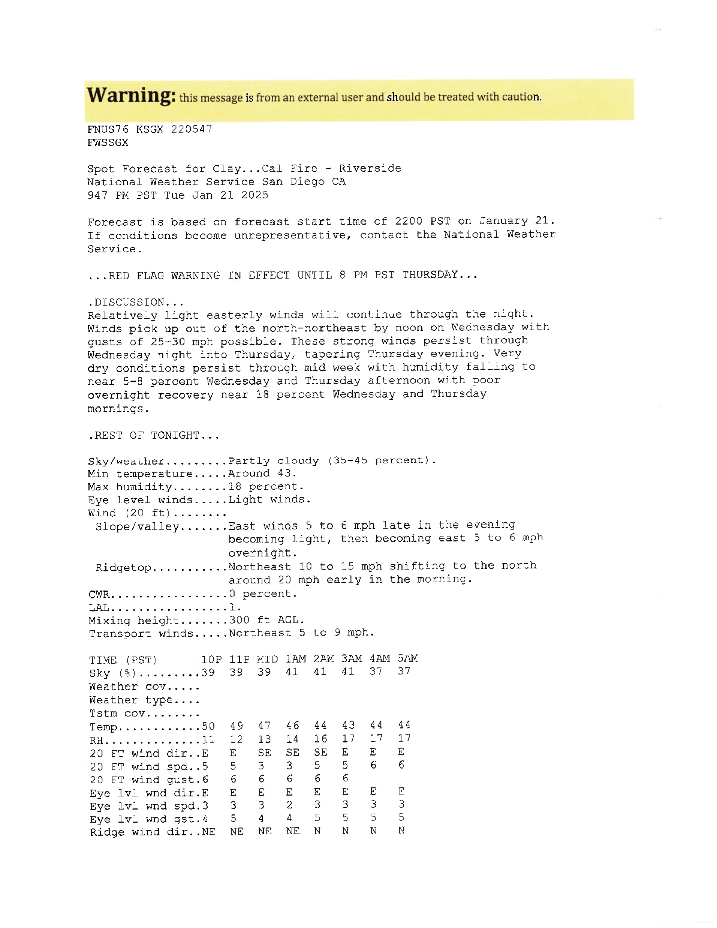

Slide 20
