Slide 1
Director Memorandum 2025-86 Consider Adoption of Resolution No. 2025-929, A Resolution of the Rubidoux Community Services District Transferring Certain Property Tax Revenue Between the County of Riverside and the Rubidoux Community Services District; LAFCO Cases 2022-19-2 and 2022-20-2
October 2, 2025

Slide 2
Background
LAFCO Annexation – Began 2019 (District staff)
Clean up existing service area boundaries
“Donut holes” “islands”
LAFCO – Local Agency Formation Commission
Created in CA (1963) – Each county has its own LAFCO
Purpose:
Independent regulatory bodies
Oversee formation, dissolution, and boundary changes of cities and special districts
Encourage orderly formation and development of local government agencies

Slide 3
Background
Annexation
What is it?
Common way to adjust service area boundaries
Common with new development (Rio Vista)
Aligned with jurisdiction of local agency best positioned to serve the area
Process
Agency prepares Plan of Service, legal descriptions
Agency submits LAFCO application
LAFCO staff analyze proposal
Existing service capacity
Financial impacts
Land use
Community needs
LAFCO conducts publics hearing and decides to approve, modify or deny the annexation request

Slide 4
Background
Previous Annexation
LAFCO Nos. 2019-07-2 and 2019-08-2 (Rio Vista)
DM 2025-18 (March 20, 2025) (Res. No. 2025-925)
Not related to tonight’s LAFCO consideration
Current Annexation
LAFCO Nos. 2022-19-2 and 2022-20-2
Intention: “clean-up” “donut holes”
Difficulties:
Existing county records are decades old, in some cases over 50 years
Irregularities from historical mapping practices, incremental development patterns, or jurisdictional overlaps
Never fully reconciled through LAFCO action

Slide 5
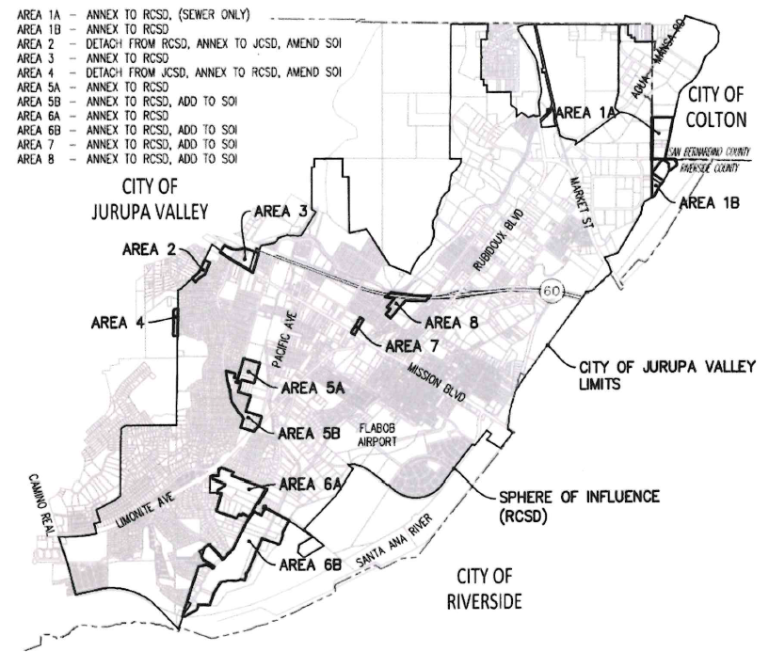
Background
Proposed Vicinity Map

Slide 6
Background
Current Annexation
In 2020, District hired TKE Engineering to assist staff with technical aspects of the application
11 total areas
296 acres
Affecting 214 single-family residential and commercial/industrial lots
Most of the affected parcels are in the “donut holes” that were already receiving District services, no change in service provider, i.e., no customer impact (billing practices)
Plan of Service – Coordinated with JCSD and West Valley
Plan of Service, legal and plats
Completed June 2025
Next steps

Slide 7
Background
LAFCO Consideration (October 16, 2025 – 9 am)
Case 1 (2022-19-2): Sphere of Influence Amendments
Case 2 (2022-20-2): Reorganization to Detach/Annex Areas Between RCSD and JCSD
But before…..

Slide 8

Background
Tax Revenue Transfer (Res. No. 2025-929)
District receives 100% of the structural fire protection property tax for all parcels in its service areas
To fund fire protection services via contract with the County of Riverside (CalFire)
Post annexation, District expects a net increase of $38,000 in annual property tax revenue.
Requirements:
Negotiation with County of Riverside
Dual resolutions
RCSD: Res. No. 2025-929 (tonight)
County: Resolution (to be considered 10/7/25)

Slide 9
Recommendation
Staff recommends the Board of Directors consider the following action:
Adopt Resolution No. 2025-929, A Resolution of the Rubidoux Community Services District Transferring Certain Property Tax Revenue Between the County of Riverside and the Rubidoux Community Services District; LAFCO Cases 2022-19-2 and 2022-20-2

Slide 10
Questions
Rubidoux Community Services District
Office: 951.684.7580
www.rcsd.org
10

