Slide 1
Heli-Hydrant System Installations
JCSD-RCSD Partnership

Slide 2
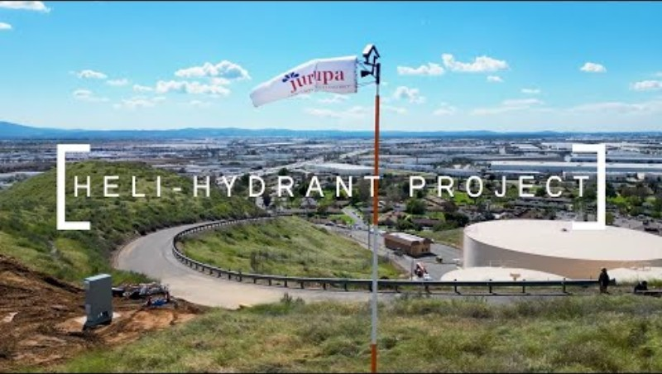

Slide 3
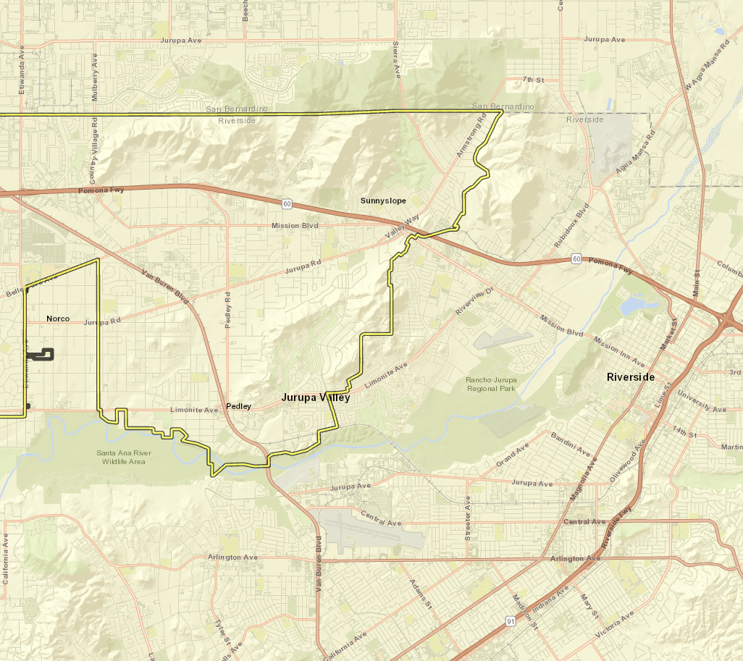
Heli-Hydrant
Installations
JCSD to install four Heli-Hydrants across its service area
  Locations determined collaboratively with CalFire, targeting fire-prone areas near reliable water supply sources that are safely accessible by helicopter
Two Heli-Hydrants planned near RCSD boundaries
Each installation ~$500K
Heli-Hydrant Location
JCSD Service Boundary

Slide 4
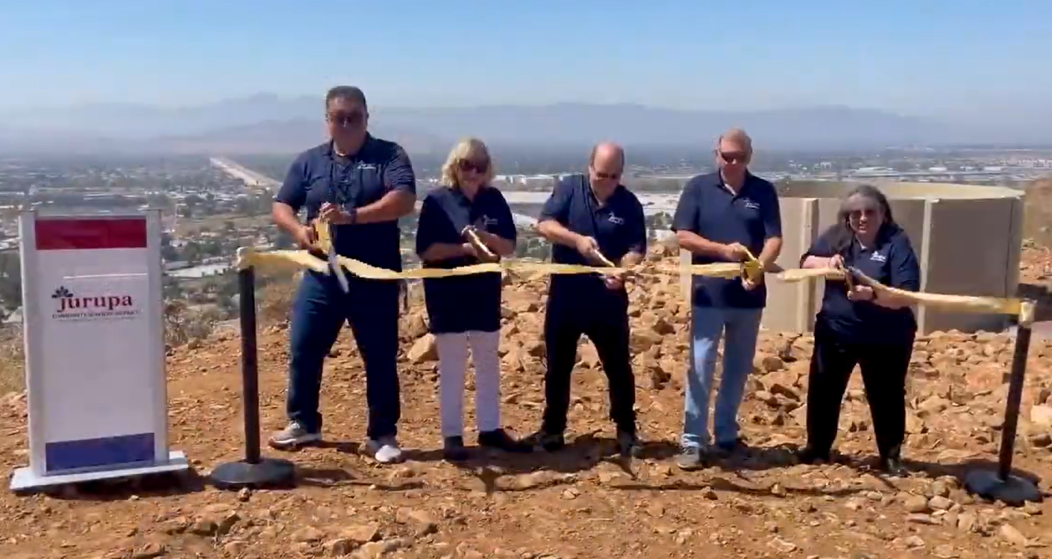
JCSD-RCSD Partnership
Signage at two locations near RCSD boundaries with logos of partnering agencies
News releases identifying project partnership when installations are completed and online
Partnership recognized on JCSD website – Public Safety and Wildfire Protection page

