Slide 1

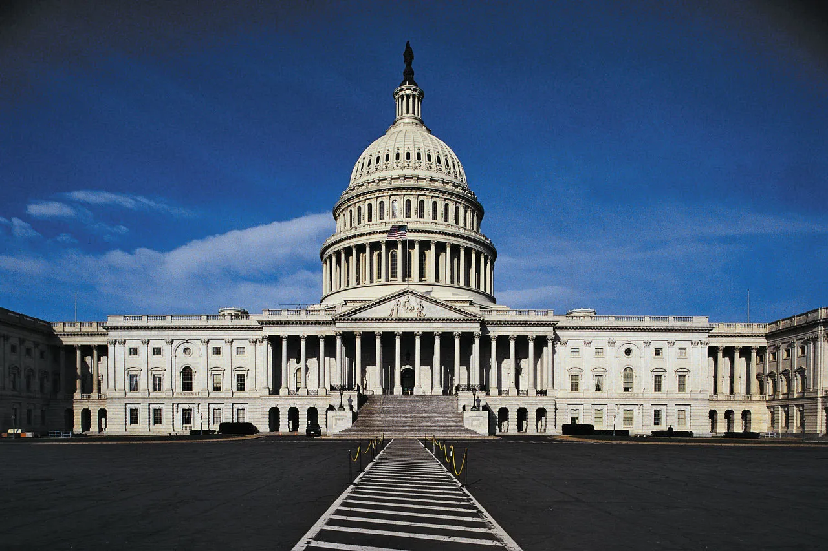
October 1, 2026
Consider Award of Professional Services Agreement and Issuance of Task Order to Kiley & Associates, LLC, for Federal and State Government Affairs and Legislative Advocacy Services
A short-term investment to complement the District’s successful grant-writing efforts with proactive advocacy, relationships, and funding strategy.
DIRECTORS MEMORANDUM 2026-84
Notes:
Template use: replace every bracketed field.
Replace the cover-photo box with one strong image and remove the placeholder box and text.
Keep the cover concise. Use Find and Replace to update [MEETING DATE] throughout the deck.

Slide 2
Where We Are Today
The District has already built a successful grant-development foundation.
$4M+
Grant Writing Works
Next Step
More than $4 million in grant funding secured over the past five years through partnerships primarily with Blais & Associates, with limited use of Webb & Associates.
The District has developed effective partnerships to identify programs, develop applications, and pursue competitive funding.
Grant writing can be strengthened by adding an ongoing government affairs function focused on relationships, timing, advocacy, and positioning.
The proposal is not to replace grant writers --- it is to complement them.
RUBIDOUX COMMUNITY SERVICES DISTRICT | October 1, 2026
1
Notes:
Template use: replace all three photo boxes with project evidence and update each caption.
Use the bottom band for the recommended solution and the major scope components.
Keep the scope summary brief. Put detailed technical requirements in the Directors Memorandum or attachment.

Slide 3
Why Add Government Affairs
Move from primarily responding to opportunities to positioning the District earlier in the process.
Develop relationships with congressional offices, state legislative offices, and relevant federal and state agencies.
Monitor legislation, appropriations, budgets, regulations, and funding programs before opportunities are formally released.
Position District projects and priorities for potential funding and advocacy opportunities.
Ex. Reservoir Replacement Project
Coordinate advocacy with the District’s existing grant-writing resources.
Provide staff with an external resource that operates as an extension of the District without adding a new full-time position.
RUBIDOUX COMMUNITY SERVICES DISTRICT | October 1, 2026
2
Notes:
Template use: replace all three photo boxes with project evidence and update each caption.
Use the bottom band for the recommended solution and the major scope components.
Keep the scope summary brief. Put detailed technical requirements in the Directors Memorandum or attachment.

Slide 4
A New Federal Funding Avenue
Congressionally Directed Spending (CDS) and Community Project Funding (CPF)
What is different?
What advocacy would do
RCSD has not previously pursued CDS in the Senate or CPF in the House. These processes allow Members of Congress to request funding for eligible community projects through the annual appropriations process.
Identify potentially eligible District projects, monitor the federal appropriations cycle, coordinate with congressional offices, and help prepare and advance requests.
CDS/CPF requests are subject to eligibility requirements, congressional rules, and the appropriations process; submissions does not guarantee funding.
RUBIDOUX COMMUNITY SERVICES DISTRICT | October 1, 2026
3
Notes:
Template use: replace all three photo boxes with project evidence and update each caption.
Use the bottom band for the recommended solution and the major scope components.
Keep the scope summary brief. Put detailed technical requirements in the Directors Memorandum or attachment.

Slide 5
Proposed Scope
The engagement is broader than grant writing alone.
Funding Strategy
Legislative Monitoring
Meetings & Access
Identify and monitor state/federal funding opportunities and eligible projects.
Track legislation, appropriations, budgets, regulations, and policy developments.
Facilitate meetings with governmental stakeholders and support Sacramento/DC engagement.
Maintain relationships with legislative offices, agencies, and other stakeholders.
Coordinate with existing grant writers and assist with competitive applications.
Grant Support
Issue Support
Advocacy & Relationships
Assist with project, reimbursement, regulatory, and other state/federal issues.
RUBIDOUX COMMUNITY SERVICES DISTRICT | October 1, 2026
4
Notes:
Template use: replace all three photo boxes with project evidence and update each caption.
Use the bottom band for the recommended solution and the major scope components.
Keep the scope summary brief. Put detailed technical requirements in the Directors Memorandum or attachment.

Slide 6
Kiley & Associates
Recommended firm following a three-quote procurement process.
$3,750 / Month
References
District Protection
$45,000 annual retainer
Lowest proposal received.
Kiley currently provides government affairs services to the City of Jurupa Valley and Monte Vista Water District (Montclair).
Both agencies provided favorable references.
If Kiley represents two agencies pursuing the same opportunity, it will use a qualified subconsultant to represent one party, at no additional cost to the agency
General Counsel reviewed the proposed agreement and did not identify any issues.
RUBIDOUX COMMUNITY SERVICES DISTRICT | October 1, 2026
5
Notes:
Template use: replace all three photo boxes with project evidence and update each caption.
Use the bottom band for the recommended solution and the major scope components.
Keep the scope summary brief. Put detailed technical requirements in the Directors Memorandum or attachment.

Slide 7
A One-Year Commitment
Establish the function, evaluate the results, and reassess before making a longer-term commitment.
Budgeted
Initial Term
What We Measure
One-year agreement with an option to renew.
The first year provides an opportunity to establish the function and evaluate performance.
$50,000 is included in FY 2026|2027 General Fund Budget Line 32 – Consulting Fee: Financial.
$45,000 proposed annual cost.
Relationships and access
Funding opportunities advanced
CDS/CPF efforts
Grant support
Legislative priorities
Overall value to the District
Bottom line: A defined one-year test of a new capability, using funds already included in the adopted budget.
RUBIDOUX COMMUNITY SERVICES DISTRICT | October 1, 2026
6
Notes:
Template use: replace all three photo boxes with project evidence and update each caption.
Use the bottom band for the recommended solution and the major scope components.
Keep the scope summary brief. Put detailed technical requirements in the Directors Memorandum or attachment.

Slide 8
Recommended Board Action
Staff recommends that the Board of Directors take the following actions:
1
Authorize the General Manager to enter into a Professional Services Agreement with Kiley & Associates to provide federal and state government affairs and legislative advocacy services, and issue a task order for the initial scope of work.
2
Authorize the use of the FY 2026|2027 General Fund Budget, Line 32 – Consulting Fee: Financial, for these services.
RUBIDOUX COMMUNITY SERVICES DISTRICT | [MEETING DATE]
7
Notes:
Template use: match the final recommendation and fiscal figures in the Directors Memorandum exactly.
Delete any action that does not apply. Keep the sequence aligned with the Board motion.
Replace the image placeholder or remove it if the item has no useful visual.

Slide 9
Questions?
RUBIDOUX COMMUNITY SERVICES DISTRICT | October 1, 2026
8
Notes:
Template use: use this slide only when timing or operational impacts materially affect the decision.
Replace the photo placeholder and all bracketed text.
Do not use emergency, sole-source, regulatory or forecast language unless the agenda item and supporting record establish it.

