Slide 1
Director Memorandum 2025-60
Consideration to Adopt Amendment No. 3 to the Burrtec Contract
June 26, 2025

Slide 2
Background
January 2008 – Burrtec Solid Waste Agreement (“Agreement”) (Attachment 1)
May 2024 – Amendments 1 and 2
  Amendment 1
    Adjusted CPI measurement to annual average
    Cleaned up outdated language
    Adjusted billing fee to $4,500 with annual CPI adjustments
  Amendment 2
    Necessitated by SB 1383
Note: City of Jurupa Valley (“City”)
  Exclusive agreement with Burrtec (July 2012)(Exp. June 2035)
  Provided to “other” City residents

Slide 3
Background
Agreement – Expired December 31, 2022
  But…
    “Wind-down” language – rolling 4-year term
    Requires a formal written-notice of non-renewal (this was never submitted)

Slide 4
Background
Why extension?
  Outdated (17-year-old) agreement provides risks such as:
    Misunderstandings
    Disputes
    Legal exposure
  Evolving industry standards (regulatory, market, technological) changes have outpaced the current contract
  The Agreement predates the incorporation of Jurupa Valley where each jurisdiction has separate services

Slide 5
Background
May 19, 2025 – Solid Waste Committee (Murphy and Skerbelis):
  Reviewed and supported the draft language of Amendment No. 3 (Attachment 2)
  Recommended it be presented to the full Board for consideration at the June 26, 2025, Special Board Meeting

Slide 6
Amendment No. 3
Section 1.0 – Term of Agreement
  Extended to December 31, 2035
  Extended annually for 1-year (after 2035) with a 7-year “wind-down” clause
Section 2.10 – Free Service to the District
  Expanded bulky-item pickup program
  Battery recycling drop off (AA, AAA, etc.) at District office (new)
  Barrel roll out service (for disabled or physically challenged SFR accounts with no other abled body person available)
  Holiday tree recycling
  Up to 5 roll-off containers or front-end loaders 2x per year for community cleanup efforts (new)
  Additional green waste (that is tied and bundled not to exceed 4 feet in length and 18 inches in diameter
  Residential used oil collection (up to 2 gallons per visit, 4x per year) (new)

Slide 7
Amendment No. 3
Section 2.18 – Street Sweeping
  2x per month at no cost on all public streets with curb and gutter
  Removes Jurupa Valley’s involvement
  Staff working to replace existing signage – Unit price $65
  MAP(Attachment 3)

Slide 8
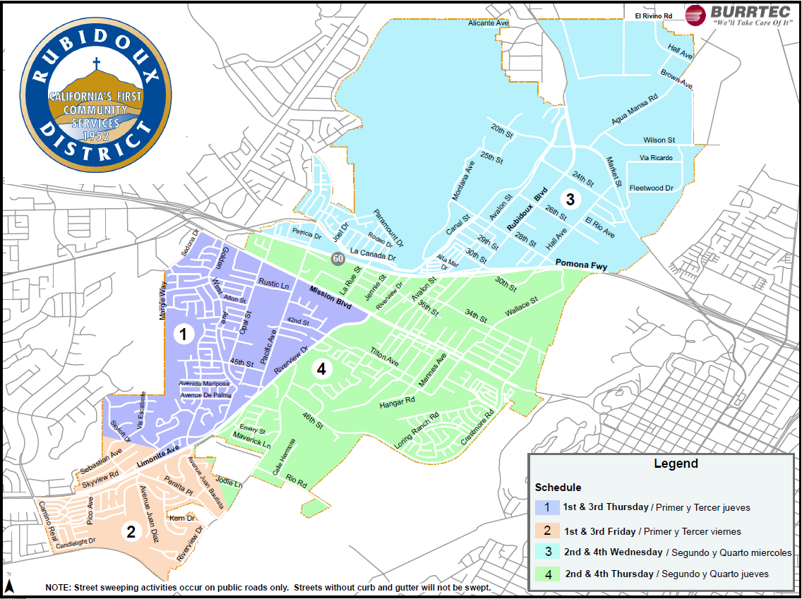
Amendment No. 3

Slide 9
Amendment No. 3
Section 3.2 – Change in the Cost of Doing Business
  CPI (service cost) capped at 4.0% annually
  90-gallon residential rate must not exceed Jurupa Valley by more than 2.0%
    For example: $38.92 x 2.0% = $0.78

Slide 10
Other Considerations
Amendment No. 3 supported by:
  Solid Waste Committee
  Staff
  Burrtec representatives
From a customer standpoint:
  Provides additional services, most of which are free (used battery, oil, street sweeping)
  Provides long-term rate stability
  Agreement Overview Summary on website for customer clarity (Attachment 4)
Reviewed by General Counsel

Slide 11
Recommendation
Sign and execute Amendment No. 3 to the “Contract Services Agreement for Refuse Collection, Disposal, and Recycling Services in the Rubidoux Community Services District” with Burrtec Waste Industries, Inc.

Slide 12
Questions
Rubidoux Community Services District
Office: 951.684.7580
www.rcsd.org
12

