Slide 1
Well 8 Rehabilitation
Staff Presentation
12-18-2025
1

Slide 2
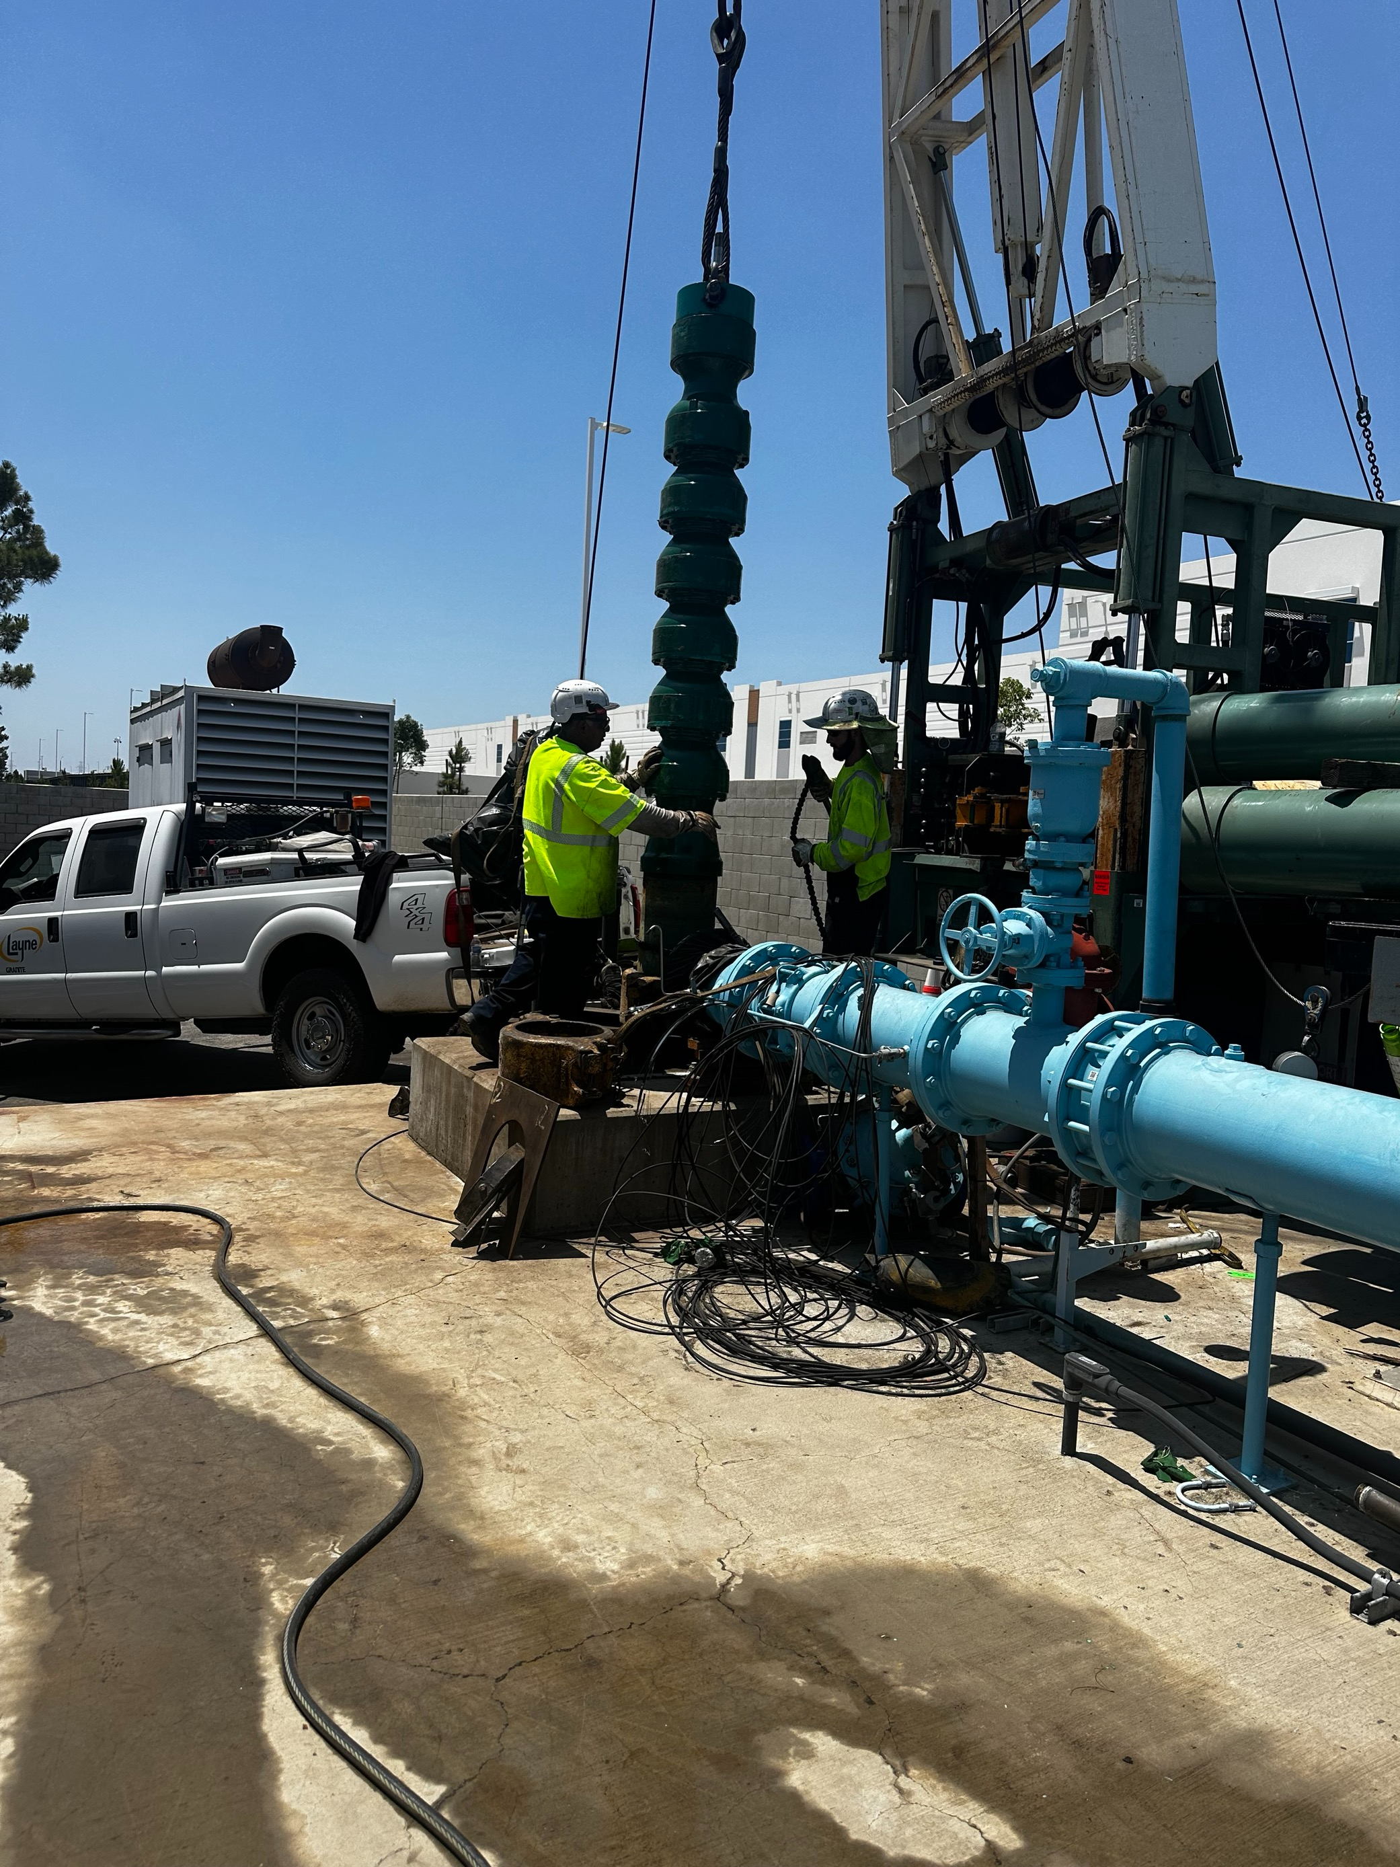
Background
Well 8 Rehabilitation, Chemical Treatment & Pump Replacement
Primary groundwater production well (Daly Ave.)
Constructed in 1998
Experiencing reduced capacity and efficiency

Slide 3
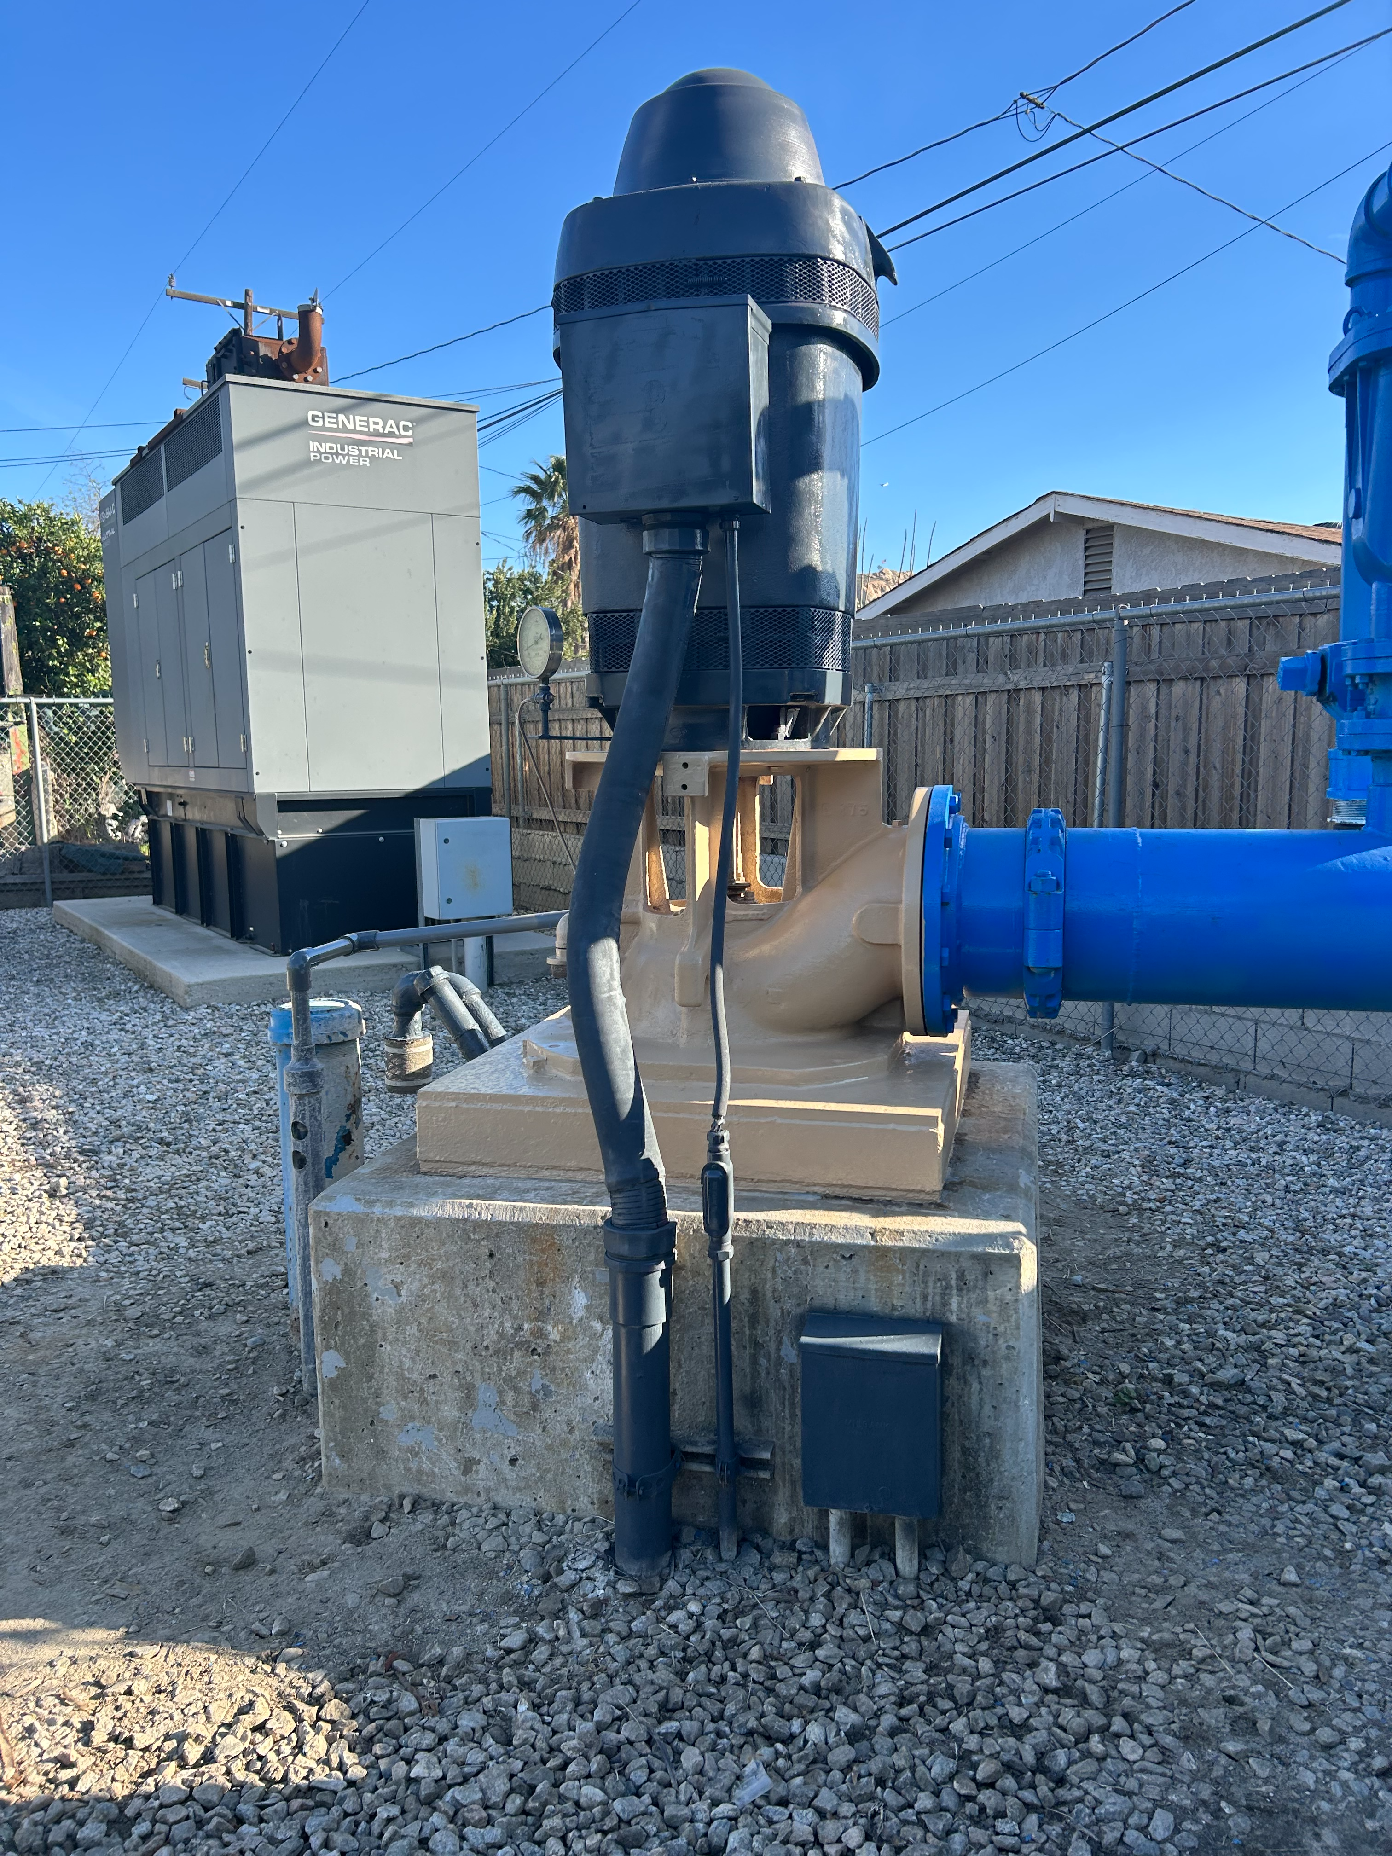
Background
Original design capacity: ~1,800 GPM
Long-term production trend: 1,200–1,250 GPM
Recent pumping rate: 1,214 GPM
No major rehabilitation since original construction
(27 years)
3

Slide 4
Condition Assessment
BESST Dynamic Flow & Chemistry Profile (Feb 2024)
Casing structurally sound
Significant mineral scale and screen encrustation
75% of production from bottom 15 feet of screen
Reduced inflow from upper screened intervals
Rehabilitation recommended to restore performance
General Pump Video Inspection (Nov 2025)
Hard scale buildup throughout screened interval
Pump bowl pinhole corrosion
Degraded column pipe sections
Pump assembly leaning against casing
Full pump replacement recommended
4

Slide 5
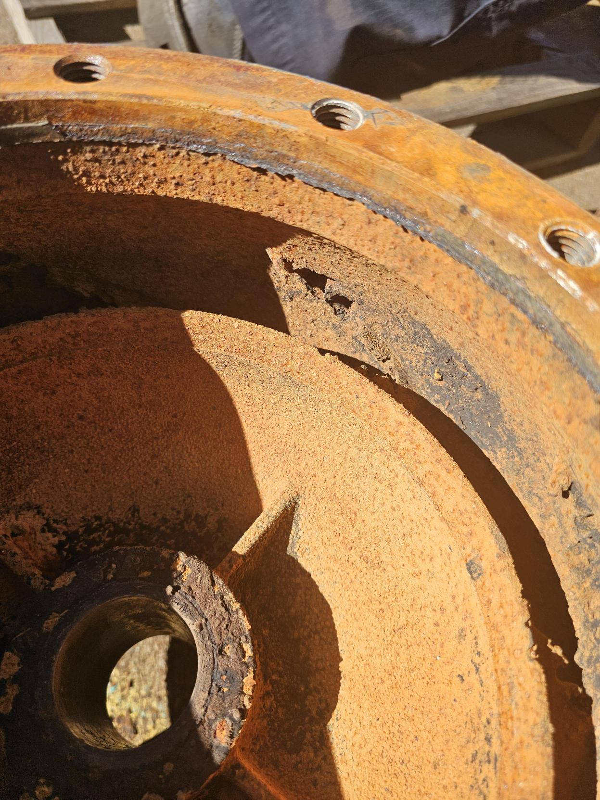
Proposed Scope of Work
Mechanical brushing and bailing
Airburst treatment to reopen perforations
Chemical treatment to dissolve mineral scale
Replacement of pump assembly:
Water-lubricated bowls
Column pipe and line shaft components
Alignment, startup, and performance verification
5

Slide 6
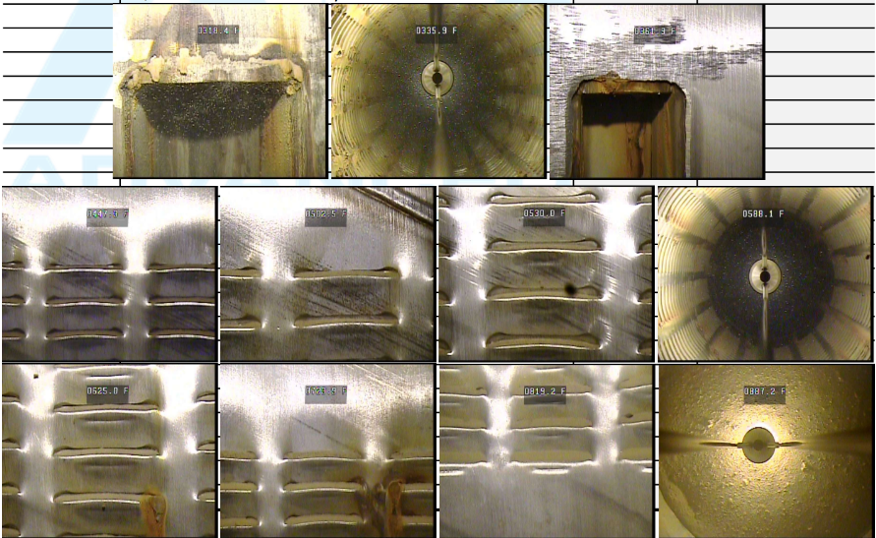
Benefits of Rehabilitation
Restore well efficiency and specific capacity
Improve inflow distribution across screen intervals
Recover production closer to original design capacity
Extend useful life of the well and new equipment
Avoid future emergency repairs
6

Slide 7
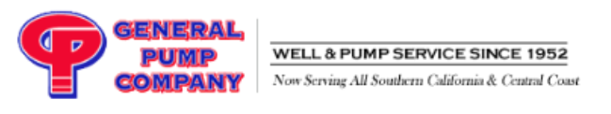
Procurement & Compliance
General Pump Company:
District on-call contractor
Agreement No. 962 (DM 2025-100)
Pricing verified against approved rate sheet
Use of on-call contract avoids delays and supports water reliability
7

Slide 8
Recommendation
Staff recommends the Board of Directors:
1. Approve the total project budget in the amount of $187,000 and amend the FY 2025|2026 Water Capital Improvement Project (“CIP”) Budget, Line Item No. 5, “Well 8 Rehabilitation,” from $125,000 to $187,000, with the additional $62,000 funded from the District’s Water Fund Unrestricted Reserves.
2. Authorize the General Manager to issue a Task Order to General Pump Company, Inc. for rehabilitation and chemical cleaning of Well 8, including replacement and installation of new water-lubricated pump equipment, in an amount not-to-exceed $159,049.63.
3. Authorize the General Manager to utilize the approved contingency, as needed, for unforeseen costs related to the Well 8 rehabilitation, provided that total project expenditures do not exceed the Board-approved amount of $187,000.
8

Slide 9
Questions
Rubidoux Community Services District
Office: 951.684.7580
www.rcsd.org
9
9

