Slide 1
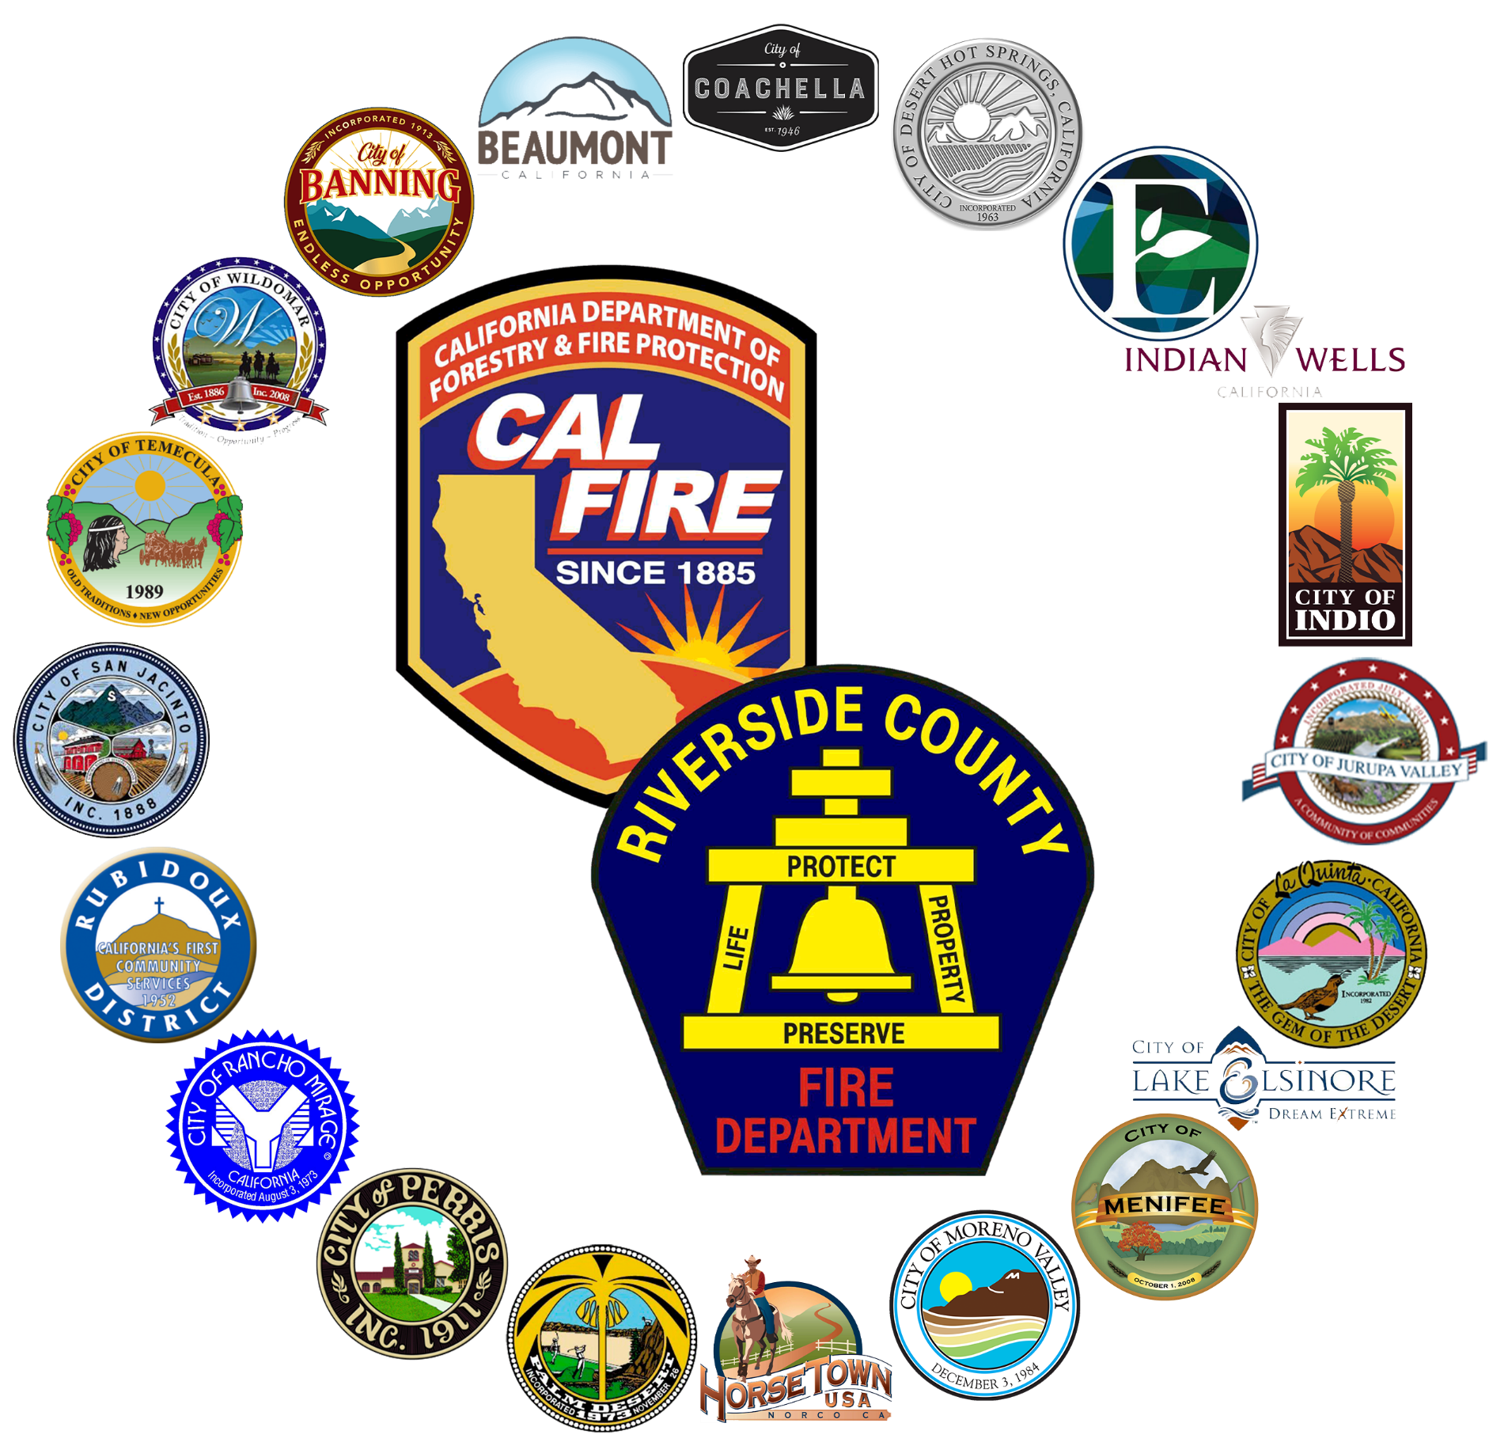
LOCAL RESPONSIBILITY AREA FIRE HAZARD SEVERITY ZONES (FHSZ) MAP UPDATE

Slide 2
LEGISLATION
📜 Assembly Bill 337 (1992) – Originally mandated the identification of Very High Fire Hazard Severity Zones following destructive wildfires. Panorama Fire in San Bernardino and Tunnel Fire in Oakland Hills.
📜 Senate Bill 63 (2021) – Amended Government Code Section 51178 to expand fire hazard oversight to include Moderate and High zones in addition to Very High FHSZ classifications with the LRA. Expanded the responsibility to the local agency, imposing a state-mandate.
📜 Assembly Bill 211 (2022) – Required local agencies to adopt Moderate, High, and Very High FHSZ designations within 120 days of OSFM recommendations. Local governments cannot downgrade state-designated hazard levels but may increase them if justified.
📜 Assembly Bill 38 (2019) – Established that as of July 1, 2021 any seller of real property located in a High or Very High Fire Hazard Severity Zone shall provide the buyer with documentation stating the property is in compliance with defensible space requirements.

Slide 3
Acreage Changed
CURRENT

Slide 4
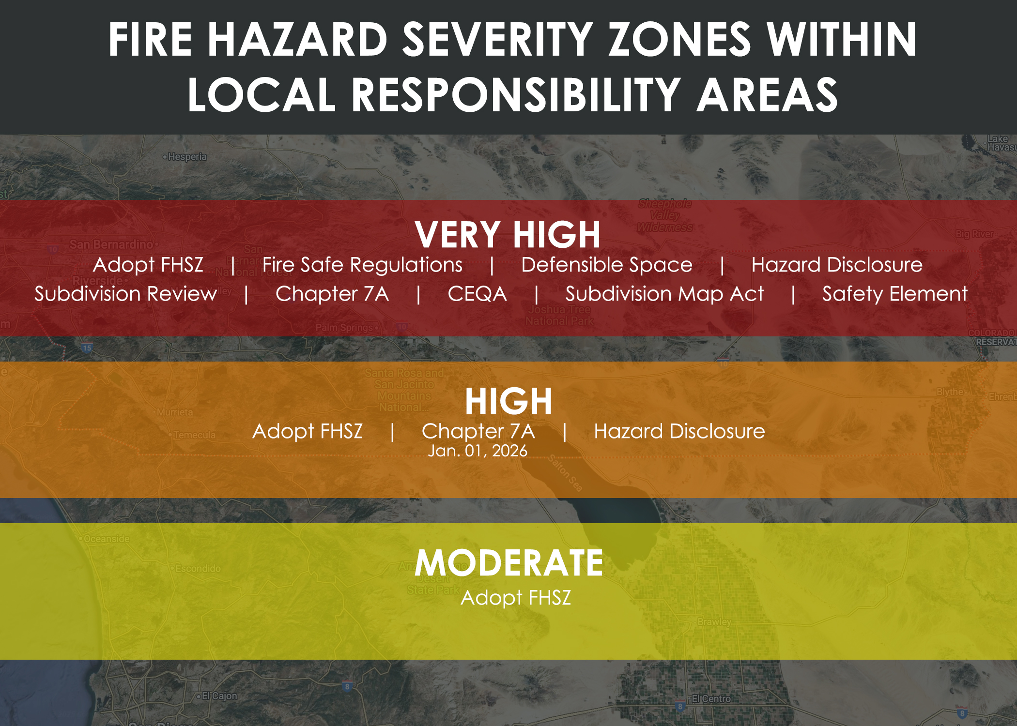
Zones and Requirements
Properties are designated as Moderate, High, or Very High Fire Hazard Severity Zones based on:
Terrain and topography
Vegetation and fuel conditions
Ember Casting
Fire history and frequency
Climate and weather patterns
Assembly Bill 629 – Could expand the defensible space requirement and add an inspection frequency requirement to the High Fire Hazard Severity Zones.

Slide 5
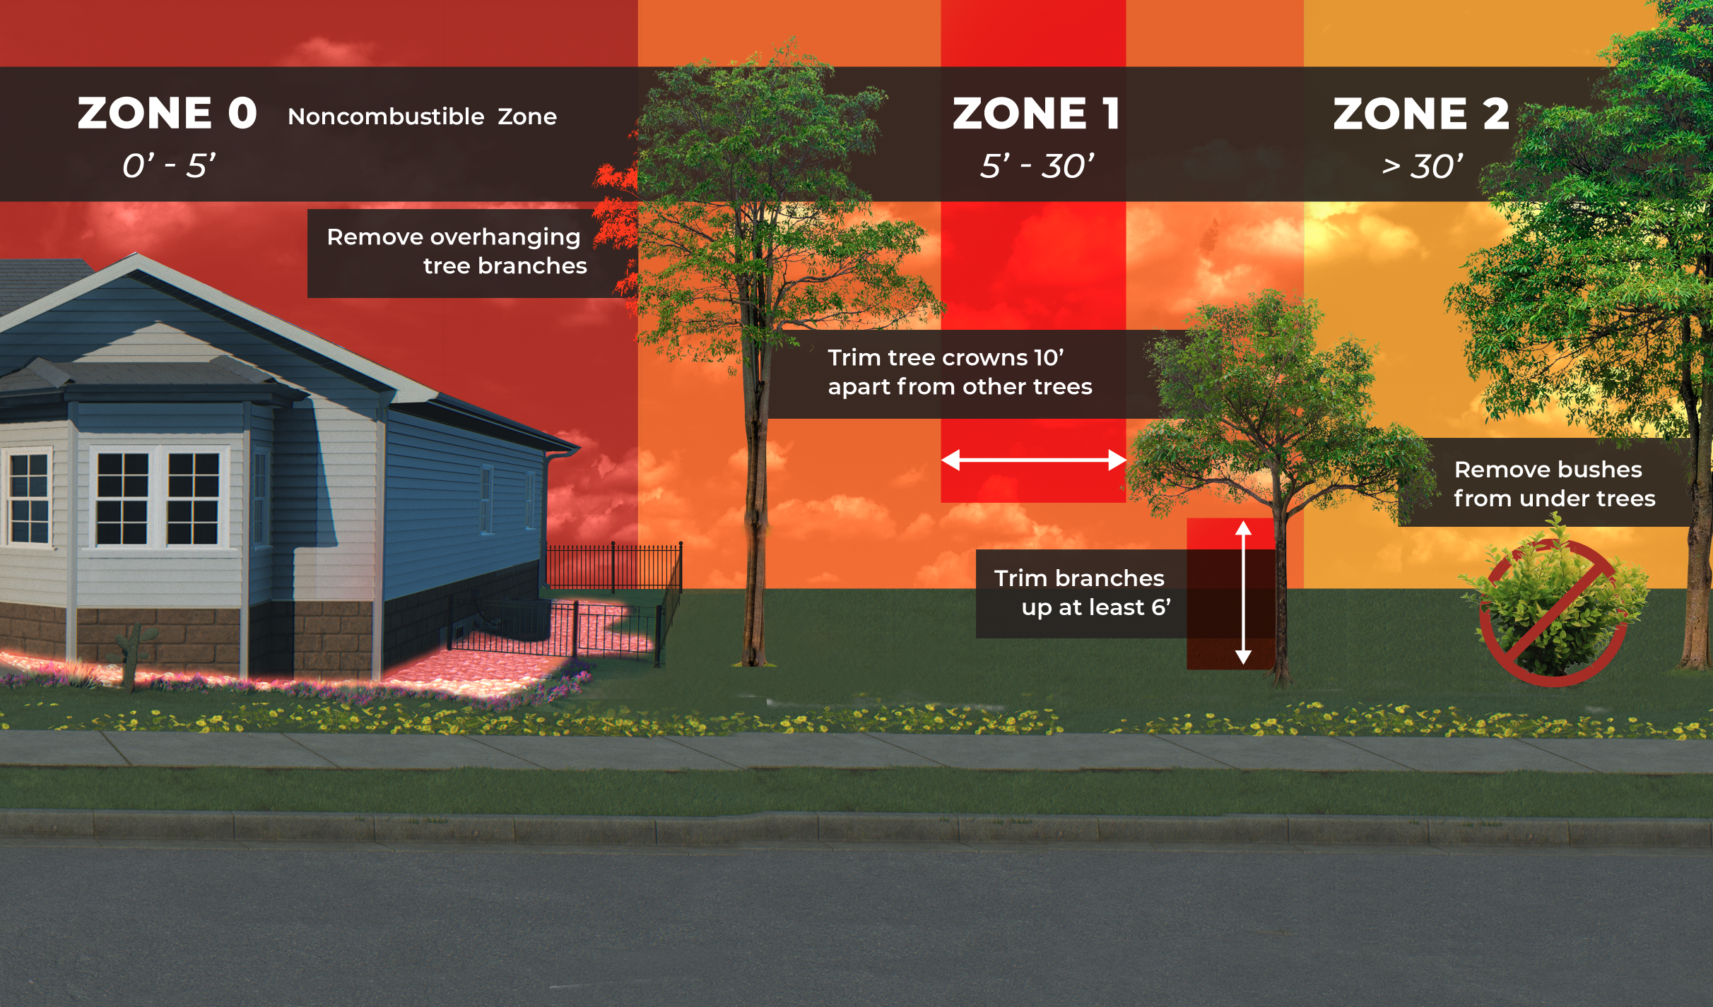
Affects on Property
Requirements in Very High FHSZ:
Maintain 100 feet of defensible space around structures – or to your property line.
Ensure new construction and some renovations adhere to Ch. 7A or future WUI Code requirements.
Disclose FHSZ designation when selling property – AB38 Inspections.
Requirements in High FHSZ:
As of Jan. 1, 2026 new construction and some renovations must adhere to Ch. 7A or future WUI Code requirements.
Disclose FHSZ designation when selling property – AB38 Inspections.
Zone 0 – AB 3074 (2020) – Effective 1/1/2021
Pending State Requirements.

Slide 6
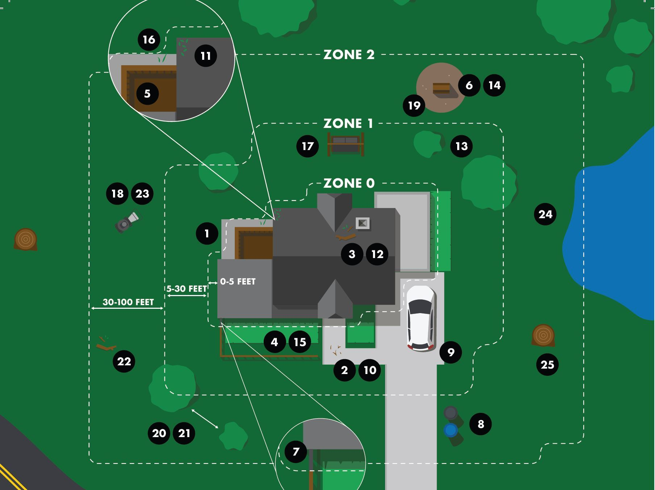
ASSEMBLY BILL 38 – REAL ESTATE INSPECTIONS
Assembly Bill 38 established that, as of July 1, 2021, California Civil Code Section 1102.19 requires a seller of real property located in a High or Very High Fire Hazard Severity Zone to provide the buyer with documentation stating the property is in compliance with defensible space requirements.

Slide 7
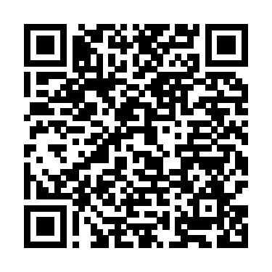
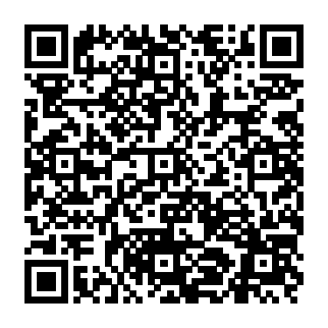
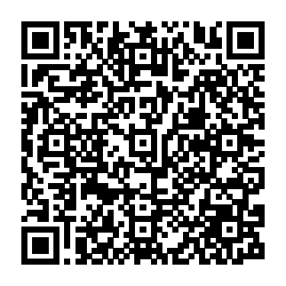
LINKS
RVC Fire – Fire Hazard Severity Zone Website
CAL FIRE FHSZ LRA Fact Sheet
California Department of Insurance: Fire Hazard Severity Zones & Insurance Impacts

Slide 8
Thank You
Notes:
Questions?

