Slide 1
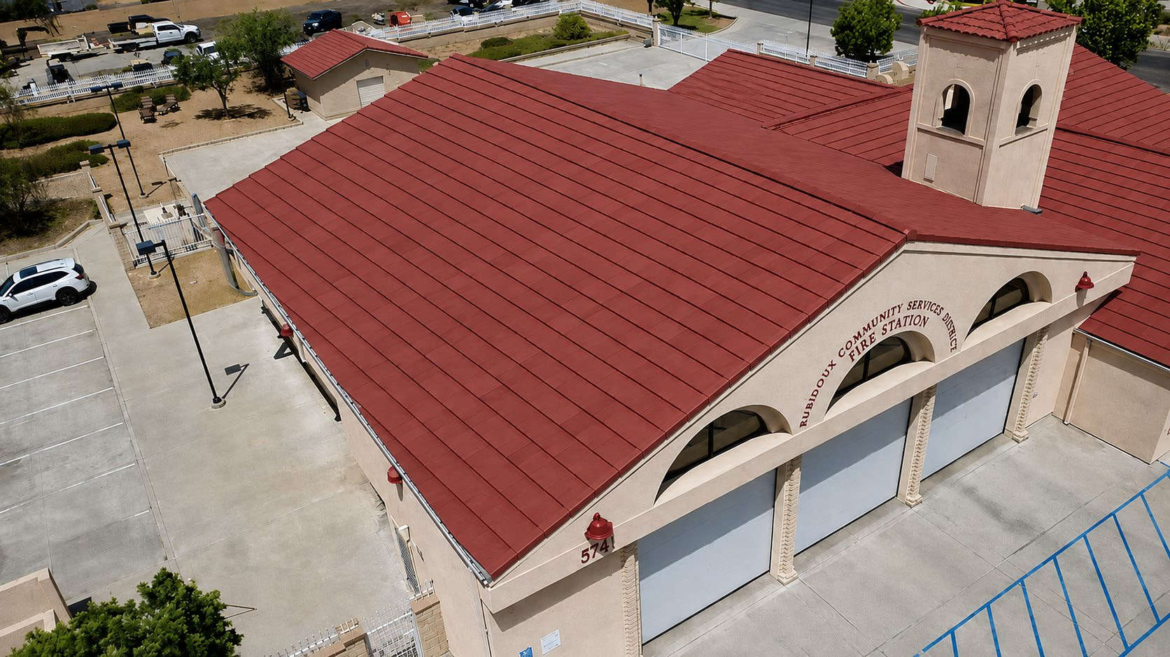

OCTOBER 1, 2026 BOARD MEETING
Fire Station 38
Tile Roof Replacement
Emergency award to HYT Construction, Inc.
DIRECTORS MEMORANDUM 2026-85
Protecting a 24/7 public-safety facility before winter weather
Notes:
Purpose: summarize the documented need, timing, proposal comparison and requested Board action.
Source image: Fire Station Roof and Concept.pdf, overview photograph supplied by the District.
Source: Directors Memorandum 2026-85.

Slide 2
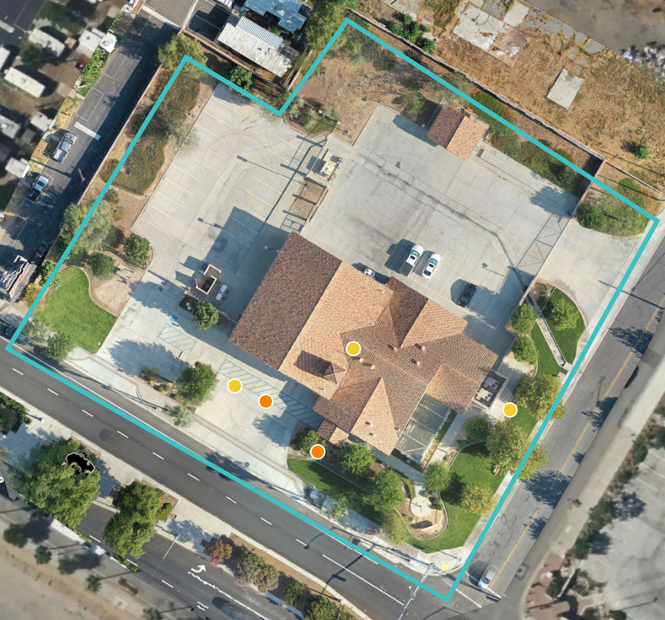
How We Got Here
The August discussion memorandum explains the progression from recurring repairs to full replacement
2006
Station 38 constructed
The Mission Boulevard facility begins continuous fire and emergency-service operations.
Prior work
Tile damage follows termite treatment
Repairs were made, but the roof system continued to age and deteriorate.
2023–26
Recurring repairs and leaks
The District made sizable repairs on an almost annual basis; isolated work did not solve the system-wide risk.
Aug. 20
Board reviews tile and metal
Staff presented lifecycle, maintenance and cost considerations for both replacement approaches.
Sept. 2026
Tile direction and common scope
2024 facility assessment aerial
City representatives preferred retaining the Mission Boulevard tile character; the same scope was sent to local contractors.
Ongoing repairs no longer provide the long-term protection required for a continuously occupied fire station.
RUBIDOUX COMMUNITY SERVICES DISTRICT | OCTOBER 1, 2026
2
Notes:
Sources: DM 2026-72 (Discussion Regarding Fire Station Roof Replacement), dated August 20, 2026; DM 2026-85; 2024 facility assessment aerial.
City input is described as an informal preference to retain the existing tile character and Mission Boulevard appearance.
The 2024 assessment predates the more recent leak and damage photographs; this slide uses it for site context, not as the sole condition determination.

Slide 3
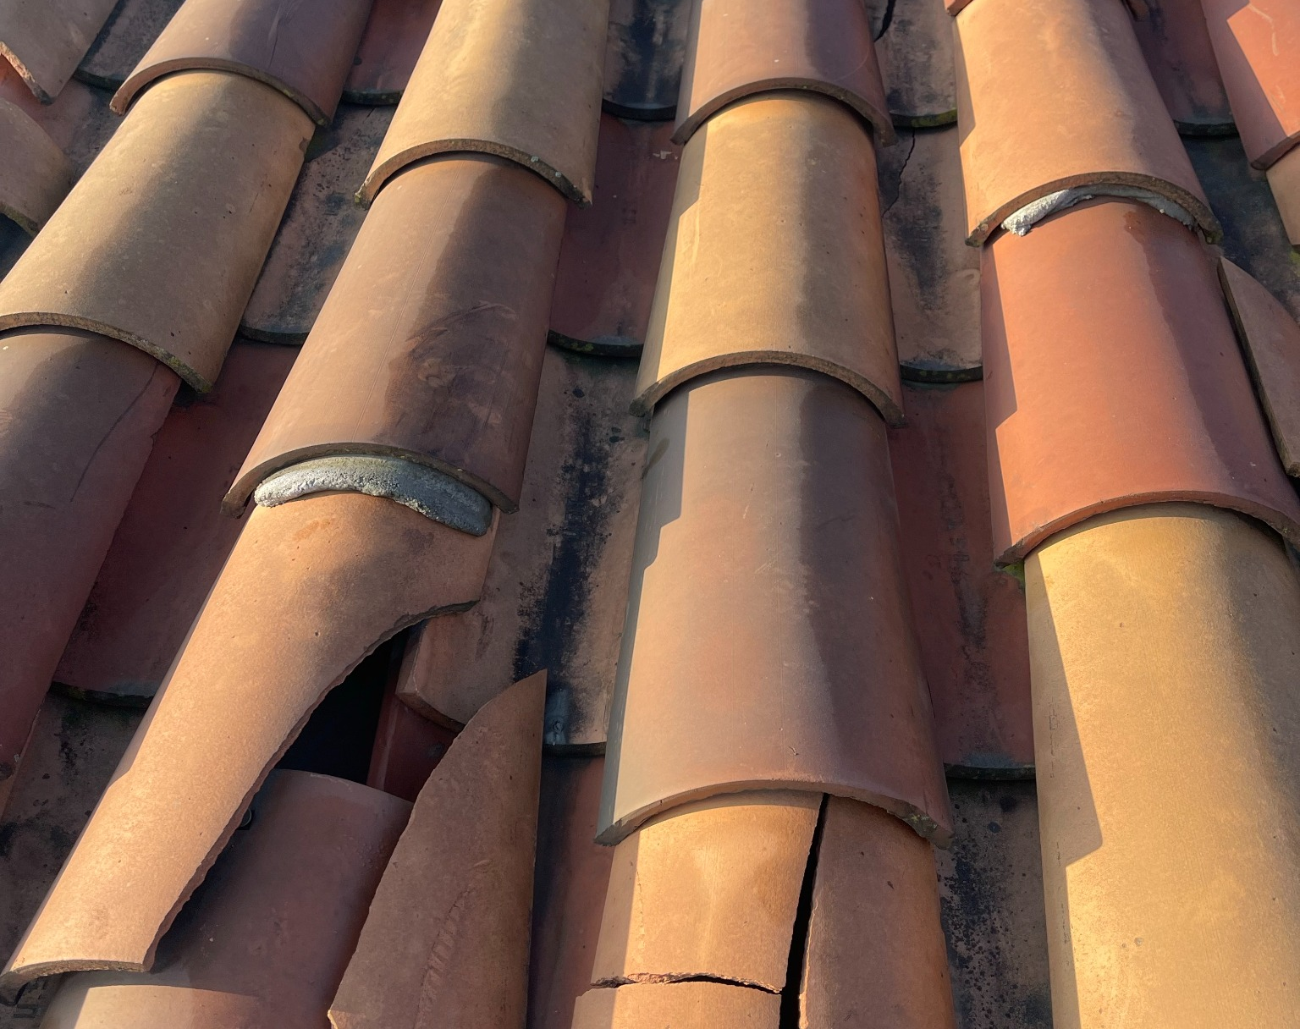
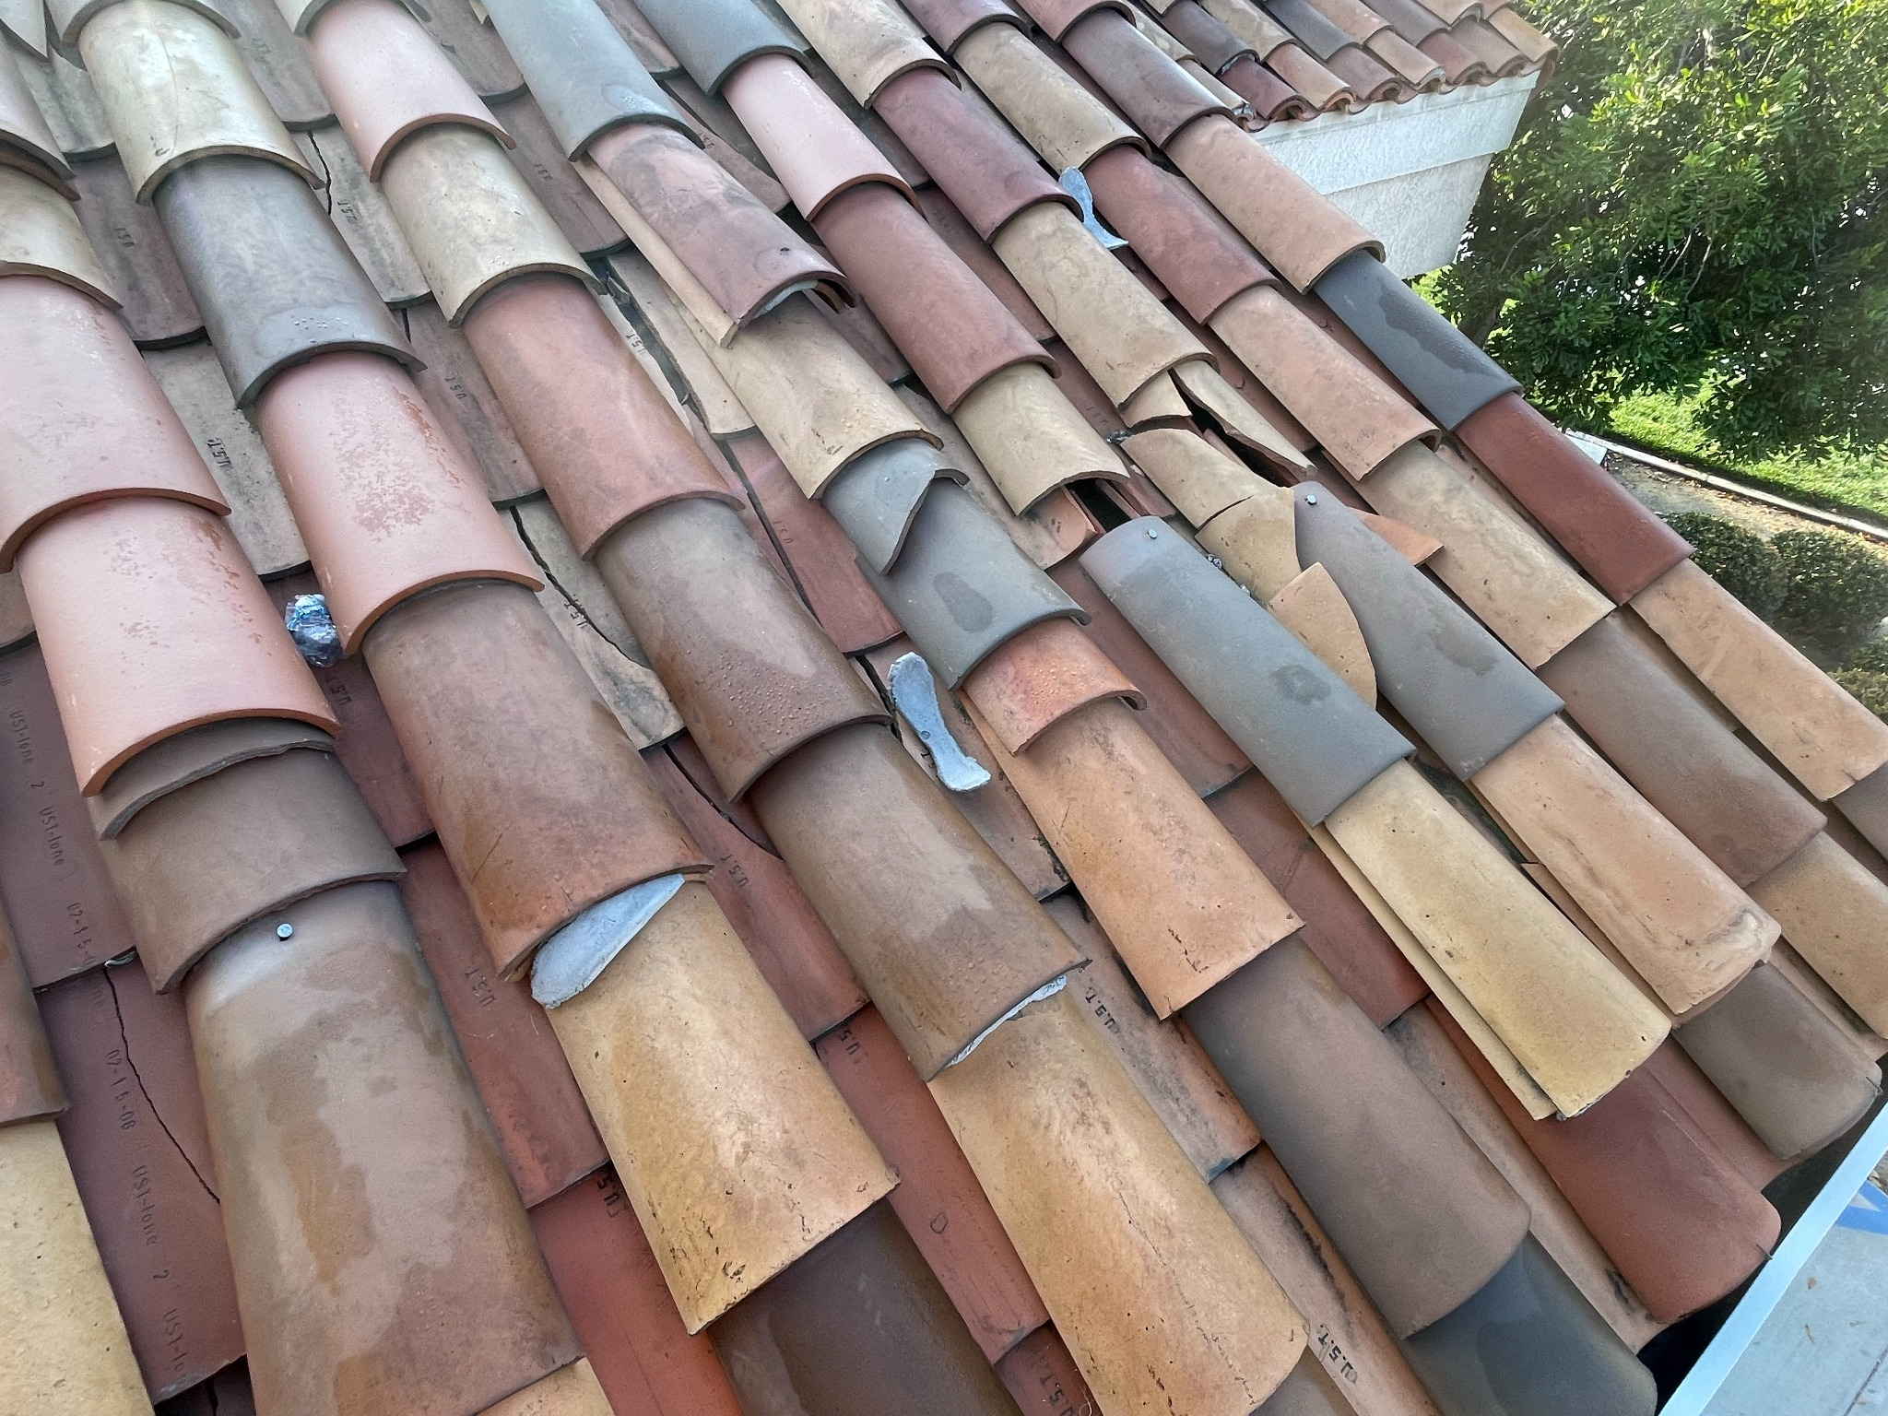
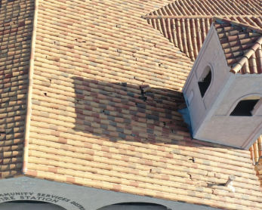
Repairs Are No Longer a Durable Solution
Some broken tiles have been replaced, but leaks are still observed
Broken tile
Displaced repairs
Documented condition
Visible fractures and open gaps
Mixed pieces and repeated patching
2024 assessment identified fractured roof tiles
A full replacement—not another patch
Remove existing tile and underlayment • Replace all roof sheathing • Install full-deck waterproofing, new flashings and new tile
RUBIDOUX COMMUNITY SERVICES DISTRICT | OCTOBER 1, 2026
3
Notes:
Sources: District photographs Image (82).jpg and Image (84).jpg; 2024 assessment image documenting fractured tile.
District staff reports that some broken tiles have since been replaced, but leaks are still observed.
Required scope: complete removal, full sheathing replacement without overlay, full-deck self-adhered waterproofing, new flashings and new concrete tile.

Slide 4
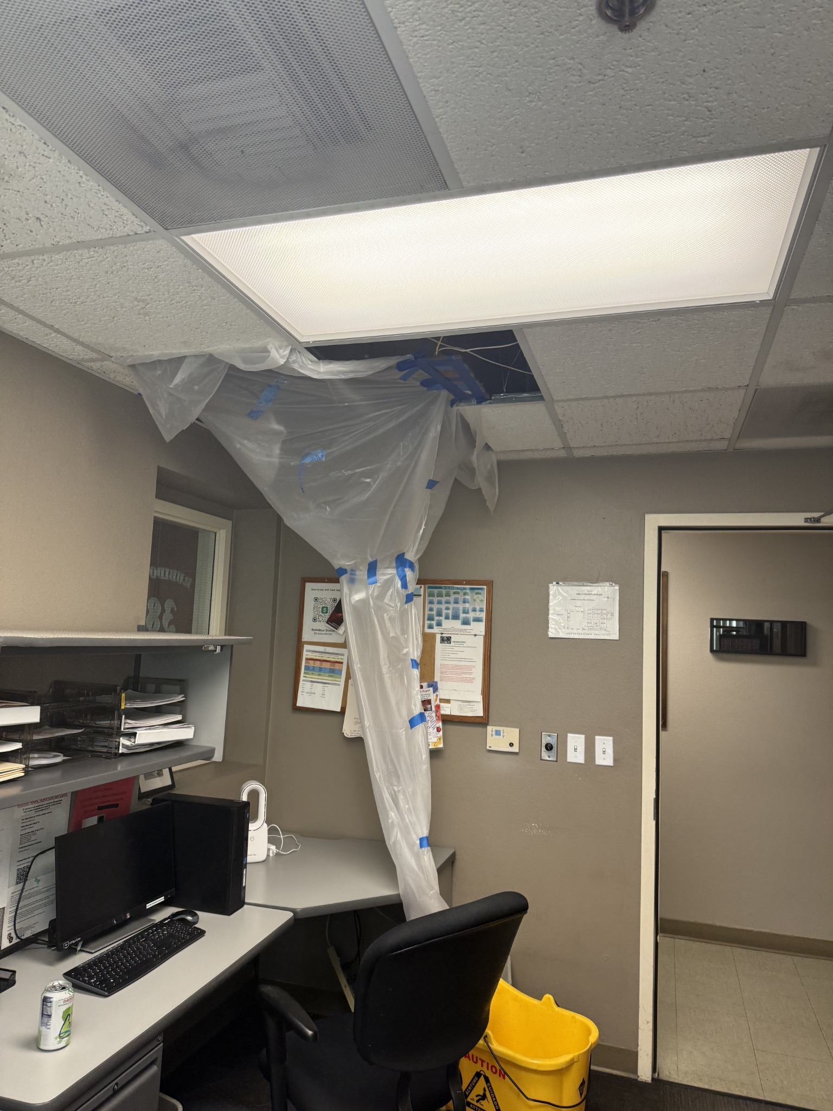
POTENTIALLY HISTORIC ‘SUPER’ EL NIÑO
A Narrow October
Construction Window
>90%
chance of a very strong El Niño
this fall and winter
A statewide emergency was proclaimed September 21, and above-normal precipitation is favored across Southern California.
OCT 2
→
OCT 30
START
FINAL COMPLETION
Station 38 remains fully operational throughout construction
Recent interior leak response
RUBIDOUX COMMUNITY SERVICES DISTRICT | OCTOBER 1, 2026
4
Notes:
Official sources:
Governor of California, September 21, 2026 statewide emergency proclamation: https://www.gov.ca.gov/2026/09/21/governor-newsom-proclaims-state-of-emergency-to-bolster-statewide-el-nino-preparedness-protect-california/
Signed proclamation: https://www.gov.ca.gov/wp-content/uploads/2026/09/SIGNED_Super-El-Nino-SOE-9-21-26.pdf
NOAA Climate Prediction Center ENSO discussion, September 10, 2026: https://www.cpc.ncep.noaa.gov/products/analysis_monitoring/enso_advisory/ensodisc.shtml
NOAA seasonal precipitation outlook: https://www.cpc.ncep.noaa.gov/products/predictions/90day/fxus05.html
‘Super El Niño’ is informal shorthand. NOAA's formal description is a greater than 90 percent chance of a very strong El Niño during fall and winter 2026–27. Forecasts do not guarantee an individual storm or wet winter.
The Governor's proclamation supports urgency; the proposed award is grounded in RCSD Procurement Policy 1040.3.2 and the documented project conditions.
Photo source: District photograph IMG_0605.jpg.

Slide 5
HYT Offers the Best Value Within the Required Schedule
Contractor | Quoted amount | Scope alignment | October completion
HYT Construction | $295,000 NTE | Full District scope; station and shed | Confirmed Oct. 2–30
JRT Roofing | $334,117.38 | Comparable core replacement scope | Not committed
Huffman Roof | $241,495 | No full re-sheeting; felt underlayment | Not stated
Clear View | $168,000 tile option | Shingle-based scope; partial decking, not prevailing wage, no contingency built in | Not stated
Only HYT and JRT priced the core full-replacement scope. HYT was the only contractor to confirm October completion without interrupting station operations.
$39,117
11.7%
HYT
OCT. 2–30
lower than JRT
savings vs. JRT
full scope
confirmed construction window
RUBIDOUX COMMUNITY SERVICES DISTRICT | OCTOBER 1, 2026
5
Notes:
Sources: HYT revised Estimate No. 260921001; JRT proposal JT-RVSD-26092063; Huffman Fire Station 38 bid form; Clear View materials and District-provided tile option price; DM 2026-85.
HYT: $270,000 base plus $25,000 District-controlled allowance, total not to exceed $295,000; full removal, complete sheathing replacement, full-deck self-adhered membrane, new flashings and concrete tile; prevailing wage; permits; 10-year workmanship; October completion; uninterrupted operations.
JRT: $334,117.38 including the same $25,000 allowance; substantially comparable core scope, but no October commitment, prevailing-wage statement or included permit commitment in the proposal, and standard pitched-roof warranty is seven years.
Huffman: lower quoted amount but no full re-sheeting, two layers of No. 30 felt except dead valleys, three-year workmanship warranty and no schedule.
Clear View: tile option amount is not supported by a defined tile-roof scope; detailed scope is for shingles, replaces only up to 20 percent of decking, and does not state prevailing-wage requirements or October schedule.

Slide 6

Recommended Board Action
Approve the emergency award, budget amendment and October delivery conditions
1
Determine an emergency
Act under Procurement Policy 1040.3.2 based on roof condition, recurring repairs, essential operations and the limited October window.
2
Approve the budget amendment
Increase Fire Fund Line Item 20 by $100,000—from $250,000 to $350,000—using restricted Fire Mitigation monies.
3
Award the project to HYT
Westlake/Newpoint Barcelona – Goldenrod
$270,000 base contract plus a $25,000 District-controlled allowance; total not to exceed $295,000.
Tile appearance retained; final product data and applicable Title 24 documentation required before installation.
4
Authorize immediate execution
Issue the notice to proceed; require onsite work Oct. 2–30 and uninterrupted Station 38 operations.
NTE $295,000
≈ $4.1M Fire Mitigation balance
$55,000 remains in Line Item 20
Staff recommends approval of all four actions.
$50,000 remains available for the kitchen and other eligible long-lived assets
RUBIDOUX COMMUNITY SERVICES DISTRICT | OCTOBER 1, 2026
6
Notes:
Sources: DM 2026-85; HYT revised Estimate No. 260921001; District Fire Fund budget; Westlake/Newpoint Barcelona-Goldenrod tile product information.
The $25,000 allowance is District-controlled, may be used only with prior written authorization and is deducted from the final invoice if unused.
The District-approved agreement controls over inconsistent proposal language and must include bonds, insurance, prevailing wages, permits, inspections, manufacturer material warranties and the 10-year workmanship warranty.

