Slide 1
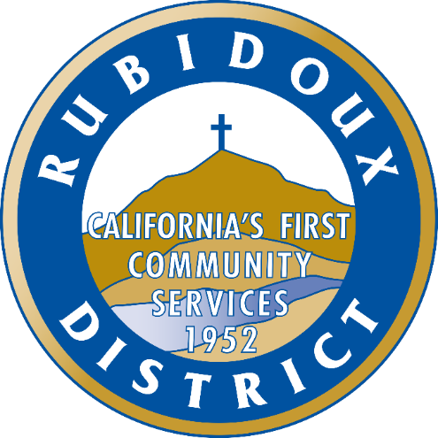

Hazard Mitigation Overview
Carolyn J. Harshman, CEM
Emergency Planning Consultants
Notes:
On behalf of the Rubidoux Community Services District, it’s my pleasure to welcome you to the overview of the planning process to prepare the District’s Hazard Mitigation Plan.
As a bit of background, the Disaster Mitigation Act of 2000 was passed by Congress “to reduce the loss of life and property, human suffering, economic disruption, and disaster assistance costs resulting from natural disasters”.
Disasters can cause loss of life; damage to buildings and infrastructure; and have devastating consequences on a community’s economic, social, and environmental well-being.

Slide 2
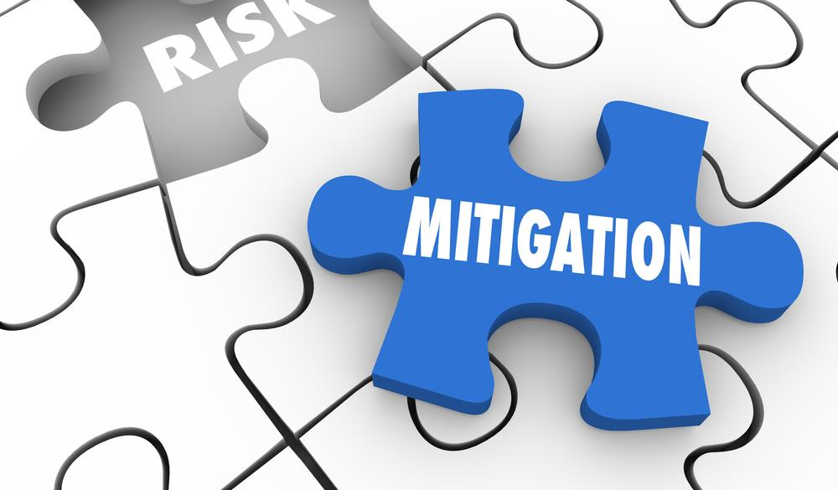
What is Hazard Mitigation?
Hazard Mitigation includes Actions Taken to Minimize or Eliminate Threats Associated with Hazards
Notes:
Hazard mitigation reduces disaster damage and is defined by FEMA as “sustained action taken to reduce or eliminate the long-term risk to human life and property from hazards”.
Examples of mitigation actions include outreach programs that increase risk awareness, projects to protect critical facilities, and the removal of structures from flood hazard areas.

Slide 3

Excellent Return on Investment
Mitigation: Every $1 spent yields a $6 return on avoided losses in the future.
Building Retrofit: Every $1 spent yields a $4 return on avoided losses in the future.
Notes:
In 2019, the National Institute of Building Sciences issued an update to its landmark report “Natural Hazard Mitigation Saves”. The study analyzed the benefit cost ratio of a range of mitigation activities including mitigation planning and building retrofits.
The findings revealed a dramatic return on investment.
For mitigation activities, every dollar spent yielded a six dollar return on avoided losses in the future.
For building retrofits, every dollar spent yielded a four dollar return on avoided losses in the future.

Slide 4

Benefits of Mitigation
Reductions in:
Deaths and injuries
Property repair costs
Additional living expenses
Direct and indirect business interruption
Loss of service to the community
Urban search and rescue costs
Notes:
According to the National Institute of Building Sciences report, the benefits of mitigation include reductions in:
Deaths, injuries, and post-traumatic stress disorder.
Property repair costs for damaged buildings and contents.
Additional living expenses including sheltering costs for displaced households.
Direct business interruption: loss of revenue and other business-interruption costs to businesses whose property is damaged.
Indirect business interruption: loss of economic activity in the broader community.
Urban search and rescue costs.

Slide 5
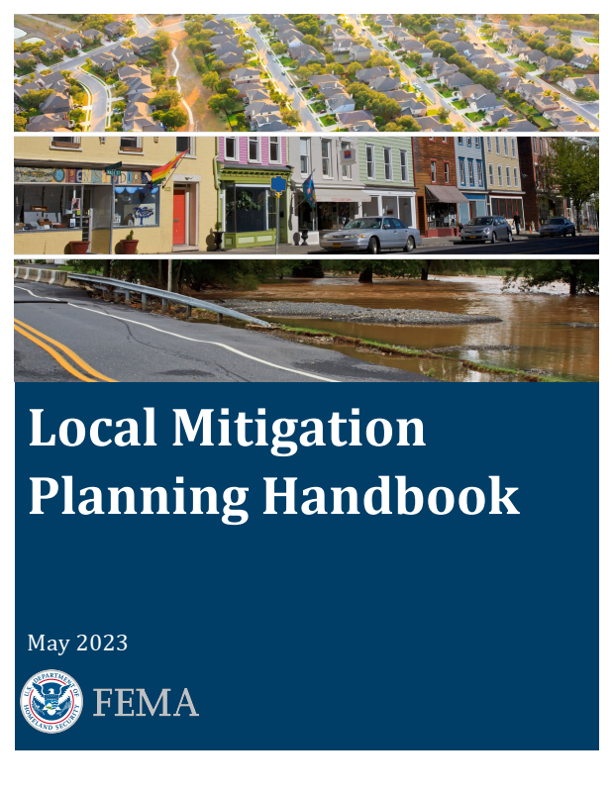
New FEMA Requirements
Notes:
In 2023, FEMA issued new standards regarding preparation of hazard mitigation plans. In addition to the previous regulations from 2011, jurisdictions are now required to discuss climate change and the impacts on natural hazards. Also, now there are standards requiring focused outreach to disadvantaged communities and socially vulnerable populations.
Mitigation plans are key to breaking the cycle of disaster damage and reconstruction. Mitigation planning begins with state, tribal and local governments identifying natural disaster risks and vulnerabilities that are common in their area.
After identifying risks, they develop long-term strategies for protecting people and property from similar events.
Local governments are eligible to prepare a mitigation plan and receive mitigation funds through federal and state grants as well as funds following a major disaster.
The purpose of today’s overview is to introduce the planning process used by the District to prepare the Hazard Mitigation Plan.

Slide 6
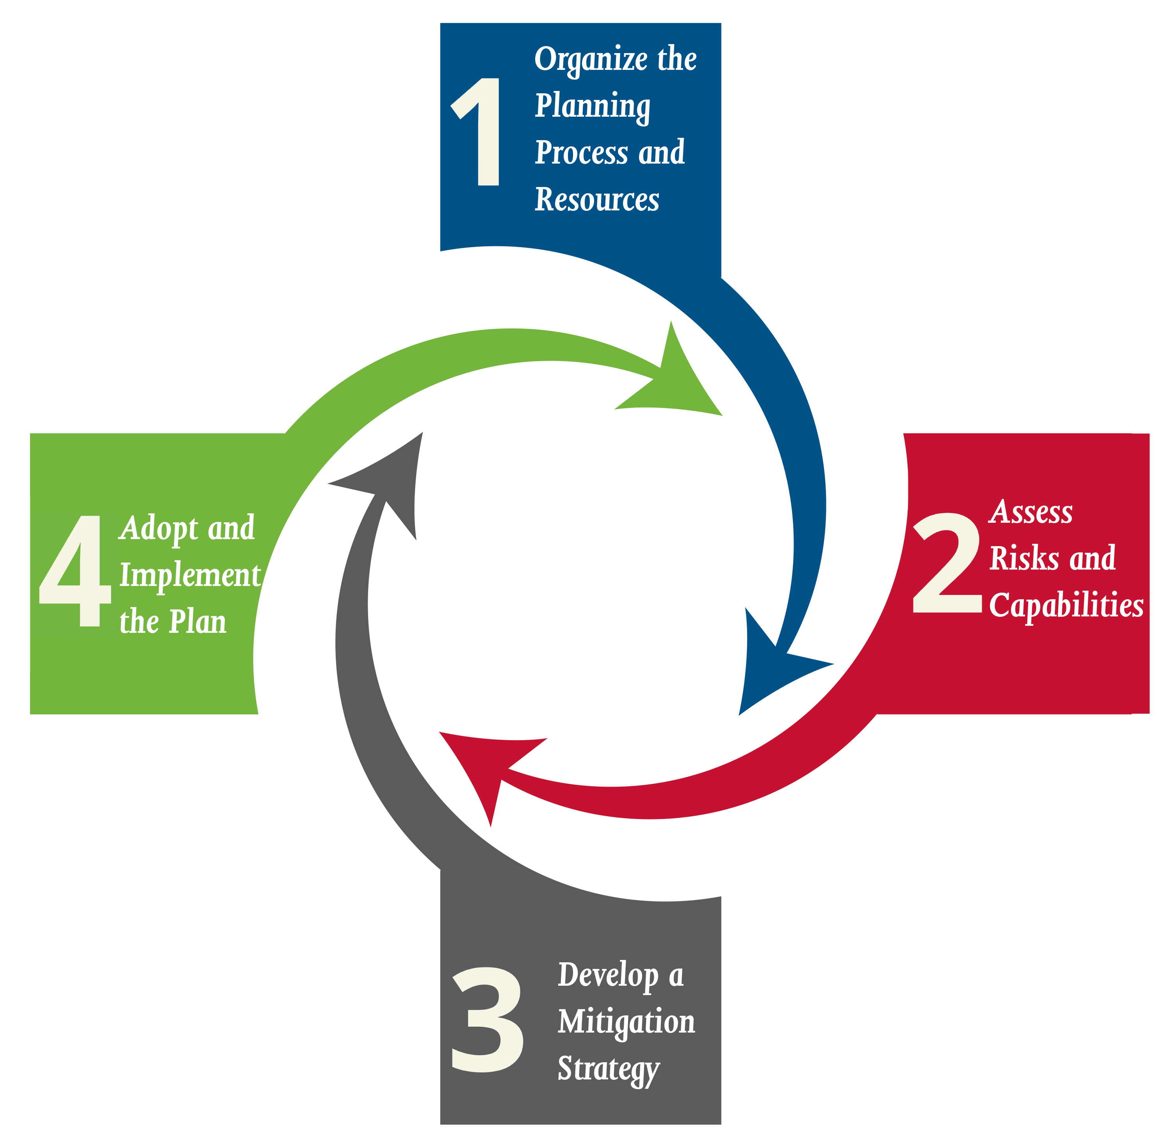
Planning Process
#1 Organize Planning Process and Resources
Community Outreach Strategy
Planning Team Meetings
#2 Assess Risks & Capabilities
Risk Assessment, Vulnerability & Impacts Assessment, Mapping and Demographics
Review Capabilities
#3 Develop Mitigation Strategy
Develop Mitigation Actions
#4 Adopt and Implement Plan
Community Outreach
Formal Review Cal OES and FEMA
Adoption by Board of Directors
Notes:
FEMA’s 2023 Local Mitigation Planning Handbook identifies a planning process with four steps:
Step #1 is to organize the planning process and resources which includes creation of a Planning Team to assist with research and writing as well as the development of a Community Outreach Strategy.
Step #2 is to assess risks and capabilities including a Risk Assessment, and Vulnerability & Impacts Assessment as well as a review of the District’s capability to respond and recover from a major disaster.
Step #3 is to develop a Mitigation Strategy which includes a comprehensive list of mitigation actions and projects.
Step #4 is to Adopt and Implement the Plan which includes a formal review by Cal OES and FEMA and adoption by the Board of Directors.
This is the 4-step planning process followed by the District’s Planning Team.

Slide 7
Community Outreach Strategy
1st: Develop Stakeholder List
Local and Regional Agencies Involved in Hazard Mitigation
Agencies with Authority to Regulate Development
Neighboring Jurisdictions
Representatives of Businesses, Academia, and Community Lifelines
Nonprofit and Community-Based Organizations providing services to socially vulnerable populations
2nd: Announce Planning Process Activities to Customers and Stakeholders
Press Release, Website, Social Media, Public Forums
Hazard Mitigation Survey
Hazard Mitigation Overview Video
3rd: Announce Availability and Gather Input on the First Draft Plan
Customers and Stakeholders
Notes:
The Community Outreach Strategy includes three phases.
The first phase is Developing a Stakeholder List and Announcing the Planning Process.
The Stakeholders include:
Local and Regional Agencies Involved in Hazard Mitigation Activities
Agencies that have the Authority to Regulate Development
Neighboring Jurisdictions
Representatives of Businesses, Academia, and Community Lifelines
Nonprofit and Community-Based Organizations focused on underserved communities and socially vulnerable populations
The second phase is Announcing the Planning Process Activities to Customers and Stakeholders including
Press Releases, Dedicated Website, Social Media, Public Forums used to announce availability of:
a Hazard Mitigation Survey
Briefings at Public Forums including the Board of Directors and
a Hazard Mitigation Overview Video
The third phase is Gathering Input on the First Draft Plan which includes announcing the availability of the First Draft Plan for input from customers and stakeholders.

Slide 8
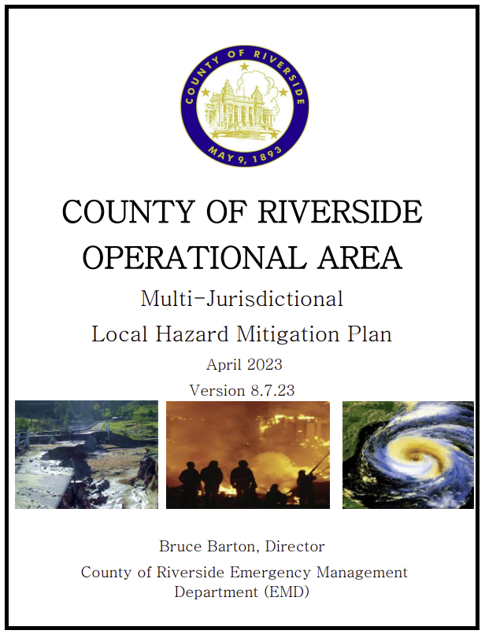

Identifying Hazards
Review: FEMA Hazards
Review: California State Hazard Mitigation Plan
Review: County of Riverside Multi-Jurisdictional Hazard Mitigation Plan and City of Jurupa Valley General Plan – Safety Element
RCSD Planning Team chose:
Drought
Earthquake
Flood
Wildfire
Windstorm
Notes:
Identifying hazards with the potential for significant impacts involved reviewing a range of hazard-focused studies and plans.
The Hazard Identification Process includes review of:
FEMA’s list of 18 hazards that are recommended for consideration. Next, California’s State Hazard Mitigation Plan (including top hazards earthquake, flood, and wildfire). Then, the County of Riverside’s Multi-Jurisdictional Hazard Mitigation Plan and the City of Jurupa Valley’s General Plan – Safety Element (including top hazards earthquake, flood, and wildfire).
Following the review, the Planning Team identified drought, earthquake, flood, wildfire, and windstorm as the hazards posing the greatest threat.

Slide 9
Existing and Future Capabilities to Increase Resilience
Planning and Regulatory – Codes, Ordinances, Policies, Laws, Plans and Programs Guiding Growth and Development
Administrative and Technical – Staff, Skills, and Tools
Financial – Taxes, General Funds, Utility Service Fees, Impact Fees, Grants, etc.
Education and Outreach – Fire Safety, Flood Safety, Preparedness Information, etc.
Notes:
The District’s “capabilities” were mentioned in the previous slide.
One of the FEMA requirements is to identify existing capabilities to increase resilience.
Also, the mitigation plan is required to identify ways to expand existing capabilities.
The capability categories include Planning and Regulatory, Administrative and Technical, Financial, and Education and Outreach.

Slide 10
Develop a Mitigation Strategy
Goals
Coordinate Strategy with Capital Improvement Plans
Comprehensive Range of Actions that will Reduce the Impacts of the Identified Hazards.
Example:
“Purchase and install generators at all District-owned facilities.”
Notes:
The Mitigation Strategy section of the plan includes the plan goals as well as methods for coordinating with the Capital Improvement Plans.
Most importantly, the Mitigation Strategy includes a comprehensive range of actions and projects capture ongoing activities along with ideas for the future. Although the lifespan of the plan is only 5-years, there’s no harm in identifying projects that will take 10- or even 20-years to complete.
Each action item identifies a lead department, timeline, plan goals met, projected funding source, and benefits, costs, and priority.
Here is an example of a mitigation action item: “Purchase an install generators at all District-owned facilities.”

Slide 11


Approval and Implementation
Review, Adoption, and Approval
Formal Review by Cal OES and FEMA
FEMA Issues Approvable Pending Adoption
Board of Directors Adoption
FEMA Issues Letter of Approval
Implementation
Planning Team Meets Annually
Coordinate with CIP
Seek Grant Funds
Five-Year Update
Notes:
Following drafting of the plan by the Planning Team and gathering input from customers and stakeholders, the document will be submitted to Cal OES for a formal review.
Utilizing FEMA’s Plan Review Tool and updated regulations, the Cal OES staff will review the District’s plan for conformance. Once Cal OES is satisfied that all the requirements have been met, the document is forwarded to FEMA. Altogether, the formal review typically lasts 4-6 months. Once FEMA is satisfied, a letter will be sent authorizing the District to take the document to the Board of Directors for adoption. When proof of adoption is received, FEMA will issue a Letter of Approval.
This concludes the Hazard Mitigation Overview. Please watch for the posting of the First Draft Hazard Mitigation Plan. We look forward to hearing your questions, thoughts, and suggestions. On behalf of the District, thank you for taking time to learn about the importance of increasing resilience through mitigation planning.

